Slide 1
Flight Dynamics II
National Aeronautics and
Space Administration
Flight Dynamics II
Motions in 6-Degrees of Freedom
Sellers, Chapters 9, 14, Appendix E

Slide 2
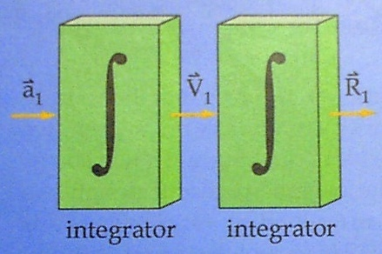
Degrees of Freedom
Trajectory Design & Optimization
Typically performed with point-mass assumption with 3-Degrees of Freedom (3-DOF)
Equations of Motion only
Consider linear dynamics

Slide 3
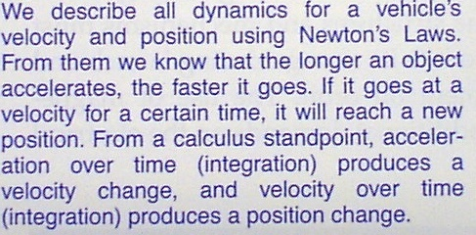
Degrees of Freedom (2)
Linear Degrees of Freedom

Slide 4
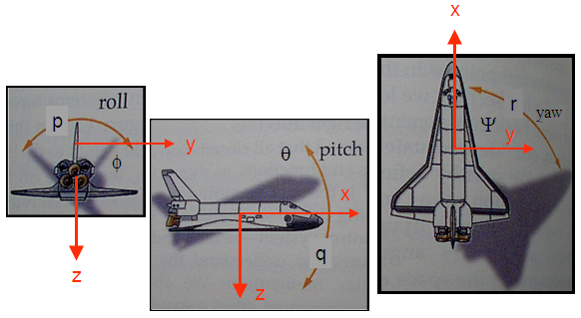
Degrees of Freedom (4)
Collected → Linear + Rotational Dynamics = 6 DOF
+
Free-flying vehicles also have Rotational degrees of freedom, governed by rotational dynamics, and described by Euler Angles – the orientation between the inertial and body reference frames

Slide 5
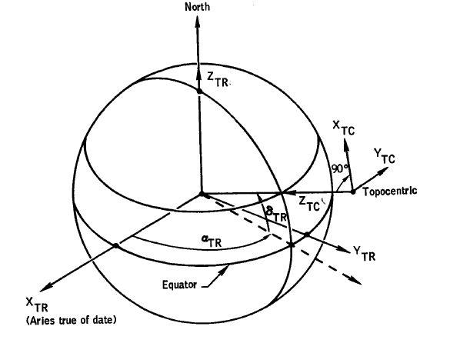
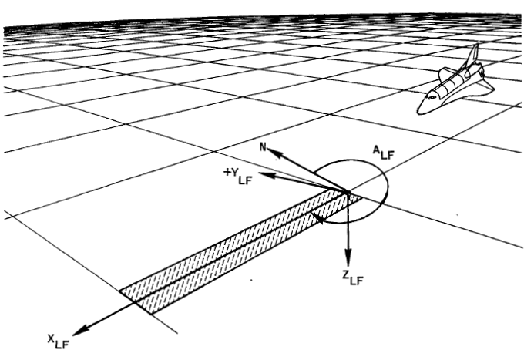

Inertial Coordinate System
Local Vertical, Local Horizontal (LVLH) (sometimes called
TopoCentric Coordinate System (NED) )

Slide 6
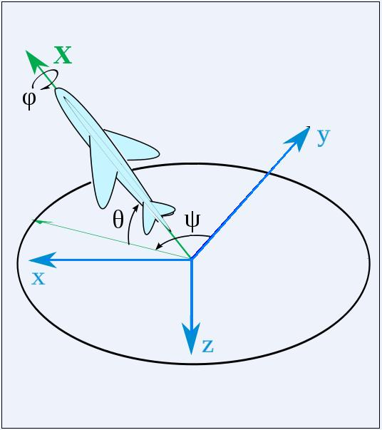

Euler Angles
Body Axis – fixed
To Vehicle … { i’, j’, k’} unit vectors
Inertial Axis – fixed
in space { i, j, k} unit vectors
Euler Angles– describe orientation
between body and inertial axes
Body axis moves with the vehicle
In space, inertial axis does not change
body

Slide 7
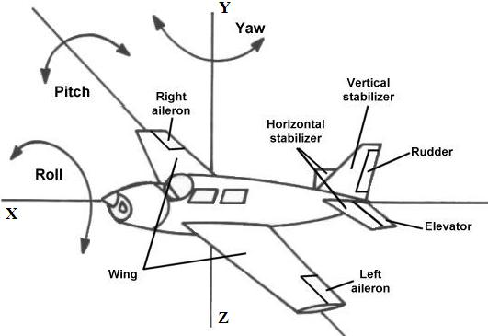
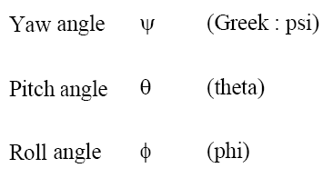
Euler Angles (2)
An alternate viewpoint
body
body
body

Slide 8
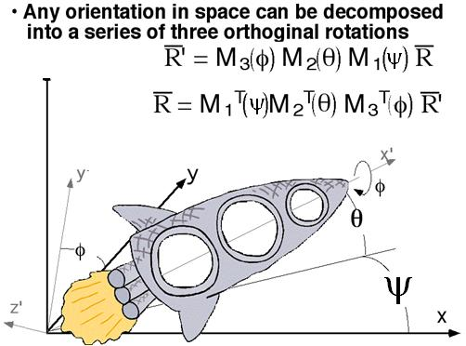

Euler Angles (3)

Slide 9
Arbitrary Orientation in Space (2)
1-2-3 Rotations in Space
Three Successive Right Handed Rotations

Slide 10
Arbitrary Orientation in Space (4)
Three Successive Right Handed Rotations
“Direction Cosine Matrix

Slide 11
Arbitrary Orientation in Space (5)
Three Successive Left Handed Rotations for the Inverse Transformation

Slide 12
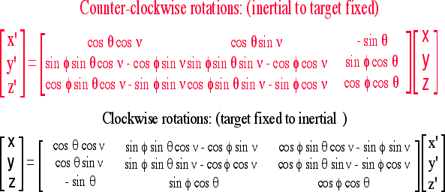
Summary: Arbitrary Orientation in Space (6)

Slide 13

Rotational Kinematics
x
r
p
Ψ
y
y
θ
φ
x
q
z
z

Slide 14
Rotational Kinematics (2)

Slide 15
Rotational Dynamics
Newton’s Laws of linear motion can be extended to
describe angular motion
Direct rotational Analogs for velocity, acceleration,
force (torque) , and momentum
Can also re-write linear equations of motion in
vehicle body axis

Slide 16
Angular Momentum, Velocity, and Acceleration
• Analogous to
• The Angular Acceleration Equation is:

Slide 17
Angular Momentum, Velocity, and Acceleration (2)
• The Angular Acceleration Equation is:
In terms of Body Axis Components

Slide 18
Angular Acceleration Equation
Using a process similar to the translational derivation

Slide 19
What is the Inertial Tensor?
• Resistance to Rotation in Three Axes
Diagonal Components of the Inertia Tensor
are commonly referred to as the “Moments of Inertia”

Slide 20
Inertial Tensor (2)
Off-Diagonal Components of the Inertia Tensor referred to as the “Cross-Products(or cross-moments) of Inertia”
• Typically, Diagonal Components >> Off-Diagonal Components
Generally an order of magnitude
smaller then than diagonal inertias

Slide 21
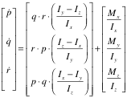
Simplified Rotational Dynamics
Neglecting Cross Products of Inertia
Forcing moment
Second order Disturbance torque
(neglected when p,q,r, are small )

Slide 22

Linearized Rotational Dynamics
Neglecting second order disturbance terms

Slide 23
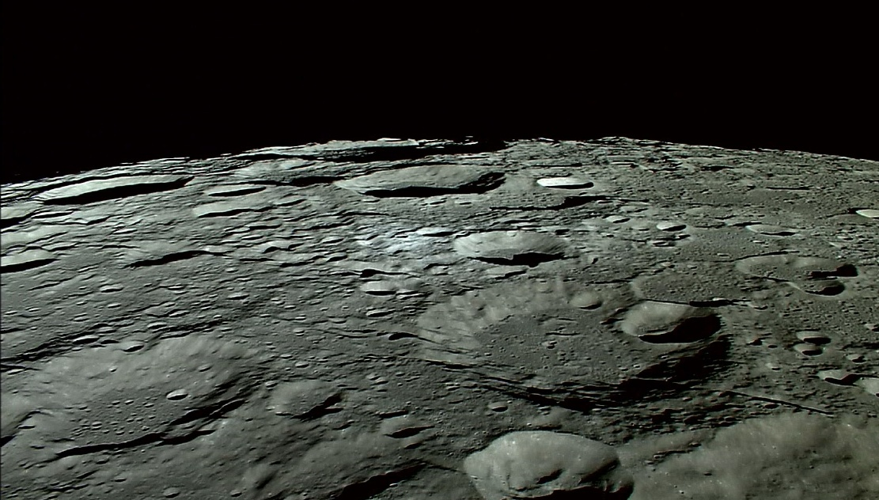
Questions??

