Slide 1
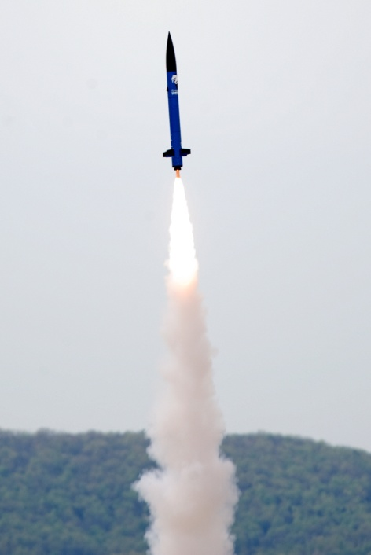
F 2011 MAE 5930, Rocket Systems Design
Class Times: MWF 1:30-2:20, ENGR 401
Office Hours: Open Door
Instructor: Stephen A Whitmore
stephen.whitmore@usu.edu
Instr. Phone: 435-797-2951
Office: ENGR 419F

Slide 2
MAE 5930, Rocket Systems Design (2)
Course Overview:
Course targets the NASA University Student
Launch Initiative (USLI) Competition.
Students registered in this course must also be
registered in MAE 4800 for fall semester 2011.
Design developed for this class applies for
full credit for the MAE 4800 / MAE 4810
design sequence.
Materials here complement those presented
in MAE 4800
In this class you will truly learn applied
“Rocket Science”

Slide 3
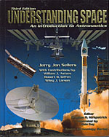
MAE 5930, Rocket Systems Design (3)
Required Course Text:
The required text for this design class is Understanding Space: An Introduction to Astronautics (Third Edition), Jerry. J. Sellers, McGraw-Hill, 2005, ISBN 978-0077230302.
Supplemental materials were posted to the course web site as required. (http://www.neng.usu.edu/classes/mae/5900/frameset_for_F2010 ).
This is an EXCELLENT text .. I strongly suggest
you buy a copy for future use …. My copy is used
so often, the pages are dog-eared!
You can buy from Barnes and Noble for $60

Slide 4
Course Structure and Format
In order to succeed an undergraduate design course must have:
Realistic but inspirational goals
Reasonable limitations on design space
Available graduate student/faculty support
Individual and group motivation factors
Project Loyalty
Peer Pressure
Grades
Strong format for peer/graduate student/ faculty oversight.
Systems Engineering Design Cycle

Slide 5
Course Structure and Format (2)
Course Structure:
During fall semester a maximum of 1-2, 50-minute formal lectures will be delivered weekly. Lecture topics will include but not be limited to
USLI Competition Overview
Review of Previous USU USLI Designs.
Systems Engineering and Design Concepts
Matlab Programming Overview
Labview Programming Overview
Simulation and Modeling
Rocket Systems and Propulsion Overview
Configuration Aerodynamics
Rocket Flight Dynamics
Structures
Control Systems
Vehicle Integration
Measurements, Testing, and Analysis
At least a one-hour period per week was made available for “break off team” meetings. Typically these breakout meetings will occur on Friday and will be referred to as “Design Friday.”
As necessary, subsystem design teams will also be expected to break-off into small development teams outside of class. The Friday afternoon design lab will be in lieu of the normal MAE 4800 design lab offered on Tuesday or Thursday Afternoons.

Slide 6
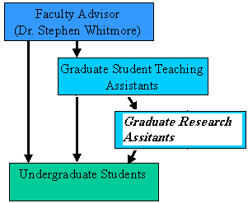
Course Challenges and Solutions
Faculty Time: Faculty must concentrate on departmental activities and research program
Department Support: administration prefers projects that “sound safe” and require few resources
Benefits of incorporating graduate
Students:
Save faculty time
Grad students provide additional subject matter experts
Provide additional management and
technical experience for graduate students
Benefits of using an established
project
Red tape has already been explored
Documentation Legacy
Student Experience
Hardware Legacy

Slide 7
Course Challenges and Solutions (2)
Grading:
First 25% -- individual homework assignments and/or quizzes.
Next 25% -- numerical scores on internal peer evaluations
Remaining 50% of final grade results from a weighted class grade.
Average class grade
Preliminary Design Report 50%
External Peer / Faculty Evaluation of PDR Presentation 50%
Student’s individual “weighted class grades” may deviate from the overall class
grade based upon subjective instructor evaluation of out-of-class commitment to project and individual contributions to presentations and reports
-- Learn to work within the team structure
-- Do Not think you can “become anonymous” and “slide through”
-- A bad grade in this class will result in a similarly bad grade in 4800!

Slide 8
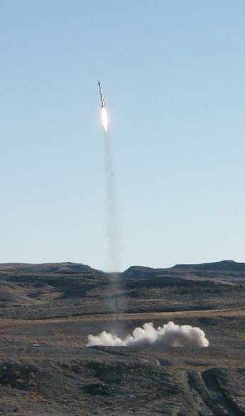
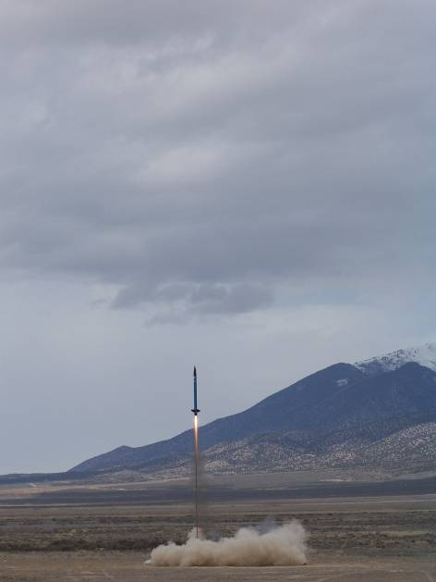
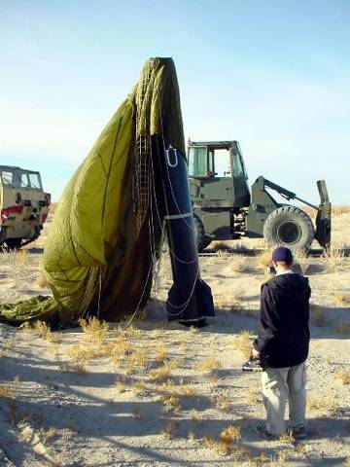
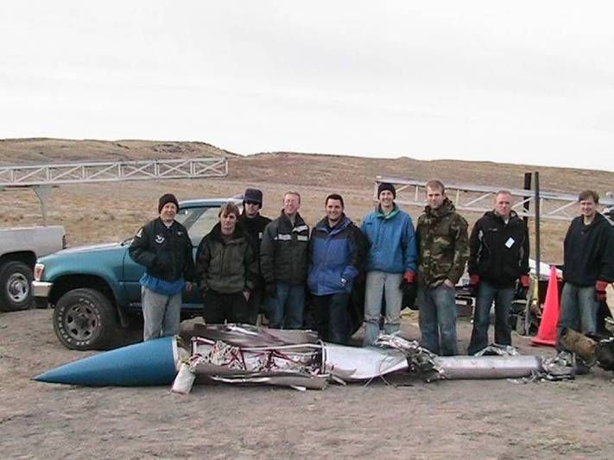
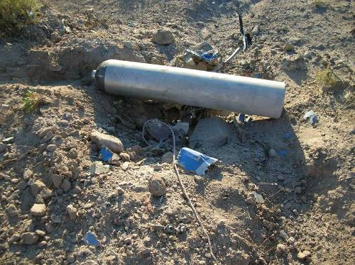
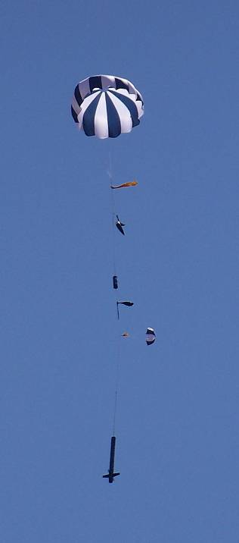
Some project history…
April 2008, Utah
Winter 2003
June 2007
January 2006
April 2008, Alabama
Chimaera spawned from Unity IV (BYU, USU, UOU, Weber)
Project goals included building 100,000 ft+ capable hybrid rockets
The Chimaera project had two launches in the ESRA competition, no successful recoveries
In 2007-2008 Chimaera switched to the NASA USLI competition and project management philosophy changed
Minimize New “Widget” Development, Emphasize Systems Engineering, System Integration and Testing
Holistic Vehicle Design Using Systems Engineering Approach, no more “garage rockets” = no more crashes!

Slide 9
2011 Flight Testing:
Holistic Vehicle Design Using Systems Engineering Approach, no more “garage rockets” = no more crashes!
Well not exactly ... Just because previous USU teams had success
.. Guarantees YOU Nothing!
This is a Real Vehicle and Not! A paper study … devil is in the details!

Slide 10
The USLI Competition
Department rules allow senior special design projects to enter into a nationally-sponsored competition
The USLI (University Student Launch Initiative) is a NASA Marshall Spaceflight Center (MSFC) sponsored competition for University Students to design, build and launch high power rockets.
Competition Scores are based on combination of reports, presentations, outreach, and rocket launch
Design requirements
Carry a scientific payload to an altitude of 5280 feet (closest to the mark)
Must use a NAR certified commercial (hobby, “high power”) rocket motor
Cannot exceed a hardware budget of $5,000
2011 Competition included 40+ colleges/
universities from across the Untied States
USU Team won 2008 & 2009 & 2011 USLI competitions!
Did not enter 2010 competition

Slide 11
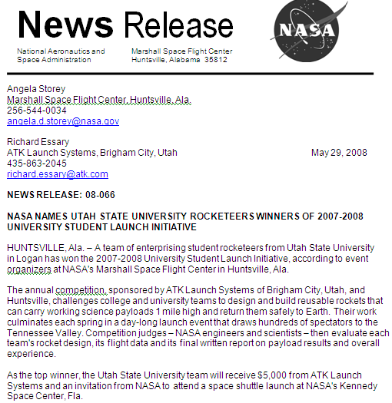
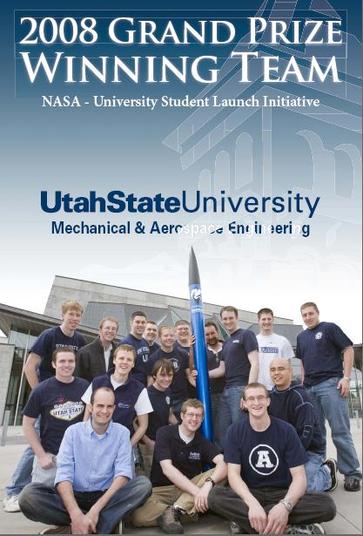
The USLI Competition (2)

Slide 12
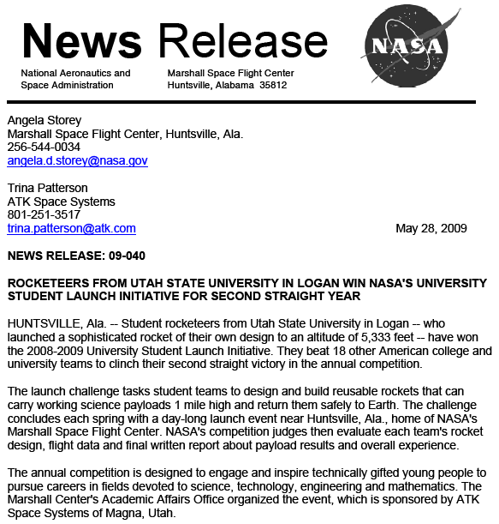
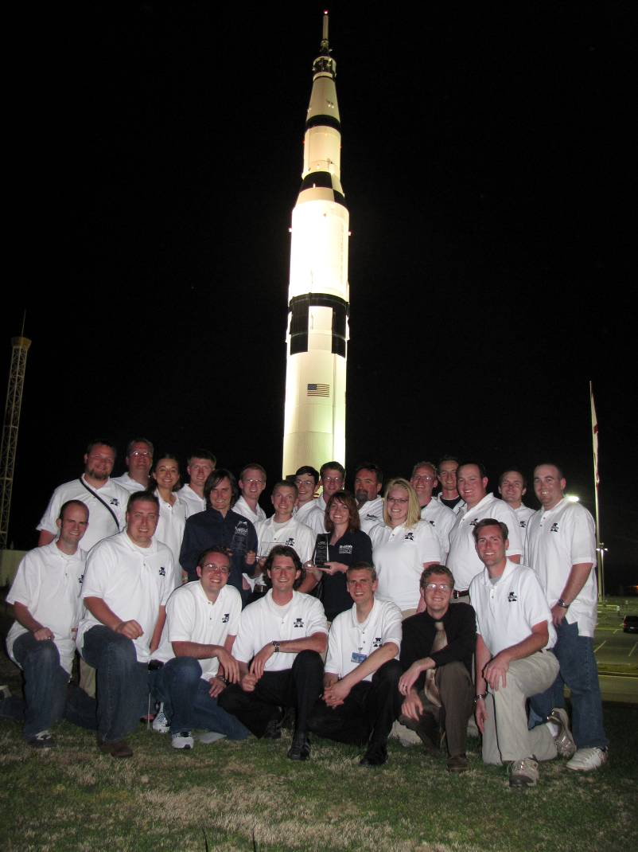
The USLI Competition (3)
2009 USLI Grand Prize
Repeat Champions!

Slide 13
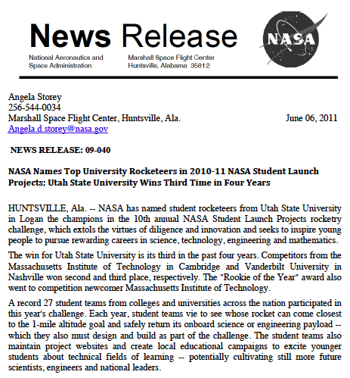
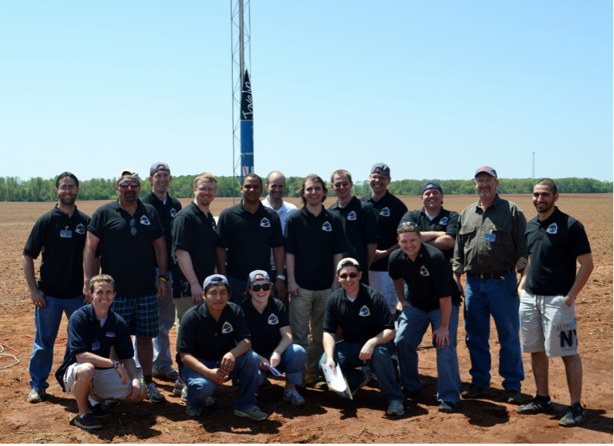
The USLI Competition (4)
2011 USLI Grand Prize
ThreePeat Champions!

Slide 14
The USLI Scoring Rubric
Scoring Rubric Summary
Critical Design Review (CDR): 200 pts
Flight Readiness Review (FRR): 200 pts
Outreach: 100 pts
Student website: 50 pts
Flight and Recovery: 200 pts
Altitude Prize: 150 pts
Above 1 mile: 150 pts x [5280-2 x Abs(H_{max}-5280)]/5280
Below 1-mile: 150 pts x [5280- Abs(H_{max}-5280) ]/5280
Final Report: 100 pts
Total: 1000 pts

Slide 15
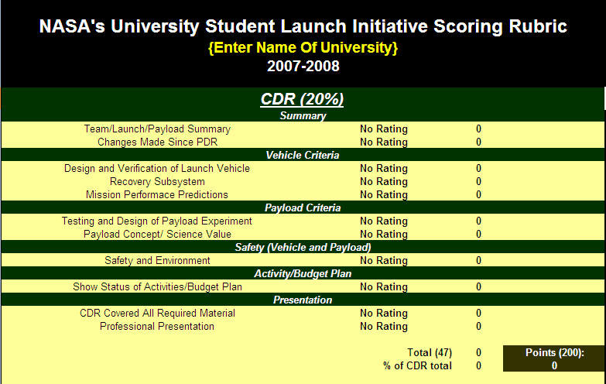
The USLI Scoring Rubric (2)

Slide 16
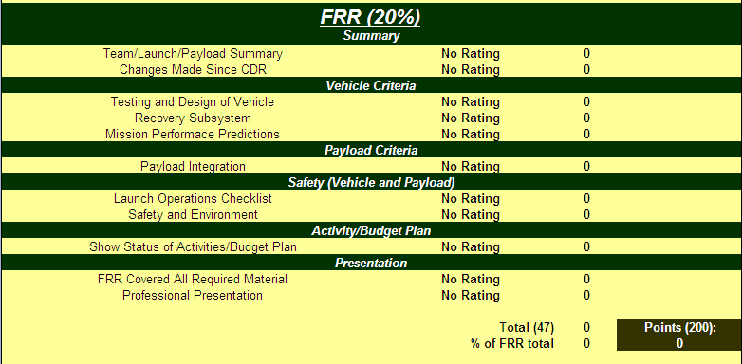
The USLI Scoring Rubric (3)

Slide 17
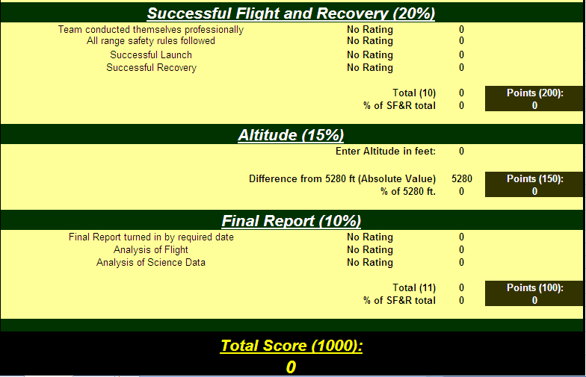
The USLI Scoring Rubric (4)

Slide 18
The 2009 Payload: Energy Management System
Dispersion Envelope 1
Projected Altitude 1
Dispersion Envelope 2
Altitude Correction 1
Target Altitude 1
Projected Altitude 2
Target Altitude 2
Altitude Correction 2
Projected Altitude 3
Final Target Altitude
Altitude Correction 3
Waypoint
Dispersion Envelope 3
Waypoint
Final Dispersion Envelope
Waypoint
Airbrake Deployments At Predetermined Altitudes
Launch Site
Launch “high” and then control maximum altitude through successive application of airbrakes until desired energy state is reached
Inertial navigation used during powered ascent and a Kalman filter used for navigation during coasting stage-both navigation algorithms were student designed and implemented

Slide 19
2011: Closed Loop Energy Management System
Final Target Altitude (one mile)
Final Dispersion Envelope
Waypoint 3
New Dispersion Envelope
New Dispersion Envelope
Waypoint 2
Initial Dispersion Envelope
Waypoint 1
Increase Energy at Predetermined Altitude Waypoints
Launch Site
Launches “low” and then increases the energy level through successive C-BAS firings

Slide 20
The 2011 USLI Competition (3)
http://education.msfc.nasa.gov/usli.
Timeline for the USLI Project (Dates are subject to change.)
August 2011:
5 Request for proposal goes out to all teams.
September 2011:
26 One electronic copy of the completed proposal due to NASA MSFC.
Send Electronic Copy to:
edward.m.jeffries@nasa.gov Jacobs ESTS Group
julie.d.clift@nasa.gov
October 2011:
17 Schools notified of selection.
21 USLI team teleconference (tentative)
November 2011:
4 Web presence established for each team.
28 Preliminary Design Review (PDR) report and PDR presentation slides posted on the team Web site.

Slide 21
The 2011 USLI Competition (4)
Timeline for the USLI Project (continued)
December 2011:
5-14 Preliminary Design Review Presentations (tentative)
January 2012:
23 Critical Design Review (CDR) reports and CDR presentation slides posted on the team Web site.
February 2012:
1-10 Critical Design Review Presentations (tentative)
March 2012:
Flight Readiness Review (FRR) reports and FRR presentation slides posted on the team Web site.
April 2012:
2-11 Flight Readiness Review Presentations (tentative)

Slide 22
The 2011 USLI Competition (5)
Timeline for the USLI Project (continued)
April 2011:
18 Travel to Huntsville
19-20 Flight Hardware and Safety Checks (tentative)
21 Launch Day
May 2011:
7 Post-Launch Assessment Review (PLAR) posted on the team Web site.
18 Announcement of winning USLI team
Things are going to get busy in a hurry!

Slide 23
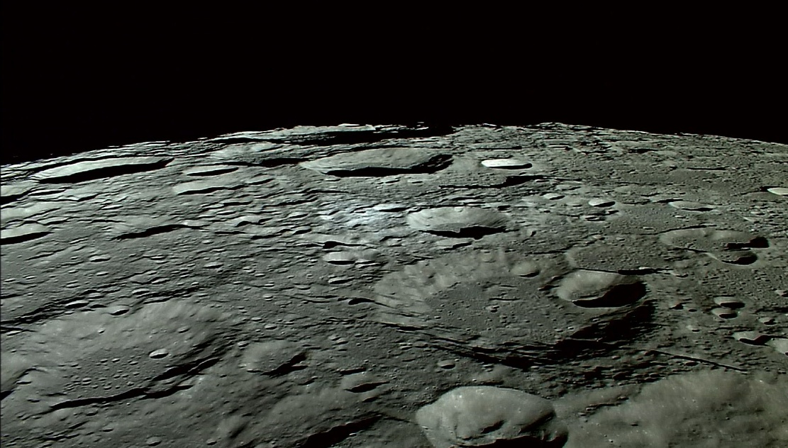
Questions??

