Slide 1
Simulation Model Revisions September 17, 2010 Description of Code Changes to Allow Using “Rocksim” Motor Data Files for Automated Parameter Input

Slide 2
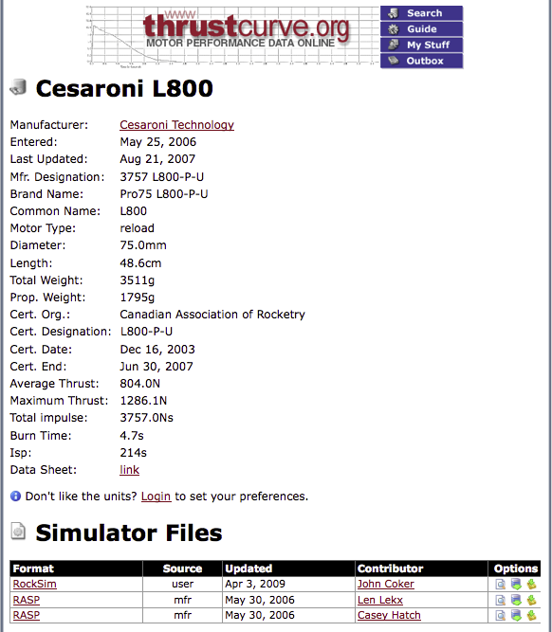
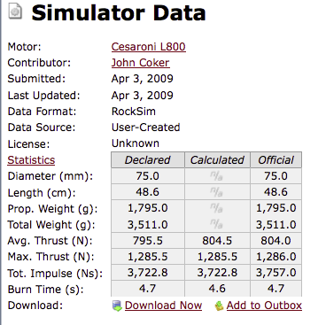
Where to Get the Data Files
Preferred to save as .txt file

Slide 3
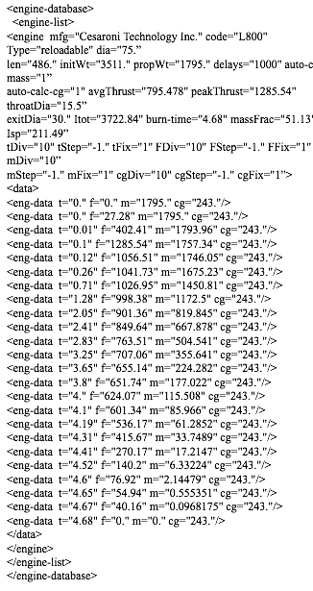
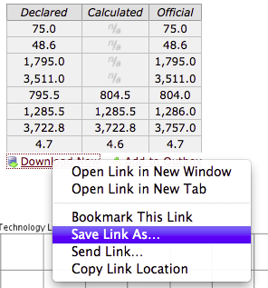
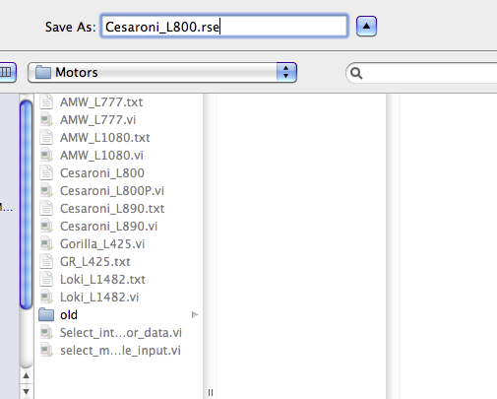
“Rocksim” File Format
Re-label as “txt”
Thrust Curve

Slide 4
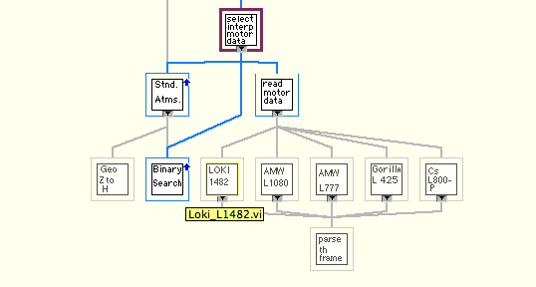
Adding Motors to Simulation
Motor VI’s

Slide 5
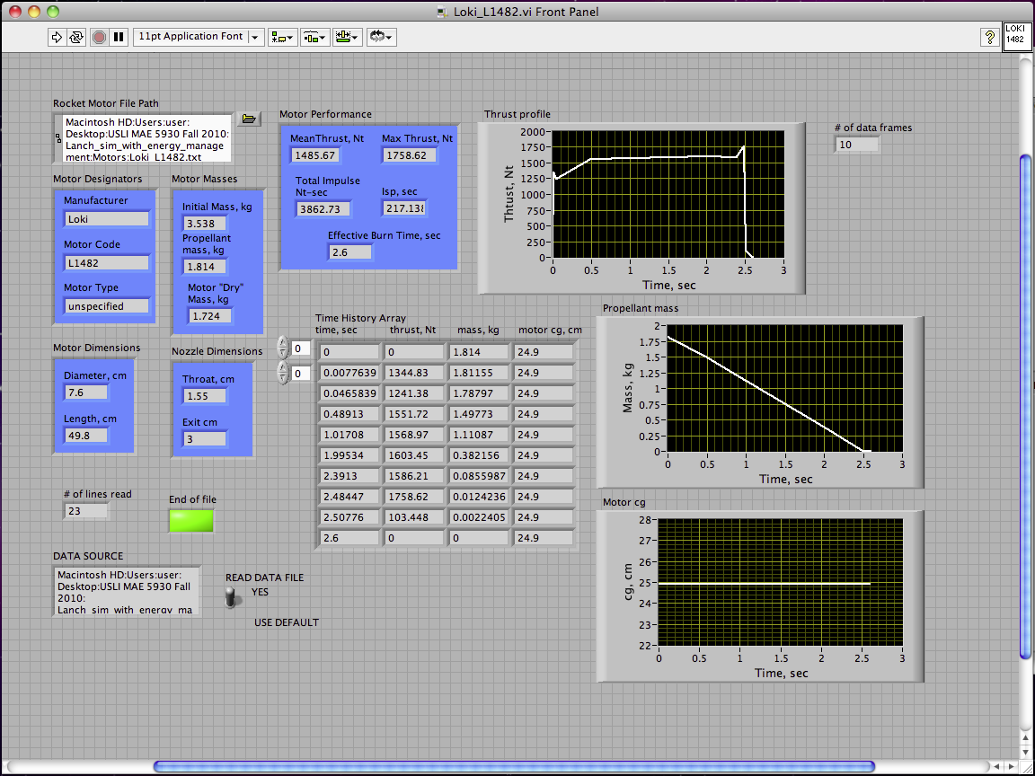
Adding Motors to Simulation (2)
Path to Rocksim File

Slide 6
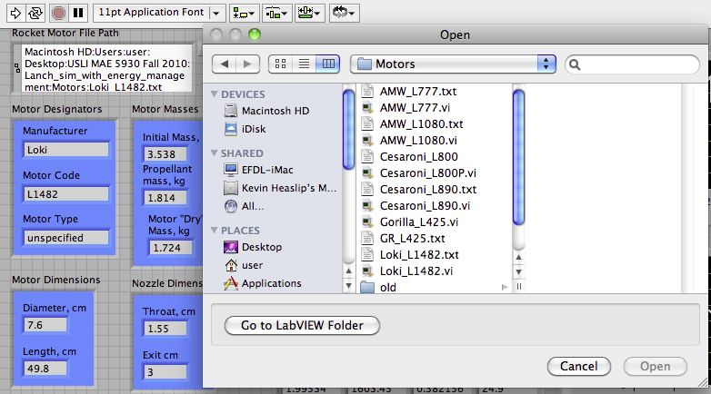
Adding Motors to Simulation (3)
Path to Rocksim File
Select new Rocksim input file

Slide 7
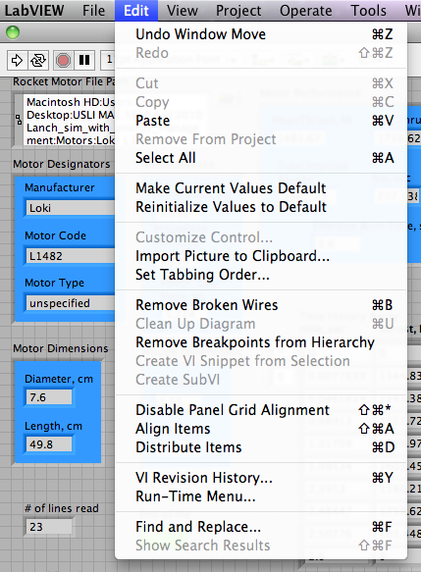
Adding Motors to Simulation (4)
Select new file … run VI
..make current values default
… save as <new file>.vi

Slide 8
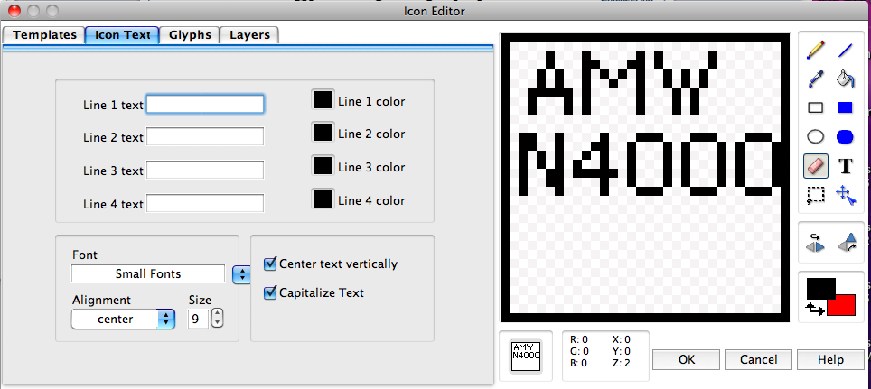
Change Icon Label, Save VI

Slide 9
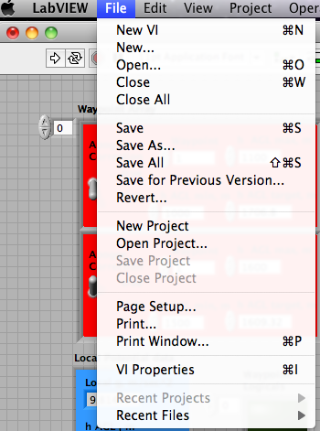
Save New Motor Model File in “Motors” Folder File

Slide 10
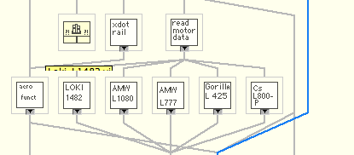
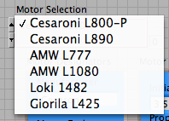
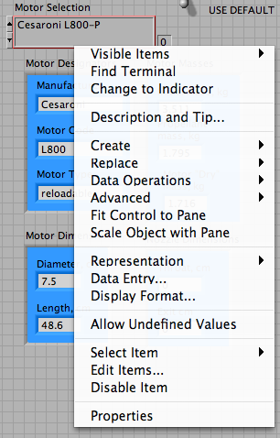
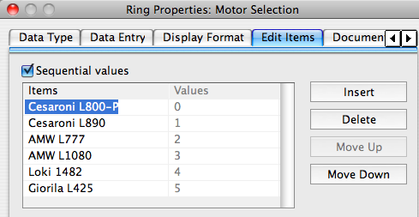
Adding Motors to Simulation (5)
“Left click”
“Right click”
Add New Motor Name Here
“Save”

Slide 11
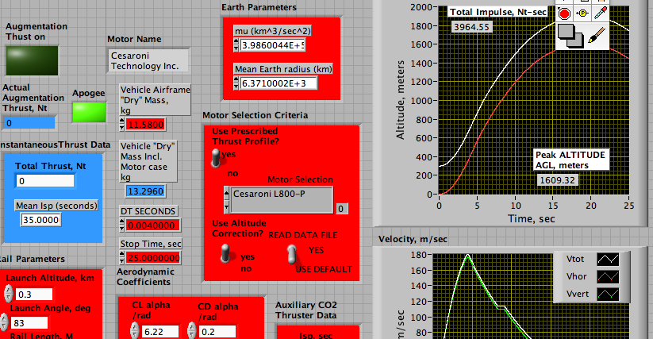
Adding Motors to Simulation (5)
Repeat Process on front panel

