Slide 1
Types of Propulsion Systems: A Quick Overview
Gas Storage Tank
Gas Exhaust Nozzle
Pressure
Regulator
Actuator Valve
for Gas Flow

Slide 2
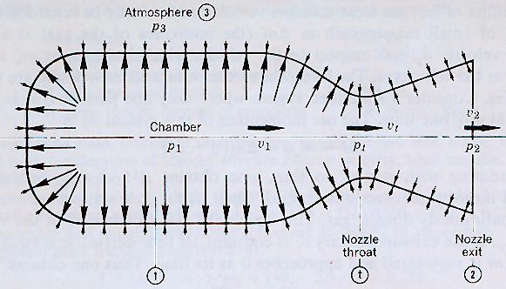
Review: Thrust Equation
• Thrust + Oxidizer enters combustion
Chamber at ~0 velocity, combustion
Adds energy … High Chamber pressure
Accelerates flow through Nozzle
Resultant pressure forces produce thrust

Slide 3
Maximum Available Thrust

Slide 4
Review: Specific Impulse
• Specific Impulse rocket’s Ability to deliver a certain
(specific) impulse for a given weight of propellant
• At a constant altitude, with
Constant mass flow through engine
Mean specific impulse
• Instantaneous specific impulse

Slide 5
Review: Rocket Equation
Is also called
propellant mass
Fraction or “load mass fraction”
• Sometimes

Slide 6
Specific Impulse (Revisited)

Slide 7
5 Types of Chemical Thrusters
Cold Gas
Monopropellant
Bipropellant
Solid
Hybrid

Slide 8
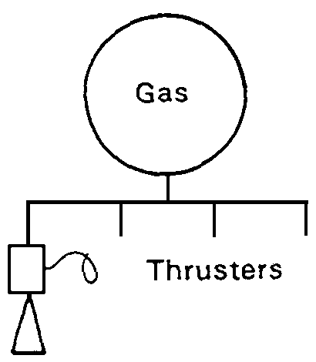
Cold Gas Thrusters
The balloon model: A big tank of gas, a valve, and a nozzle.
Used on early satellites for simplicity
I_{sp} of 50 seconds
thrust less than a pound

Slide 9
Cold Gas Thrusters
• No Combustion
• Thrust provided by
expansion of gas
through Nozzle
• Low Isp
• Simple Mechanism
Gas Storage Tank
Gas Exhaust Nozzle
Pressure
Regulator
Actuator Valve
for Gas Flow

Slide 10
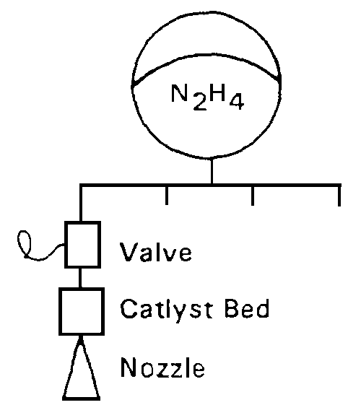
Monopropellant systems
• Often used for
spacecraft RCS
system

Slide 11
Monopropellant systems
• Often used for
spacecraft RCS
system

Slide 12
Monopropellant Thrusters
An unstable chemical that will decompose exothermically in the presence of a catalyst.
The chemical needs to be unstable, but not too unstable.
V2 used hydrogen peroxide, but it decomposes in storage, leading to overpressures and water.
Current systems use Hydrazine, which decomposes into Hydrogen, nitrogen, and ammonia in the presence of iridium. I_{sp} is on the order of 230, and total thrust can reach hundreds of lbs.

Slide 13
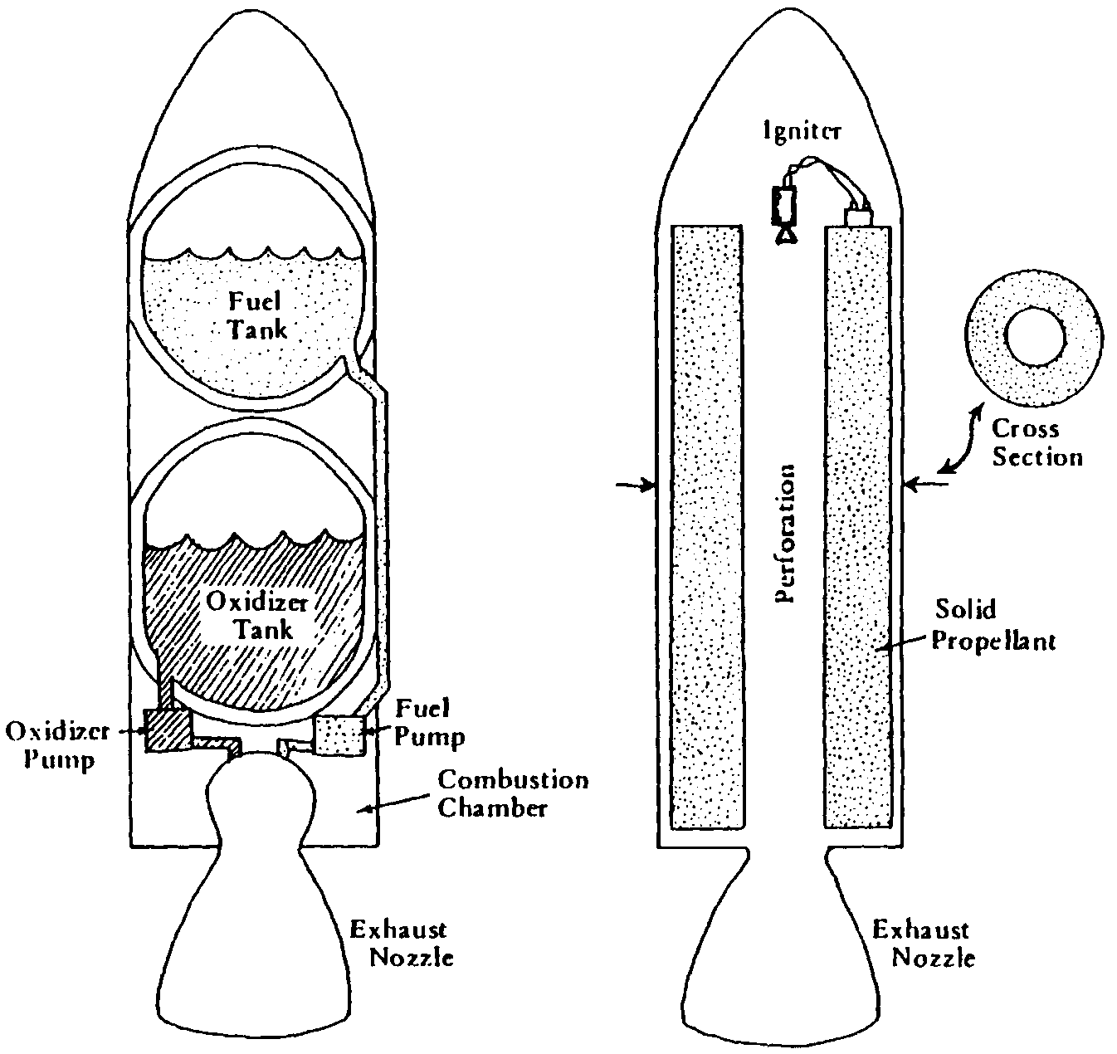
Typical Solid and Liquid Rockets

Slide 14
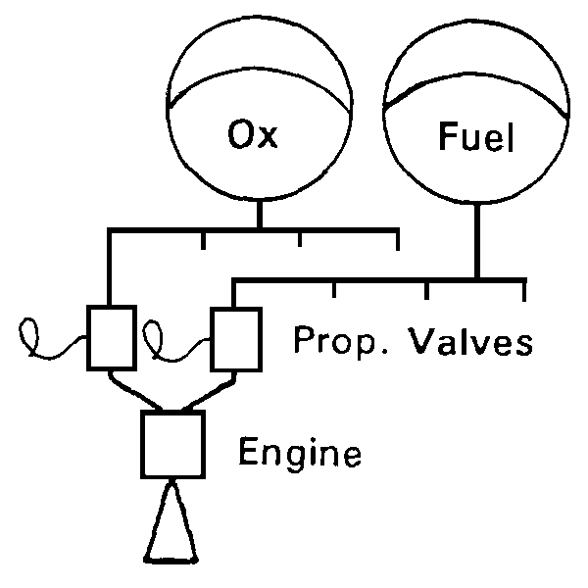
Bi-propellant System
Bi-prop offers the most performance (I_{sp} as high as 450 sec) and the most versatility. They also offer the most failure modes and the highest price tags.
Almost all first stage liquid rockets are Bi-prop.

Slide 15
Bi-Prop plumbing
Turbine Fed
Pressure Fed

Slide 16
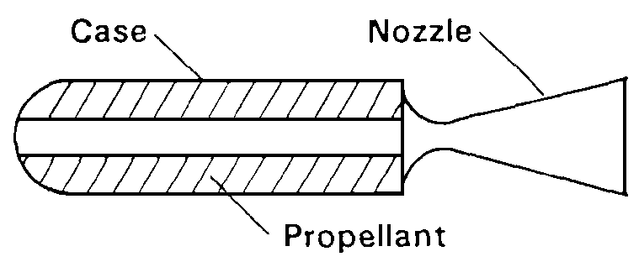
Solid Rocket Motors

Slide 17
Solid Rocket Motors
The oxidizer and fuel are stored in the combustion chamber as a mechanical mixture in solid form
Two conditions for use:
The total Impulse is known accurately in advance
Restart is not required
Elements include: Case, Igniter, Grain, Nozzle, liner/insulation
Black Powder
Composite Propellant: organic binders, aluminum powder, and an oxidizer (usually ammonium perchlorate - NH₄CIO₄.) The binders are rubberlike polymers that are both fuel and binder.

Slide 18
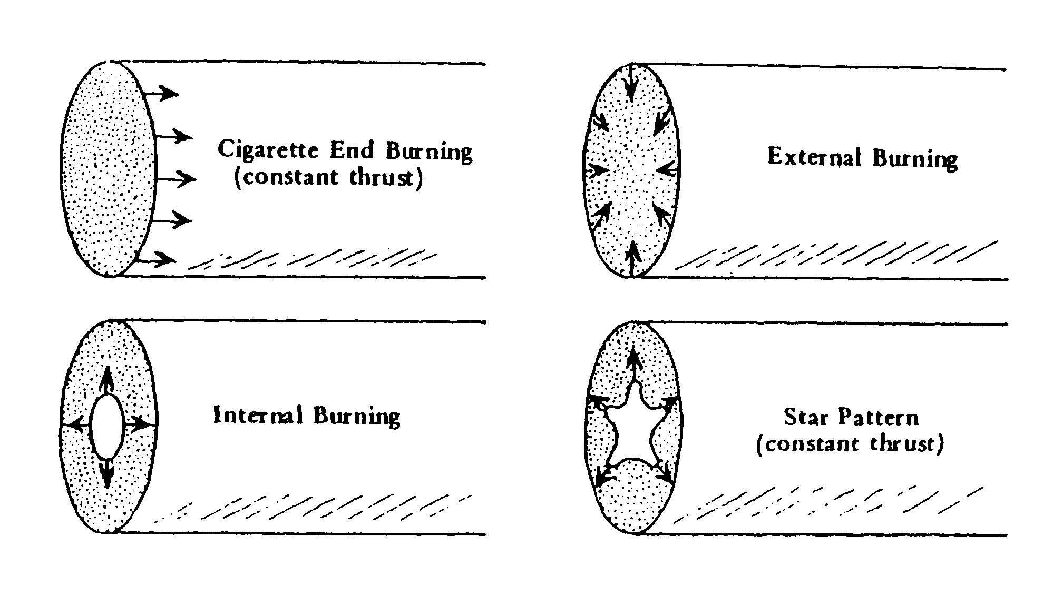
Burning Patterns

Slide 19
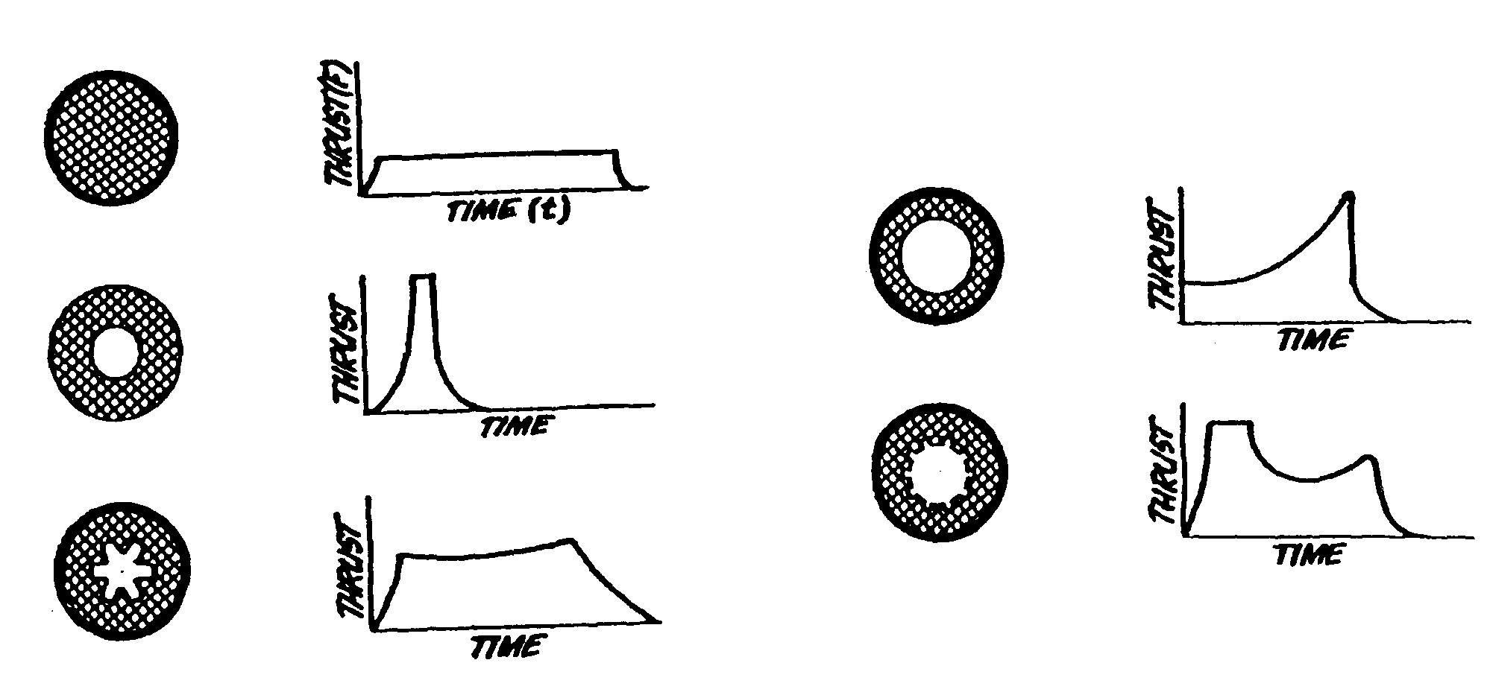
Thrust Profiles

Slide 20
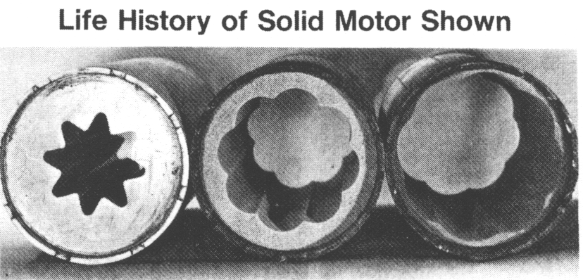
SHAPE OF PROPELLANT GRAINS QUENCHED AT DIFFERENT TIMES
Start condition Quenched at 1.5 s Quenched at 2.5 s
Notes:
20

Slide 21
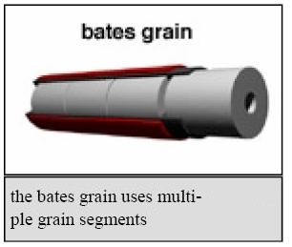
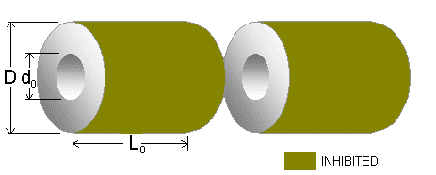
The “Bates Grain” Geometry
Simple Modification to Cylindrical Port to Give More
Even Burn Pattern
Grain segments burn from
“inside” and along the “ends”
Most NAR-certified solid-grain motors use this pattern

Slide 22
Hybrid Motors
• Relatively Low I_{sp}, Capable of High Thrust
• Throttleable, Restartable, Limited explosion potential
Very difficult to precisely regulate delivered impulse for
pressure fed systems

Slide 23
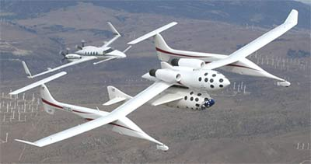
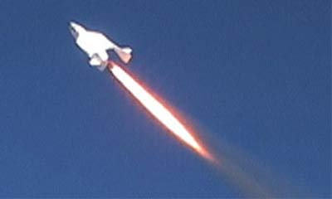


Space Dev® Hybrid Powered “Spaceship 1” (cont’d)
• Built by Burt Rutan (Scaled Composites®) with Paul Allen’s (Apple co founder)
Money in Mojave CA SS1 wrote history, when the first private suborbital
spaceflight was conducted on June 21, 2004 (with pilot Mike Melvill).
• SS1 won the X-Prize with flights on 29.09.2004 (Melville)
and a follow up flight on 04.10.2004. (Brian Binneie)
• Powered by a 16700 lbf thrust Hybrid Motor (SpaceDev)

Slide 24
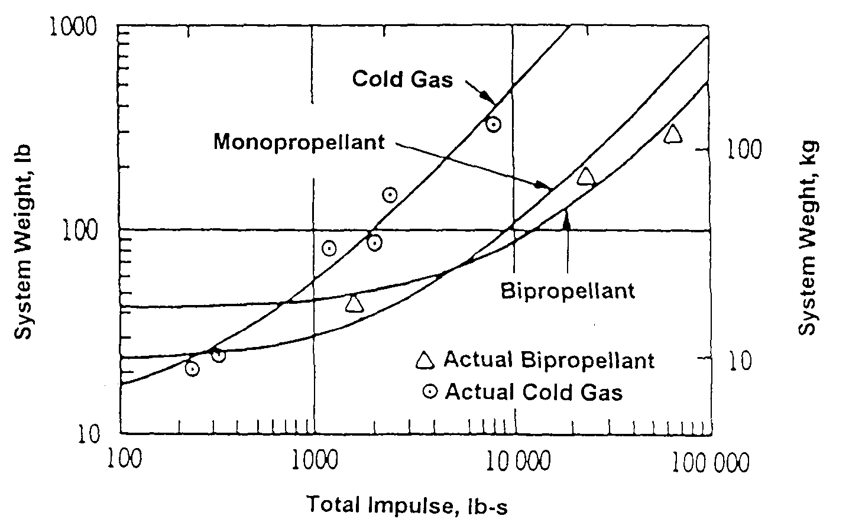
System Weight Comparison

Slide 25
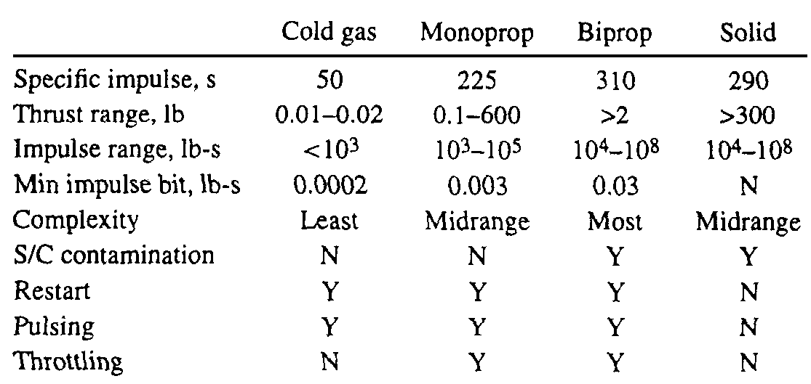
Propellant Comparisons

Slide 26
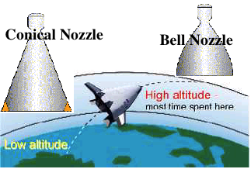
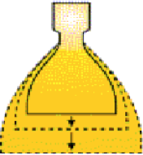
The Optimum Nozzle

Slide 27
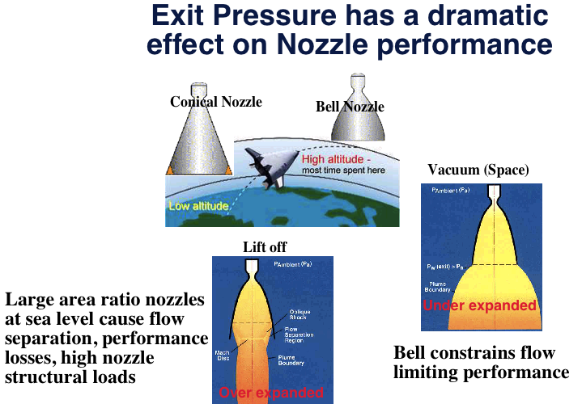
Operating Pressure

Slide 28
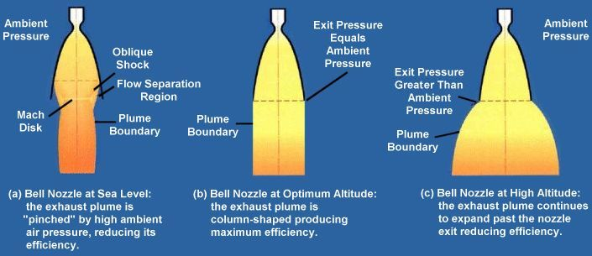
Effect of Operating Pressure on Conventional Nozzle Performance
Credit: Aerospace web

Slide 29
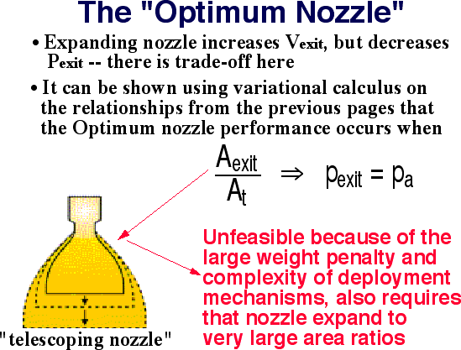
The "Optimum Nozzle”

Slide 30
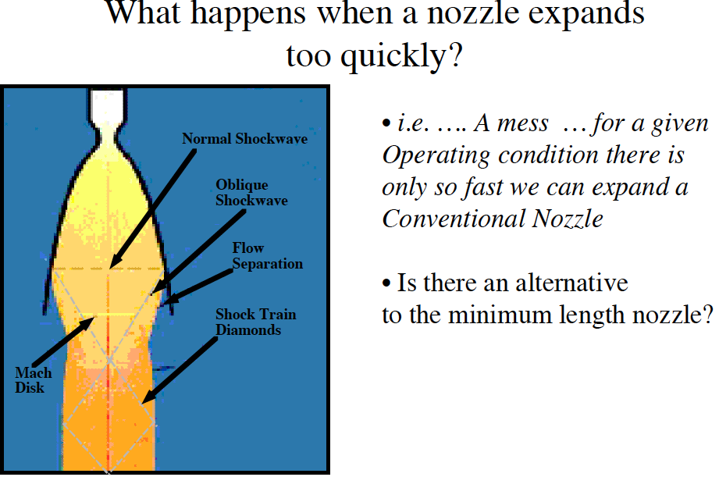

Slide 31
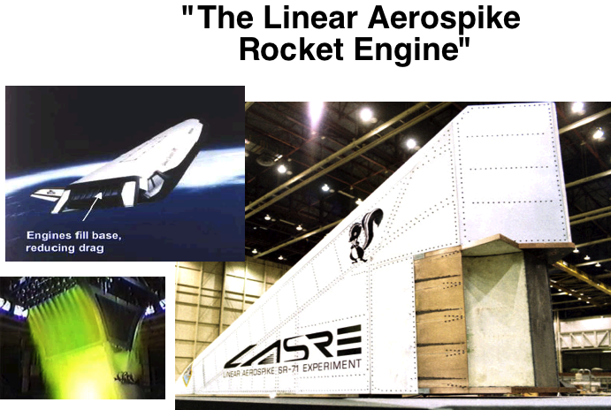
"The Linear Aerospike Rocket Engine"
The Aerospike Rocket Nozzle
… Which leads us to
the … real alternative

Slide 32
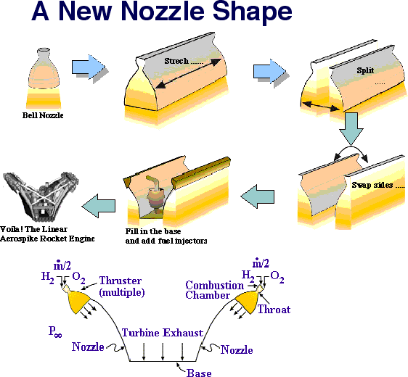

Slide 33
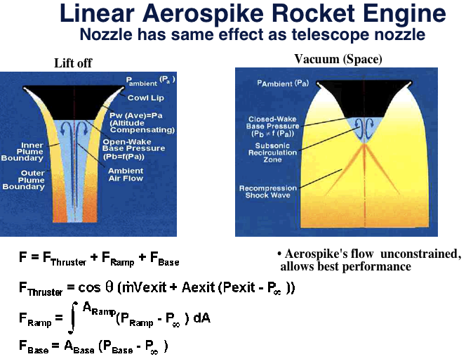
Linear Aerospike Rocket Engine Nozzle has same effect as telescope nozzle

Slide 34
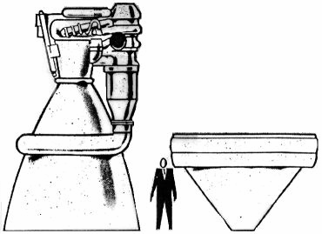
Advantages of Aerospike Nozzle
Truncated aerospike nozzles can be as short as 25% the length of a conventional bell nozzle.
Provide savings in packing volume and weight for space vehicles.
Aerospike nozzles allow higher expansion ratio than conventional nozzle for a given space vehicle base area.
Increase vacuum thrust and specific impulse.
For in-space operations, advanced nozzles can increase the thrust and specific impulse by 5-6%, resulting in a 8-9% decrease in propellant mass.
Lower total vehicle mass and provide extra margin for the mass inclusion of other critical vehicle systems.
New nozzle technology also applicable to RCS, space tugs, etc…
Comparison of F-1 Engine (Apollo Saturn V) to Proposed J 2T-250K
Replacement Aerospike Engine

Slide 35
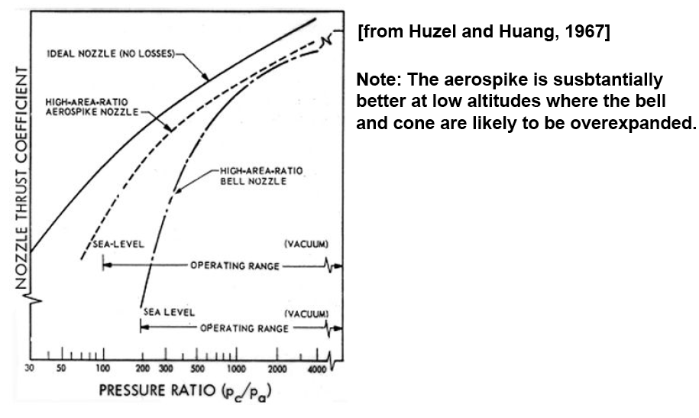
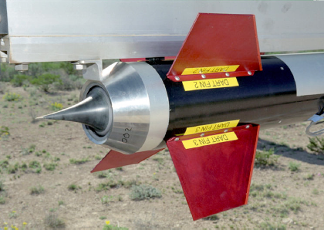
Performance Comparison
• Although less than Ideal
The significant Isp recovery
of Spike Nozzles offer significant
advantage
Annular “Plug” aerospike

Slide 36
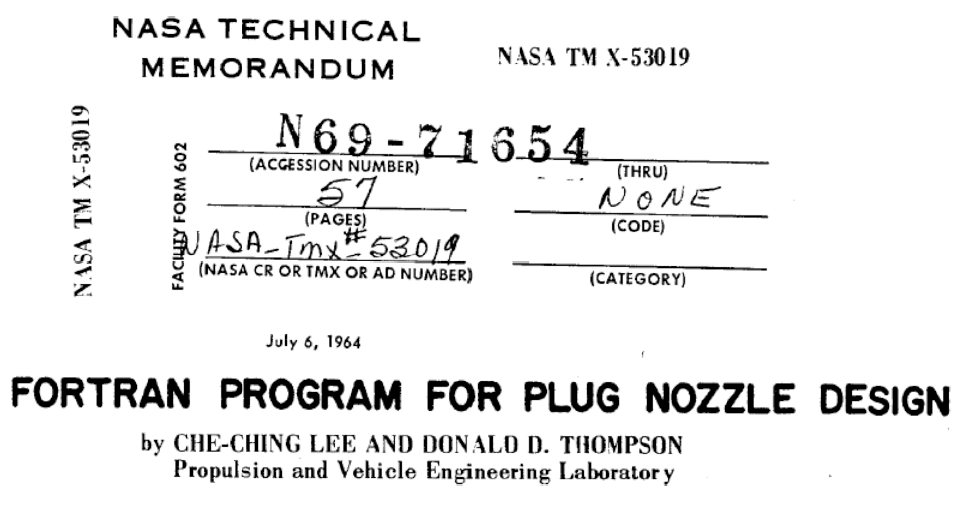
Annular Aerospike Design

Slide 37
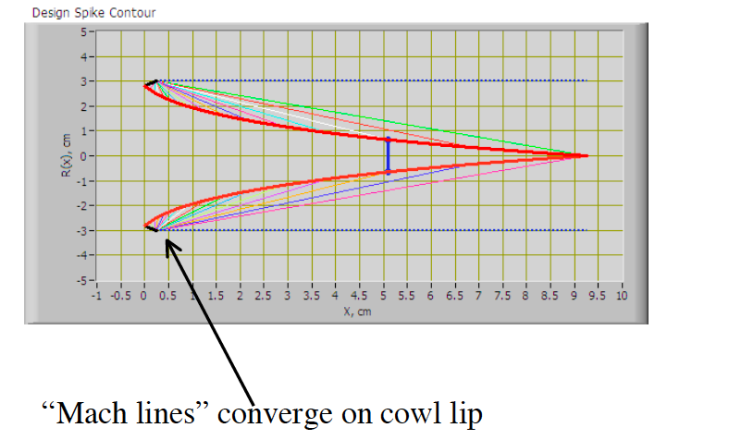
Ideal Aerospike Design

Slide 38
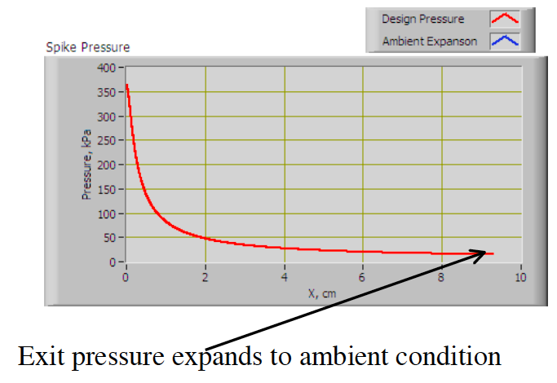
Ideal Aerospike Design (2)

Slide 39
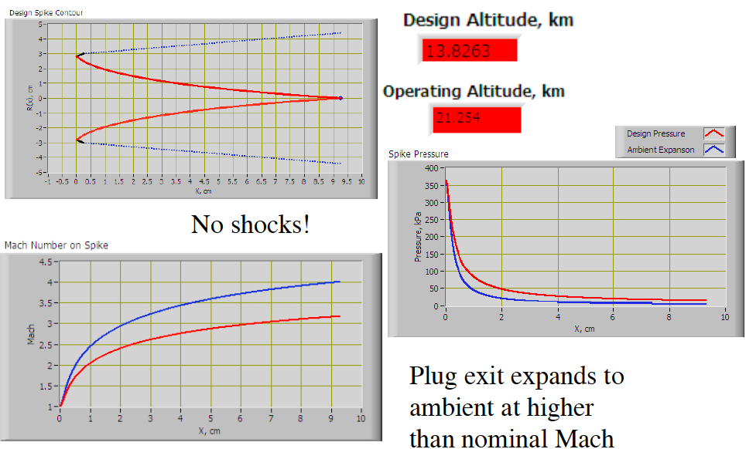
Off Design Operation (1)

Slide 40
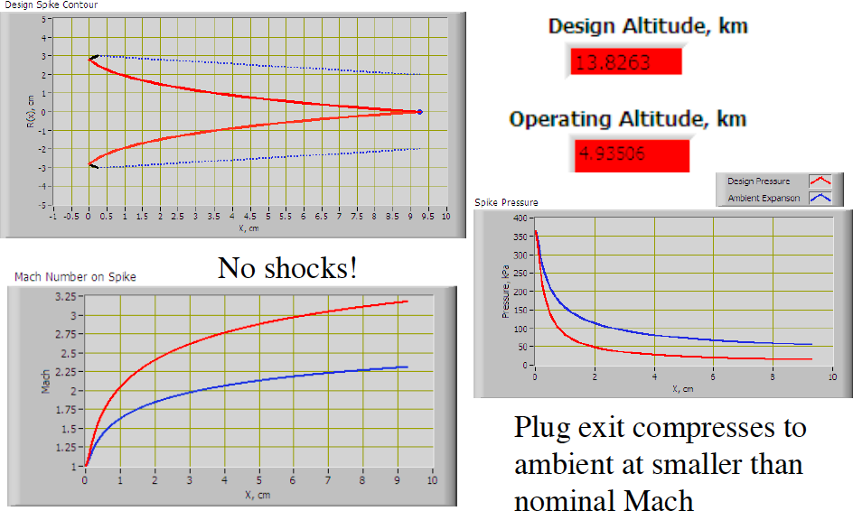
Off Design Operation (2)

Slide 41
Off Design Operation (1)

Slide 42
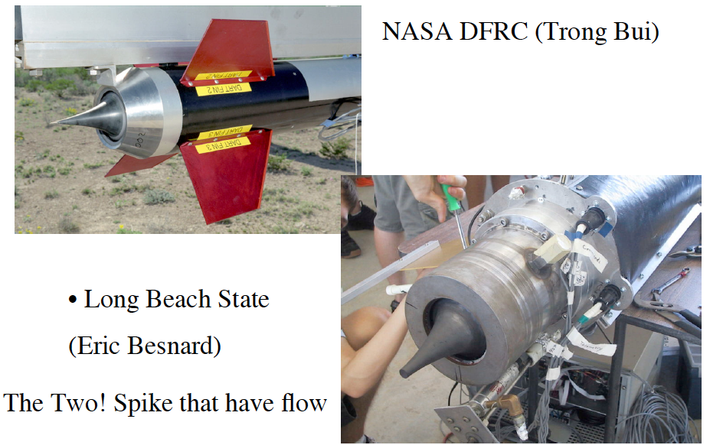
Spikes That Have Actually Flown

Slide 43
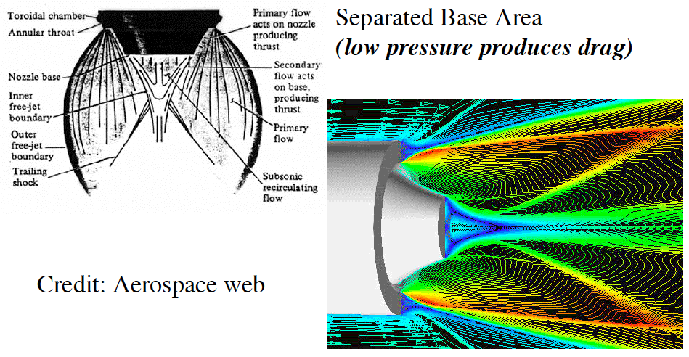
Effects of Spike Truncation
Truncation allows for
VERY SHORT LENGTH
FOR A GIVEN
EXPANSION RATIO

Slide 44
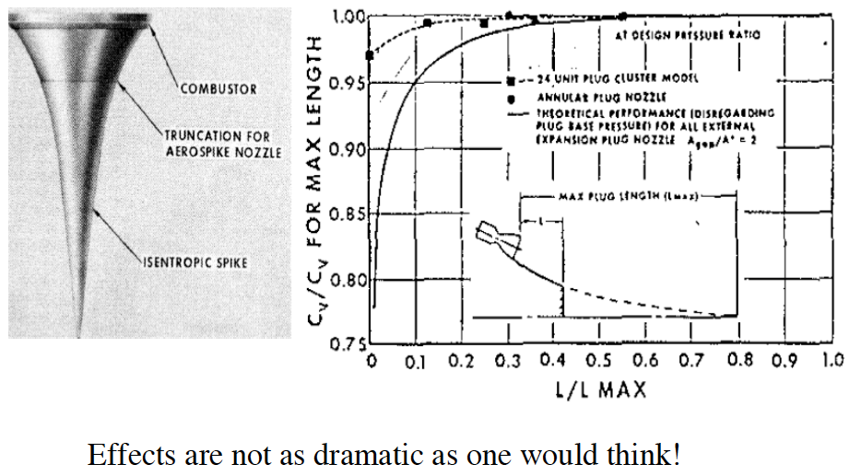
Effects of Spike Truncation (2)

Slide 45
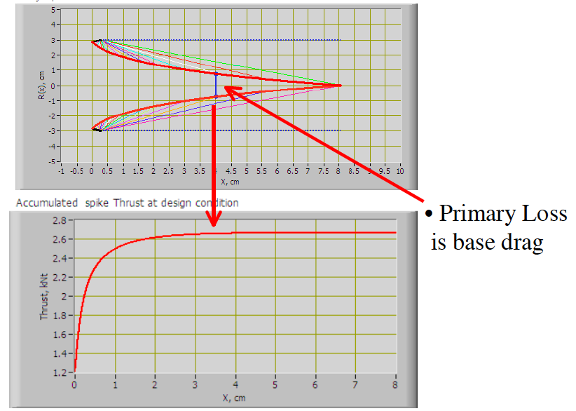
Effects of Spike Truncation (3)
Truncation DOES NOT PRESENT A GREAT PENALTY

Slide 46
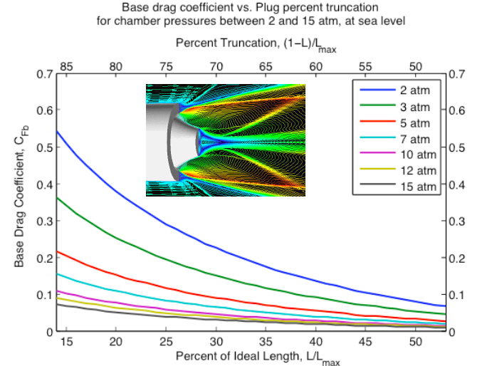
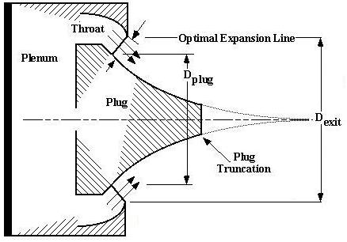
Effects of Spike Truncation (4)

Slide 47
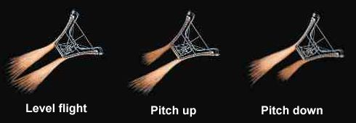
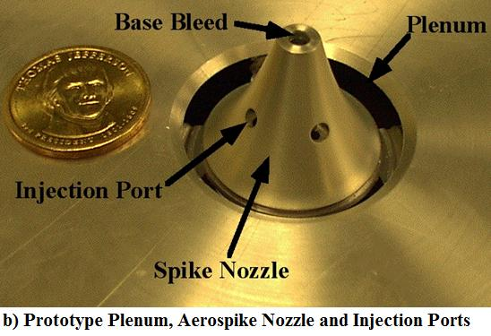
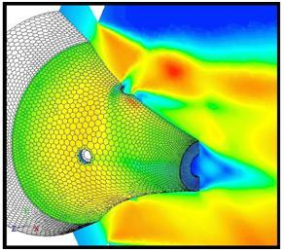
Spike Nozzle … Other advantages
• Thrust vectoring without Gimbals
Credit: Aerospace web

Slide 48
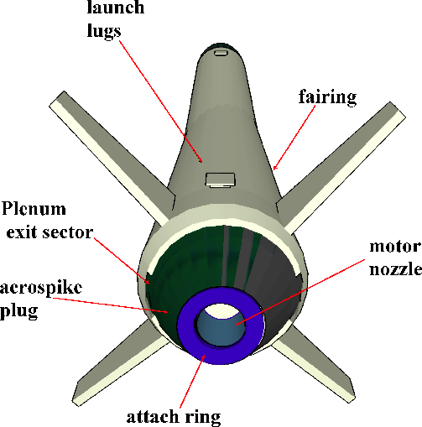
Spike on the “Javelin”
Aerospike for Cold-gas
augmentation thruster
is a “Natural Fit” for the
Javelin
Spike integrates onto
Aft eng of the vehicle
Wraps around attach ring of main motor nozzle
Thruster plenums may be sectors or possibly a
Full annulus

Slide 49
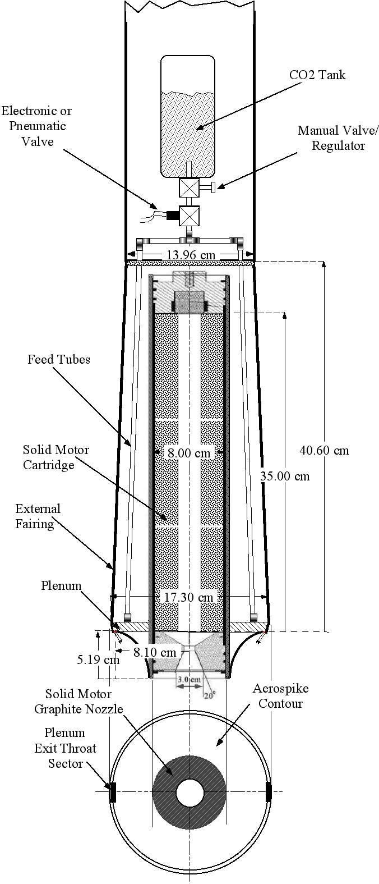
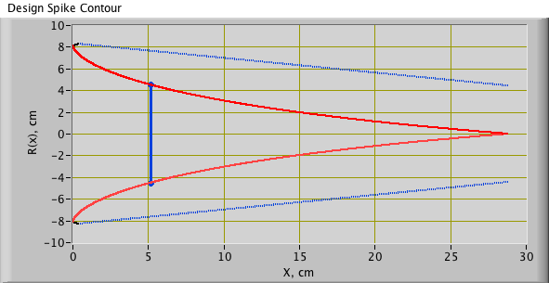
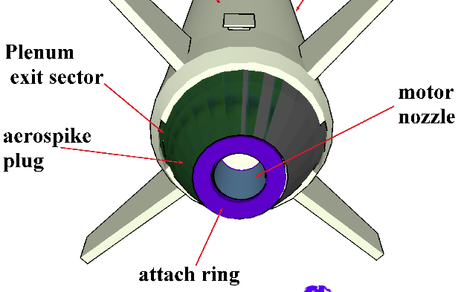
Spike on the “Javelin”
~92% Spike Truncation

Slide 50
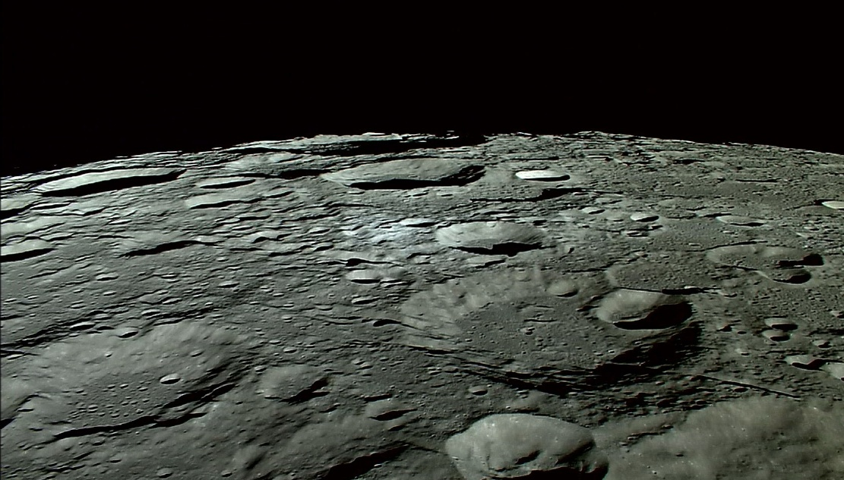
Questions??

