Slide 1
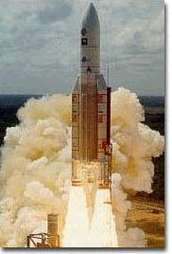
Rocket Science 103:
Ballistic Equations of Motion
Newton's Laws as
Applied to
"Rocket Science"
... its not just a job ... its an adventure

Slide 2
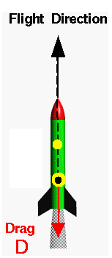
RS 102: Summary
Vertically accelerating rocket
Neglected aerodynamic drag

Slide 3
How High will my Rocket go?

Slide 4
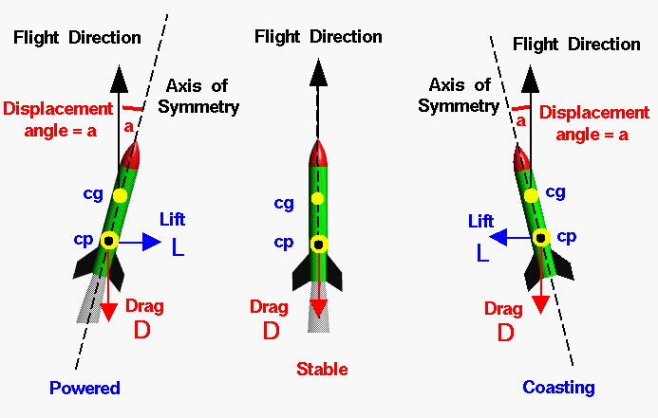
Forces Acting on Rocket
Lift – acts perpendicular to flight path (non-conservative)
Drag – acts along flight path (non-conservative)
Thrust – acts along longitudinal axis of rocket (non-conservative)
Gravity – acts downward (conservative)

Slide 5
Forces Acting on Rocket (2)
Lift – acts perpendicular to flight path (non-conservative)
Drag – acts along flight path (non-conservative)
Define

Slide 6
Friction (Drag) Losses (2)
drag
For constant C_{D}, M
“Ballistic Coefficient”

Slide 7
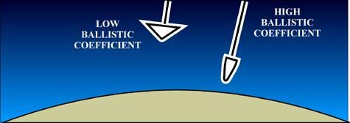
Ballistic Coefficient
• When effects of lift are negligible aerodynamic effects
can be incorporated into a single parameter
…. Ballistic Coefficient ….
• β is a measure of a projectile's ability to coast. …
… M is the projectile's mass and … C_{D}A_{ref} is the drag form factor.
• At any given velocity and air density, the deceleration of a
rocket from drag is inversely proportional to β
Low Ballistic
Coefficients
Dissipate
More Energy
Due to drag

Slide 8

Real World Launch Analysis
Trajectory Design Optimization
Orbital designs a unique mission trajectory for
each Pegasus flight to maximize payload
performance while complying with the satellite
and launch vehicle constraints. Using the 3-Degree
of Freedom Program for Optimization of
Simulation Trajectories(POST), a desired orbit is
specified and a set of optimization parameters and
constraints are designated. Appropriate data for mass
properties, aerodynamics, and motor ballistics are input.
POST then selects values for the optimization parameters
that target the desired orbit with specified constraints
on key parameters such as angle of attack, dynamic
loading, payload thermal, and ground track. After
POST has been used to determine the optimum
launch trajectory, a Pegasus-specific six degree of
Freedom simulation program is used to verify
Trajectory acceptability with realistic attitude
dynamics, including separation analysis on all stages.
• 6-DOF simulations costs
A LOT! To run and are typically
Not used for Trajectory
design!
• We are going to start with
A simple 2⁺-D code that works
Well for mission profile
development

Slide 9
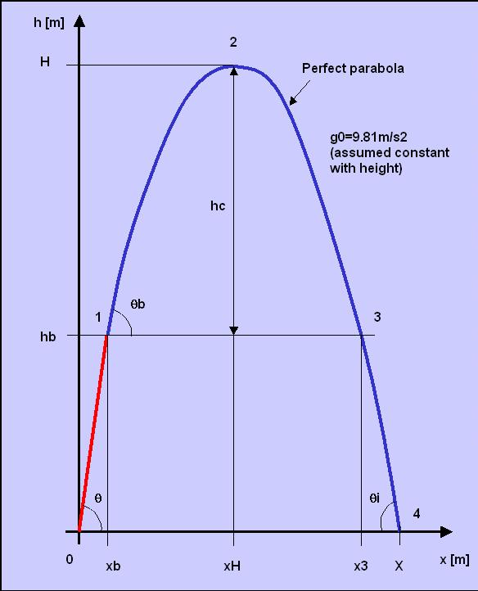
Perifocal Coordinate System
Sub-orbital Image
Sub-Orbital Launch: Spherical Earth
Sub-Orbital Launch: Flat Earth
~ Symmetric
trajectory
ν

Slide 10
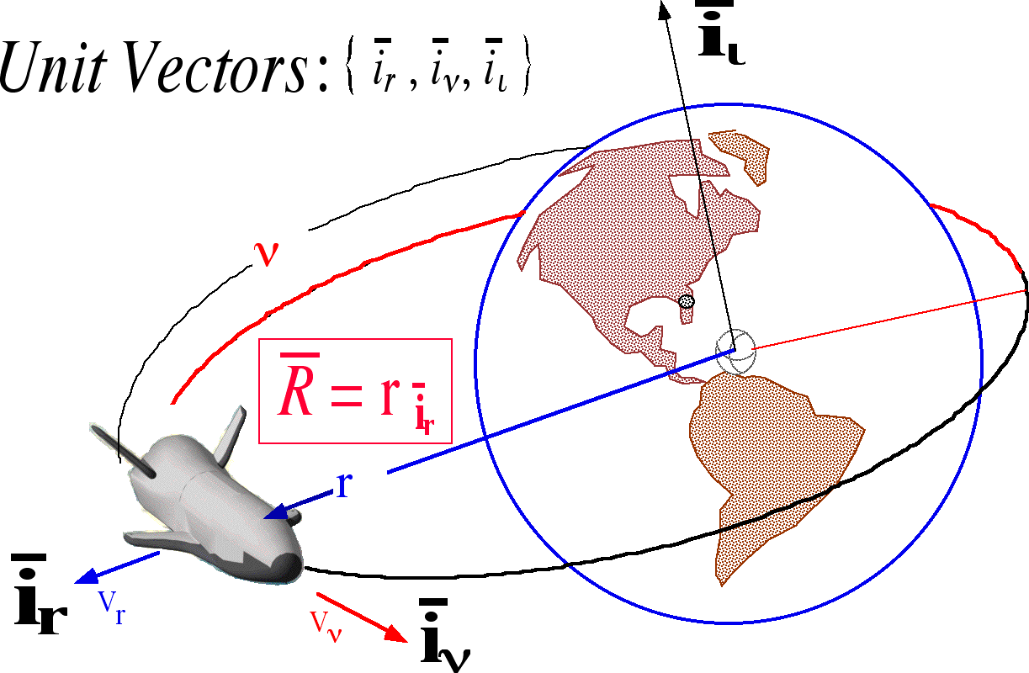
Perifocal Coordinate System
Maps spherical
earth onto flat earth

Slide 11
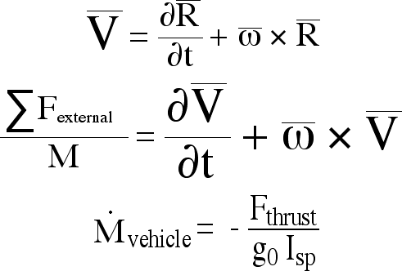
Newtonian Dynamics
• Must resort to Newton’s laws to describe
these orbits

Slide 12
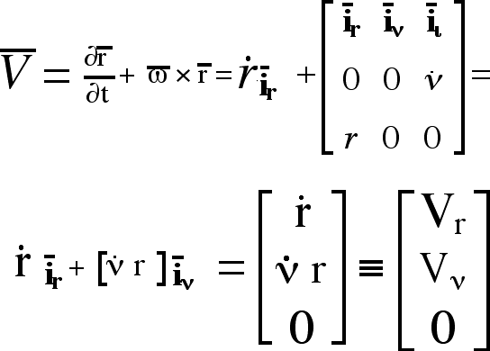
Velocity Vector

Slide 13
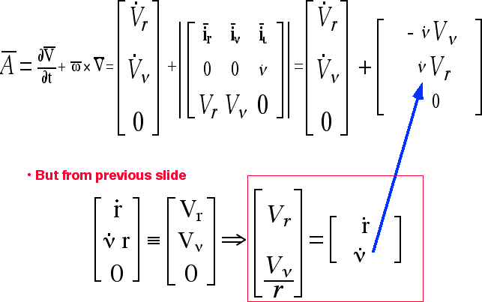
Acceleration Vector

Slide 14
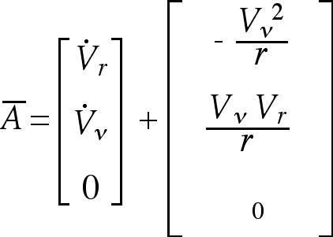
Acceleration Vector (cont’d)

Slide 15
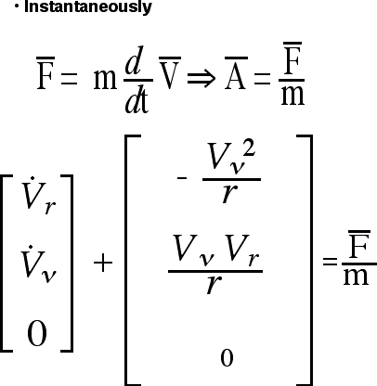
Newton’s Second Law

Slide 16
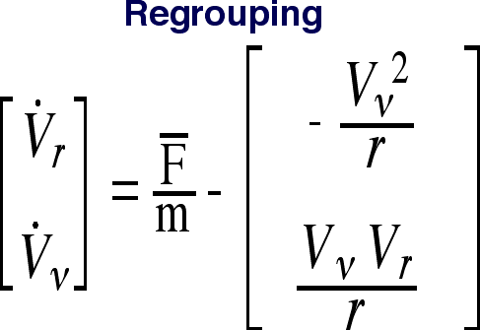
Newton’s Second Law

Slide 17
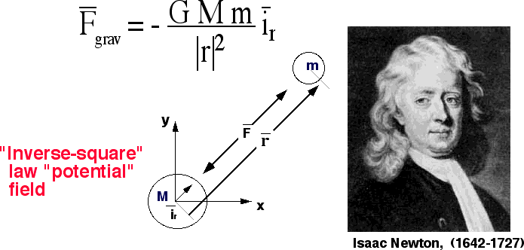
Gravitational (conservative) Forces
• Assume spherical earth .. Always acts in i_{r} direction

Slide 18
Gravitational Forces (2)
Sea Level Acceleration of gravity at 21 deg. latitude

Slide 19
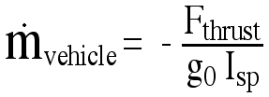
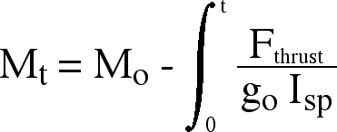
Vehicle Mass
Initial mass of vehicle

Slide 20
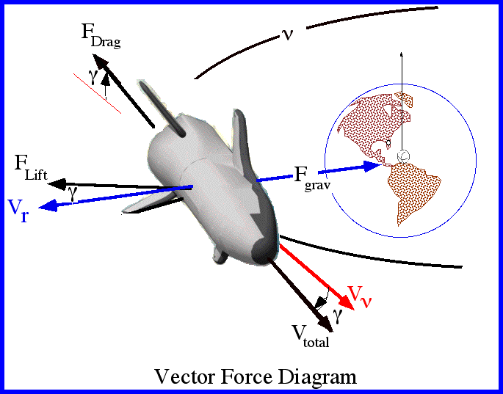
Non-Conservative Forces

Slide 21
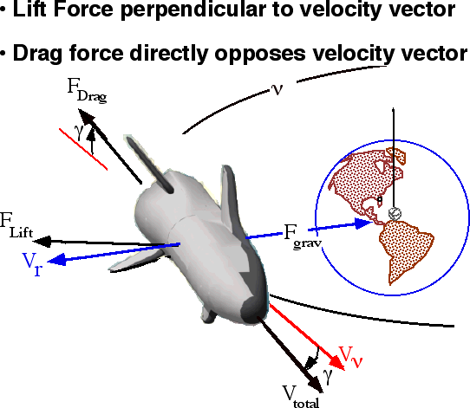
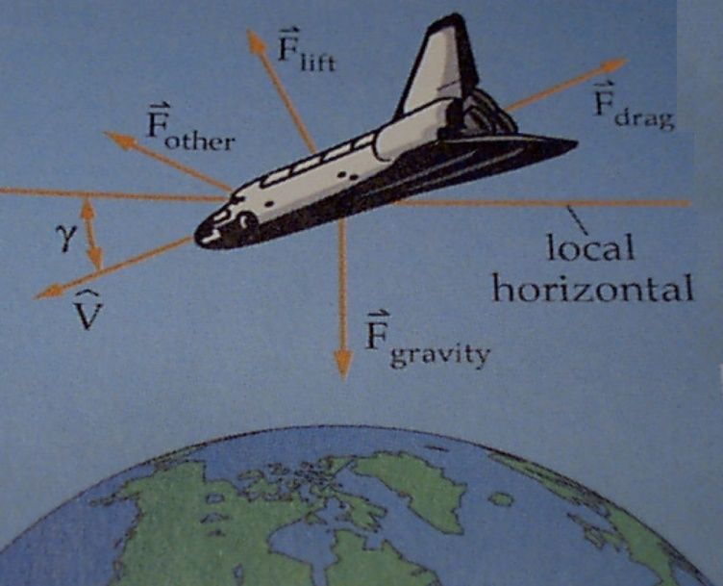
Aerodynamic Forces
A_{ref} … reference
Area … planform
Or diameter based
“Dynamic Pressure”

Slide 22
Collected Equations

Slide 23
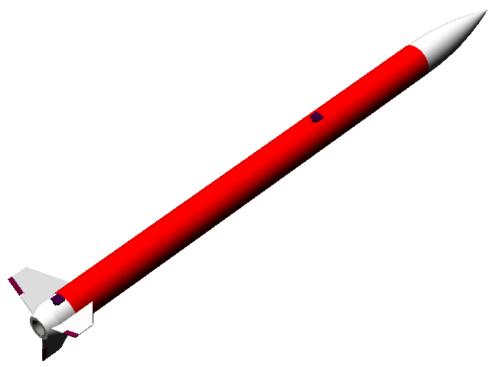

Ballistic versus Non -Ballistic Trajectories
• Non-ballistic trajectories sustain
significantly non -zero angles of attack
… lift is a factor in resulting trajectory
… so is induced drag
• Ballistic rocket trims trajectory at
… lift is a negligible factor

Slide 24
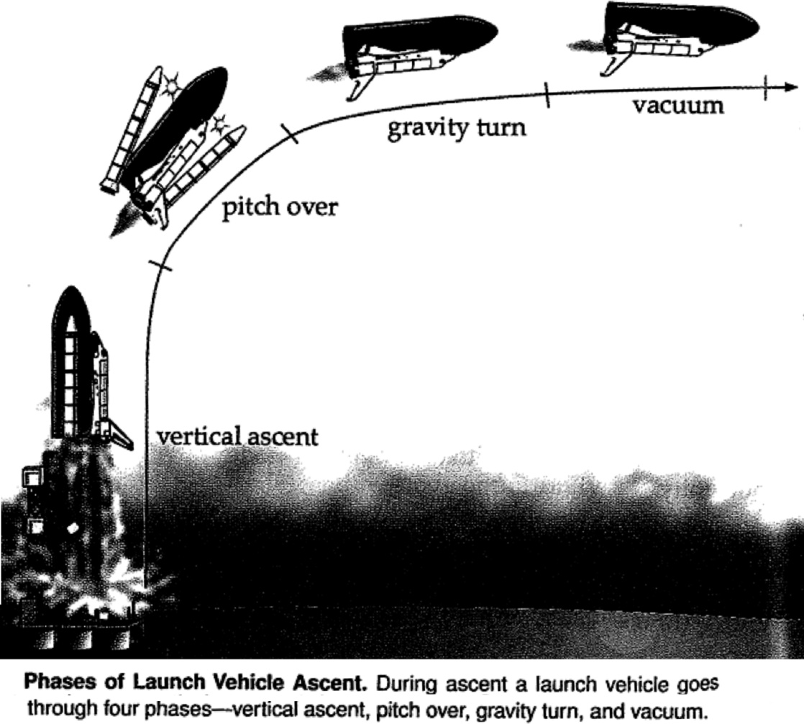
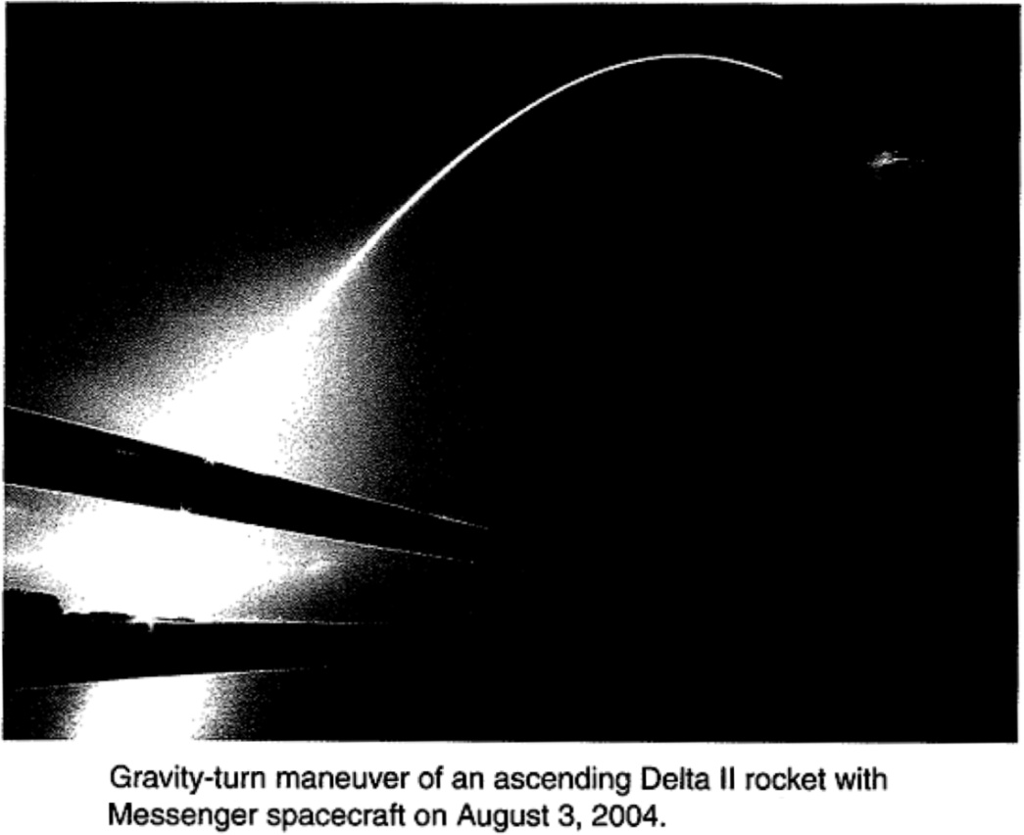

Non-Ballistic “Gravity Turn”
Yup this is real! Made to minimize
Gravity losses

Slide 25
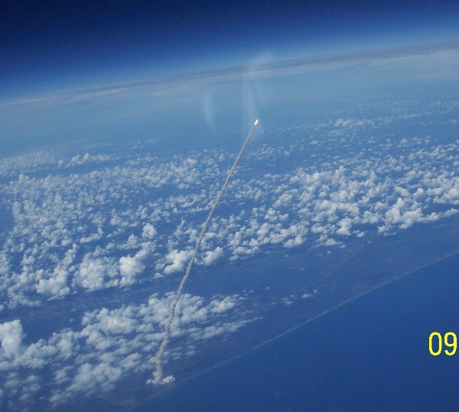
More “Gravity Turn”
Space Shuttle
Launch (STS 115
– Atlantis) as seen
from ISS
“definitely
Not ballistic”

Slide 26
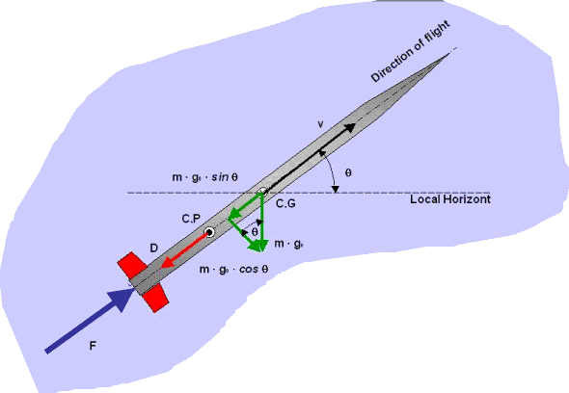
Example of Ballistic Trajectory
~ Symmetric
trajectory
• Ballistic Trajectories
Offer minimum drag profiles
( No induced drag)

Slide 27
Collected Equations, Ballistic Trajectory

Slide 28
Numerical Analysis of the
2-D Launch Equations of Motion

Slide 29
Integrated Equations of Motion

Slide 30
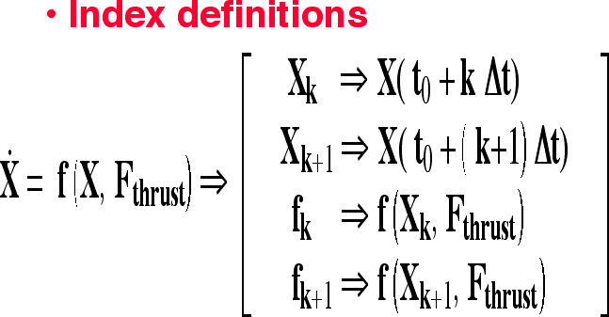
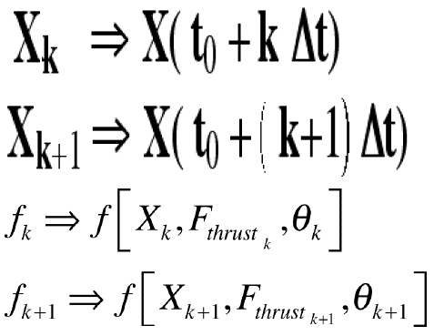
Numerical Approximation of the Integral

Slide 31
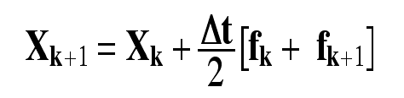
Numerical Approximation of the Integral (cont’d)
“Trapezoidal rule”

Slide 32
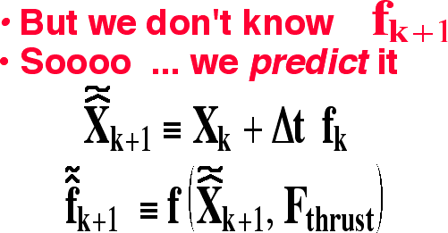
Numerical Approximation of the Integral (cont’d)
“Trapezoidal rule”

Slide 33
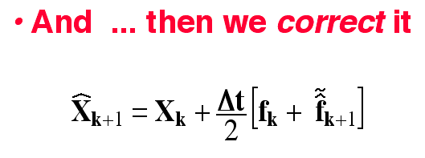
Numerical Approximation of the Integral (cont’d)
“trapezoidal rule”

Slide 34
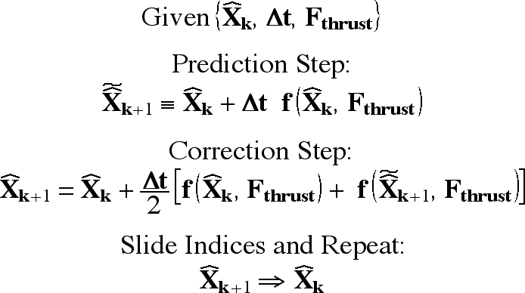
Predictor/Corrector Algorithm
“trapezoidal rule”

Slide 35
Higher Order Integrators
•Simple Second Order predictor/corrector works well for
Small-to-moderate step sizes … but at larger step sizes can
be come unstable
• Good to have a higher order integration
scheme in our bag of tools
• 4th Order Runge-Kutta method is one most commonly used
• we’ll only use the second order integrators for this simulation

Slide 36
Summary Slides on E.O.M.

Slide 37
Collected Equations, Ballistic Trajectory
This what we are going to program

Slide 38
Predictor/Corrector Algorithm
“trapezoidal rule”

Slide 39
Fixed Earth Approximation
• Ignore effects of rotation
• V_{inertial}=V_{ground}
• γ_{inertial}=γ_{ground}
• Accurate for Short Duration
lower altitude flights

Slide 40


Ground Launch: Down Range Calculation
• Integrated trajectory gives
• Inertial Downrange
Recursive Formula

Slide 41
Velocity Off of the Rail
V_{rail}
F_{drag}
F_{thrust}
F_{fric}

Slide 42
Velocity
Off of the Rail… Initial Conditions for simulation
V_{rail}
F_{drag}
F_{thrust}
F_{fric}

Slide 43

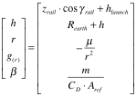


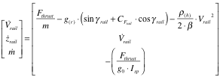


Rail Simulation Block Diagram
Initial
Conditions
Parameters and
Constants

Slide 44

Ballistic Simulation Initial Conditions
Final
conditions

Slide 45
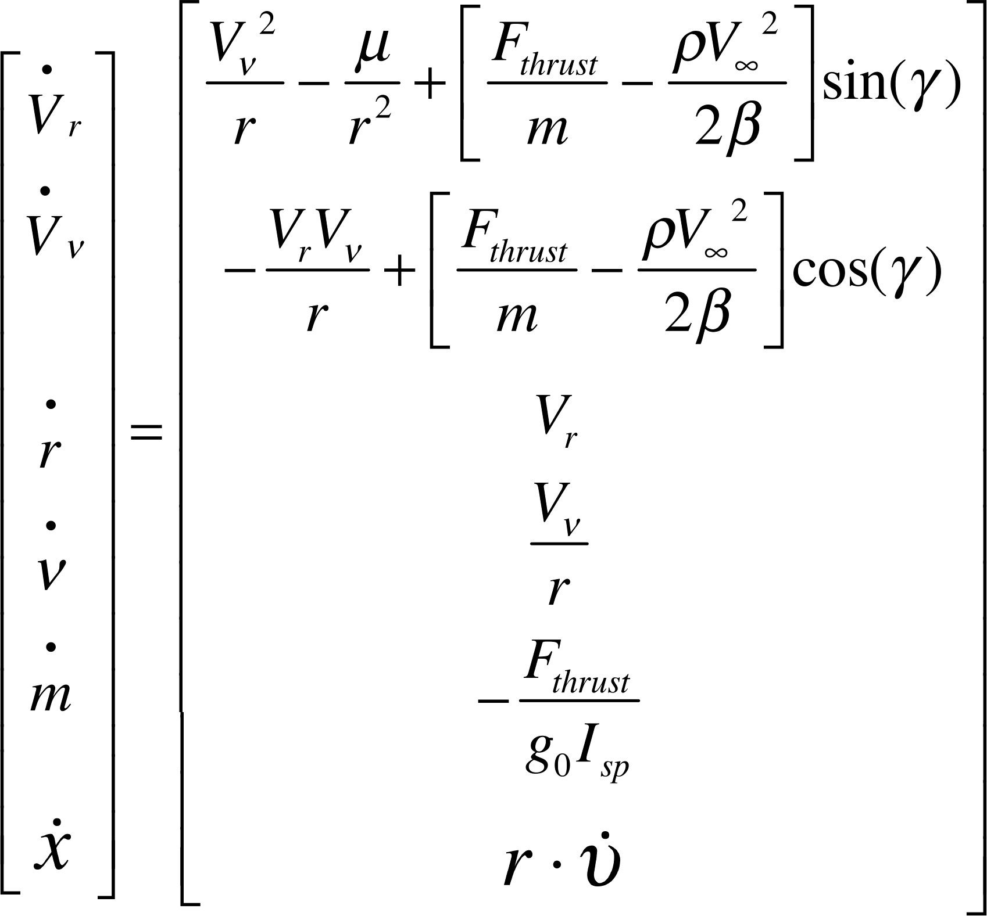
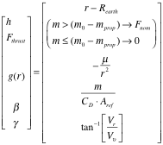



Ballistic Simulation Block Diagram
Initial
Conditions
Parameters and
Constants

Slide 46
Design Friday: 2009 “Pike” Ballistic Simulation
… Build functional block diagram of the simulation, Identify key elements
and computational blocks
Rail Launch .. Single degree of freedom model for rail dynamics, rail launch angle
assumed to be constant, assume constant thrust, deplete mass during burn
Initial conditions:… Use rail exit conditions for calculating initial conditions for
Ballistic simulation
Motor Burn phase … Assume constant thrust, constant drag coefficient,
ballistic equations of motion, deplete mass during burn
Coast phase … zero thrust (following depletion of propellant mass), constant mass,
Constant drag coefficient, ballistic equations of motion
Use trapezoidal rule for integration, Use 1976 US standard atmosphere to calculate
Density, pressure, temperature, etc .. As function of vehicle altitude

Slide 47
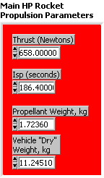
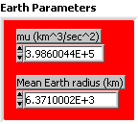
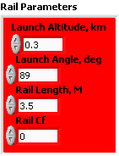
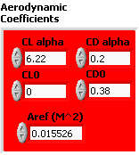

Design Friday: 2009 “Pike” Ballistic Simulation (2)

Slide 48
Design Friday: 2009 “Pike” Ballistic Simulation (3)
Check simulation results for C_{D0}=0 (β >> 1)
.. Using analytical expressions for V_{tburn}, h_{tburn} , h_{apogee}
… Plot Achieved apogee (with drag active) as a function of initial
launch rail angle for nominal motor impulse
… Plot achieved apogee as function motor impulse for
I = {1000, …. 5000 Nt-sec) at 85 deg launch angle

Slide 49
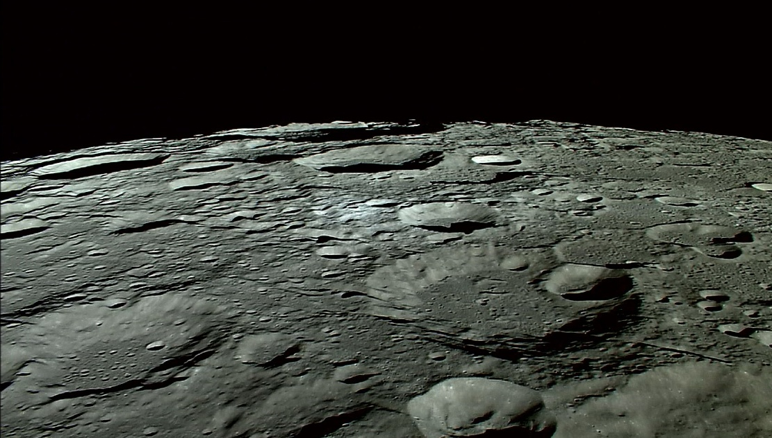
Questions??

