Slide 1
ESDM Senior Design Project
National Aeronautics and
Space Administration
Systems Engineering I
Sellers: Chapters 11, 15 + Material
From Auburn University Lunar Excavator
Design Course, Courtesy of David Beale
Notes:
Reference Defense Acquisition Management Approach

Slide 2
What is Systems Engineering?
A System Is …
Simply stated, a system is an integrated composite of people, products, and processes that provide a capability to satisfy a stated need or objective.
Systems Engineering Is…
Systems engineering consists of two significant disciplines: the technical knowledge domain in which the systems engineer operates, and systems engineering management.
It is an interdisciplinary approach that encompasses the entire technical effort, and evolves into and verifies an integrated and life cycle balanced set of system people, products, and process solutions
that satisfy customer needs.

Slide 3
What is Systems Engineering? (2)
Systems Engineering Management Entails…
Systems engineering management is accomplished by integrating three
major activities:
• Development phasing that controls the design process and provides baselines
that coordinate design efforts,
• A systems engineering process that provides a structure for solving design
problems and tracking requirements flow through the design effort, and
• Life cycle integration that involves customers
in the design process and ensures that the system
developed is viable throughout its life.

Slide 4
The Systems Engineering Process
• The systems engineering
process is a top-down comprehensive, iterative and recursive problem
solving process, applied sequentially through all stages of development,
that is used to:
• Transform needs and requirements
into a set of system product and process descriptions (adding value
and more detail with each level of development),
• Generate information for decision makers
• Provide input for the next level of development.

Slide 5
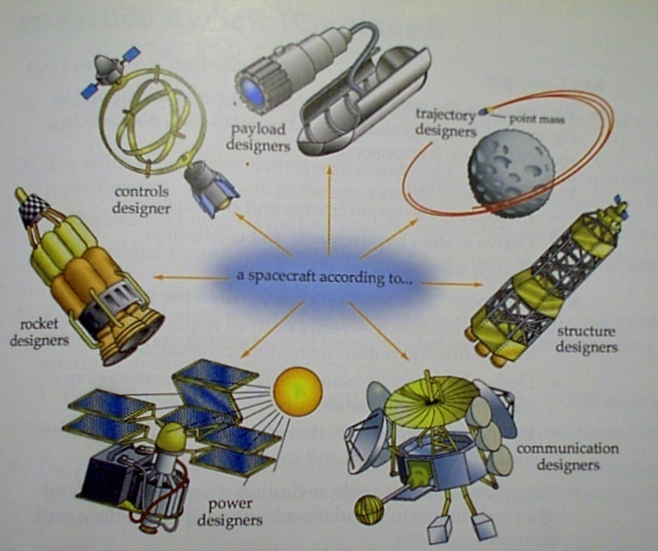
Systems Engineering Applied to the Space System Design Process
… “a spacecraft according
to …
• Sometimes individual subsystem designers get so focused on their subsystem designs that they lose sight of the overall mission objectives and requirements
• Good systems engineering
coordinates the activities
of disciplinary groups with
disparate design objectives
Notes:
From Sellers

Slide 6
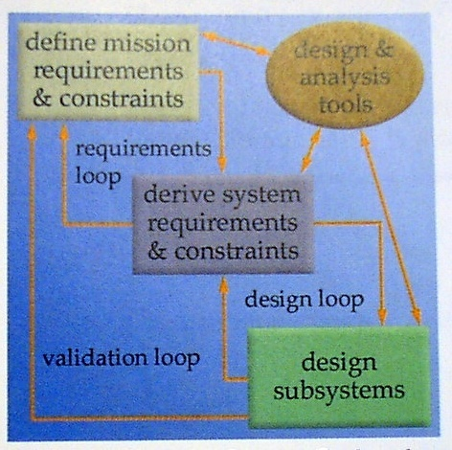
Systems Engineering Applied to the Space System Design Process (2)
• Systems Engineering is a fundamental process that can be used to design anything from a backyard grill to a crewed-space platform.
• Each step utilizes established design and analysis tools.
• The process is iterative.
• Between process steps there are “feedback loops” to review decisions made in previous steps.

Slide 7
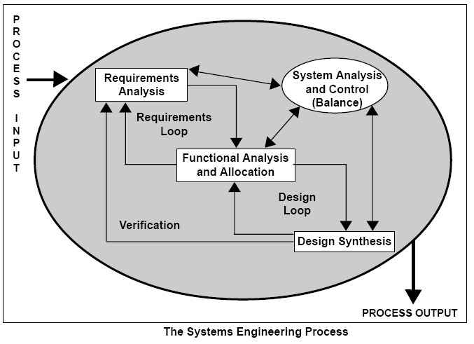
The Systems Engineering Process (4)
• An Alternative Viewpoint, .. Notice the similarities!

Slide 8
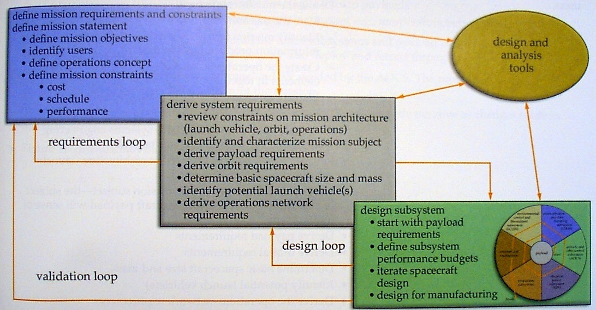
Systems Engineering Applied to the Space System Design Process
• By following a well-defined process, systems engineers design spacecraft that meet mission requirements while staying within budget and conforming to constraints

Slide 9
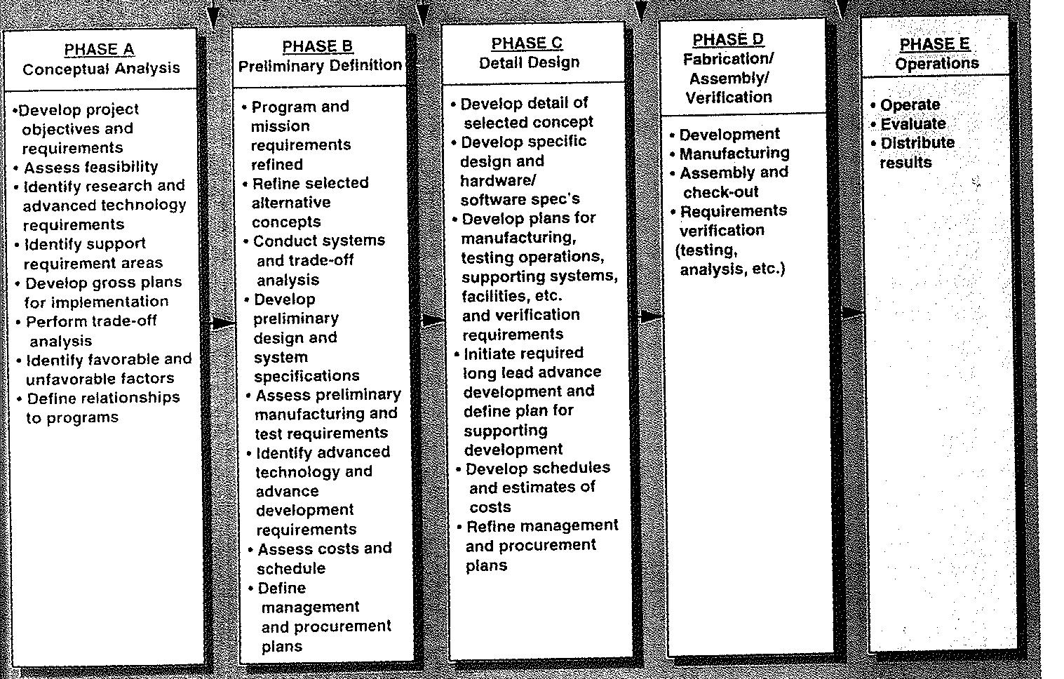
Systems Engineering Applied to the Space System Design Process (2)

Slide 10
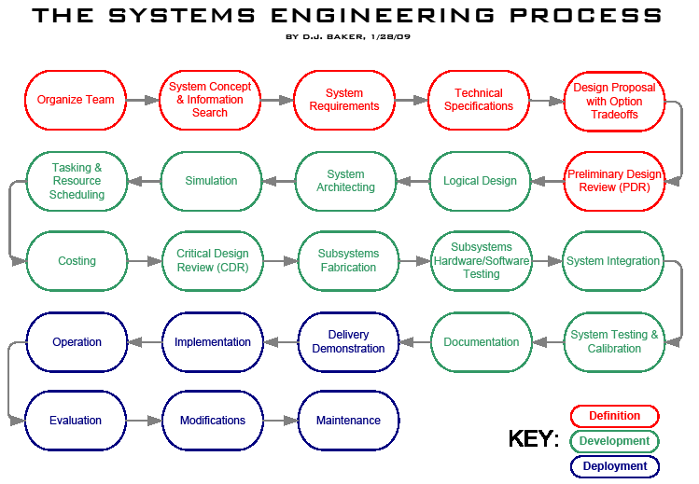
The “Baker” Chart

Slide 11
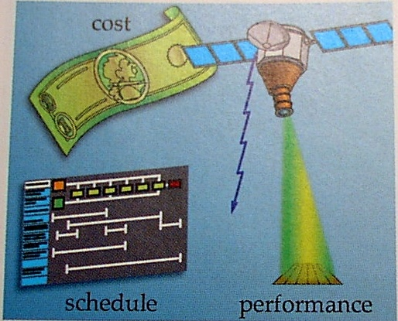
Systems Engineering Applied to the Space System Design Process (3)
Cost, Schedule, Performance
• 3-D trade space that mission must operate within.
• Systems engineers continually trade competing objectives to achieve well-balanced solution -- “optimal” solution often not-achievable

Slide 12
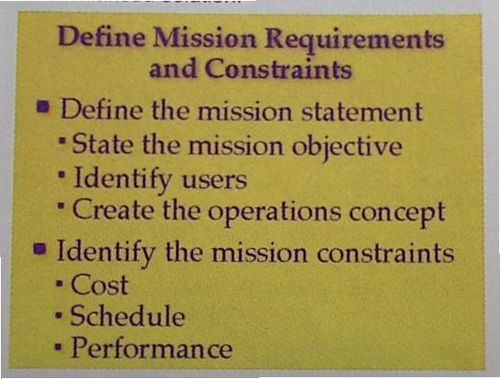
Systems Engineering Applied to the Space System Design Process (4)
• First Phase in design process is
to define the mission requirements,
Objectives, and constraints.
• Often documented and detailed in
the mission “Objectives and
Requirements Document.”
(ORD)

Slide 13

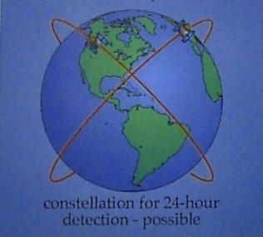
Systems Engineering Applied to the Space System Design Process (5)
Trading Requirements
• By trading-off mission requirements versus system-level requirements, an infeasible mission (too complex or to expensive or both) may become feasible and affordable

Slide 14
Requirements Analysis
Requirements analysis involves defining customer needs and objectives in the context of planned customer use, environments, and identified system
characteristics to determine requirements for system functions.
Requirements analysis is conducted iteratively with functional analysis to optimize performance requirements for identified functions, and to
verify that synthesized solutions can satisfy customer requirements.
In general, Requirements Analysis should result in a clear understanding of:
• Functions: What the system has to do,
• Performance: How well the functions have to be performed,
• Interfaces: Environment in which the system will perform, and
• Other requirements and constraints.

Slide 15
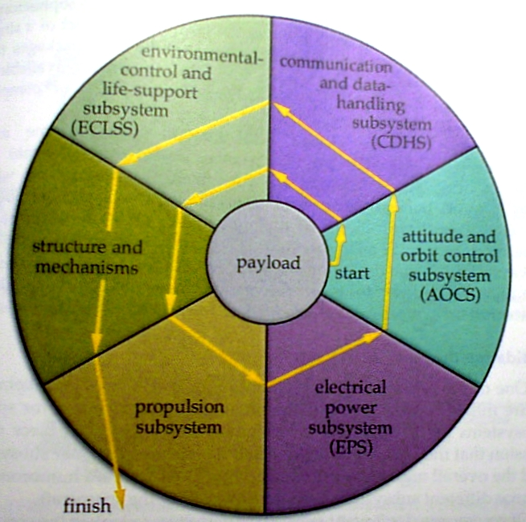
Systems Engineering Applied to Sub-System Design Process (1)
Subsystems Design
• Subsystem Design Process follows
a distinct order and development
hierarchy
• Hmmmm .. Why is the propulsion
System last on this chart?

Slide 16
Systems Engineering Applied to the Sub-System Design Process (2)
Subsystems Design Revisited
• Subsystem Design chart shows the
Interdependence of all of the
Spacecraft subsystems.
• When the design of one sub-system
is modified, then it typically become s
necessary to adjust the designs of
Some or all of the other sub systems.
• In extreme cases, the payload
sometimes needs to be modified as
the result of a mandated sub-system
Change.

Slide 17
Program Management
Typical Spacecraft Program Management Structure
(The bottom row is subsystem team leads)

Slide 18
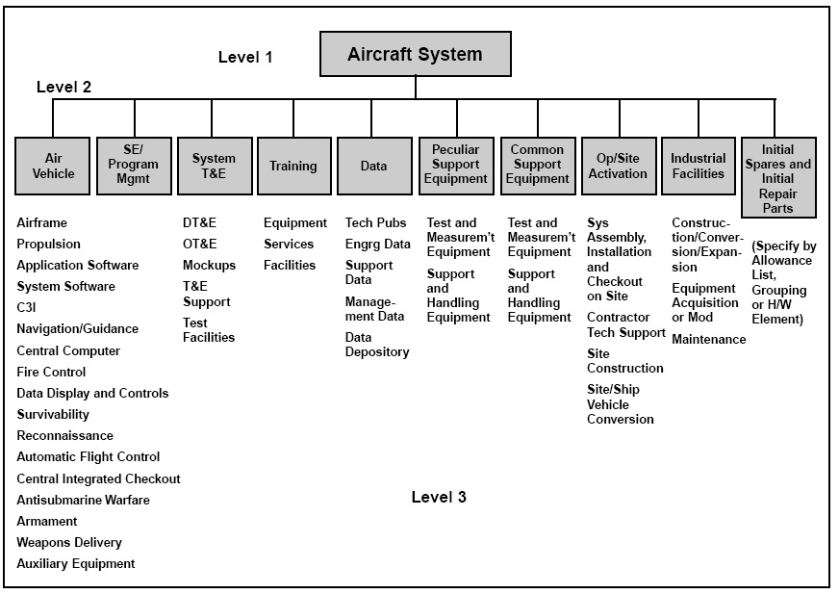
Program Management (2)
Subsystem Organization Structure

Slide 19
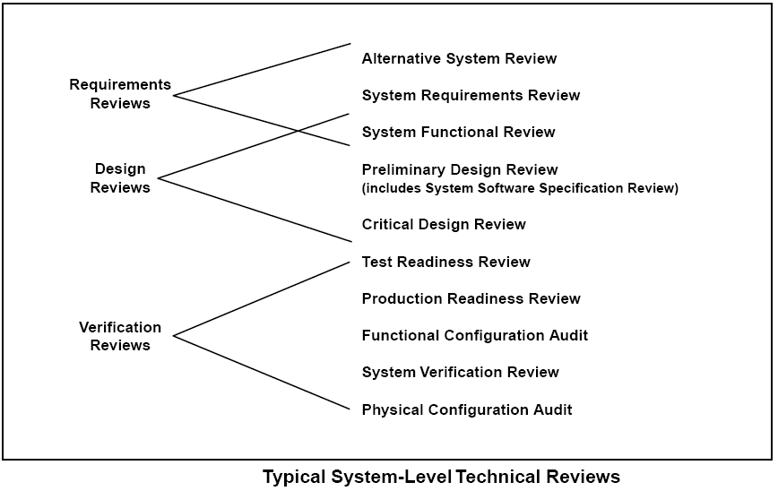
The Documentation and
Review Process
Reviews correspond to natural
phases in design evolution
Notes:
Flip PRR with TRR .. Needs work

Slide 20
The Documentation and
Review Process (2)
Reviews correspond to natural
phases in design evolution

Slide 21
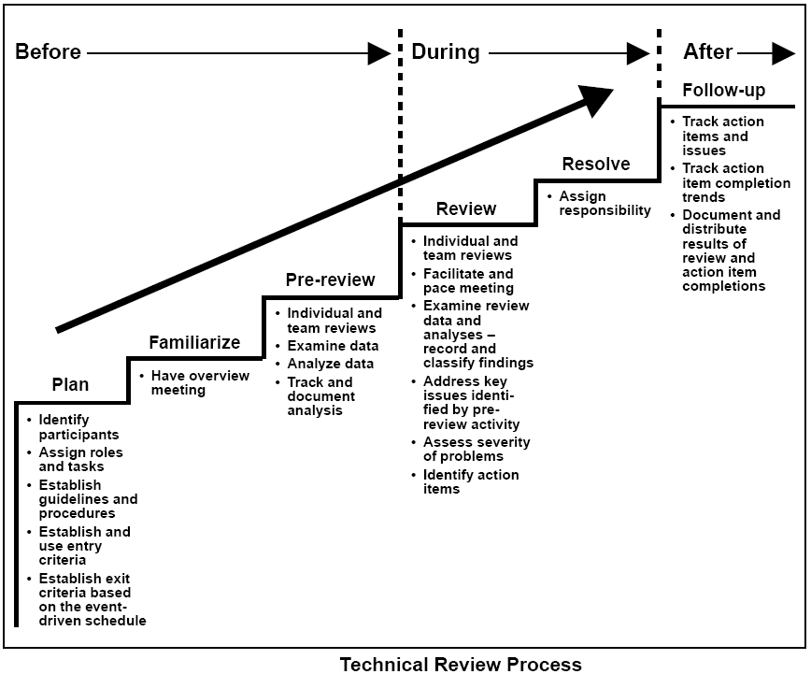
The Documentation and
Review Process (3)

Slide 22
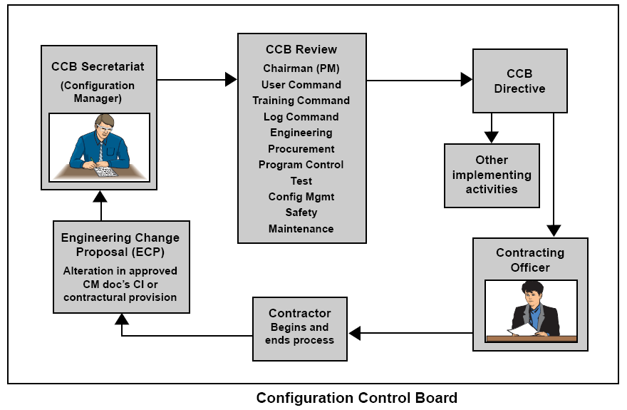
The Documentation and
Review Process (4)
Configuration Control Board
CCB keeps track
of design changes
Assures design
Does not grow
“wildly” or worse
Yet – backtracks
Helps to insure
Progressive changes
in design

Slide 23
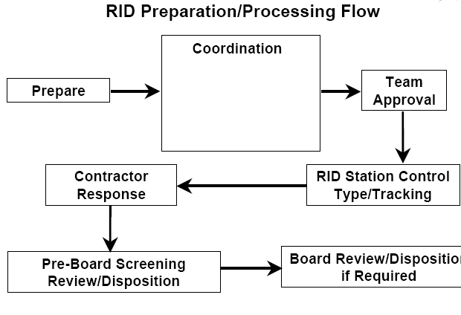
Review Item Disposition (RID)
• Formally tracks and dispositions requested actions, insures items do not “slip through the cracks”, no one is “let off of the hook” ---Responsibility of program management to set up RID Process.

Slide 24
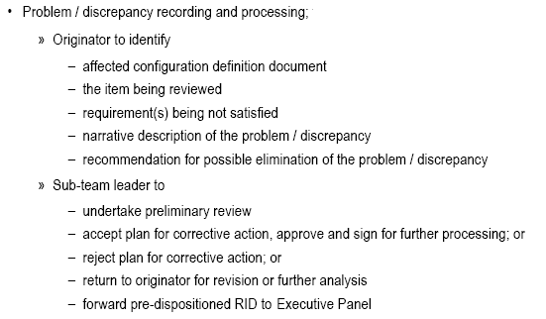
Review Item Disposition (RID) (2)

Slide 25
Review Item Dispensation (RID)
Response Protocol for this Class
RFA:
group to take a specific action to achieve a project task, goal
or deadline
RFI:
Request for Information … one group needs specific
information from another group in order to complete a
Project, task, goal, or deadline

Slide 26
RFA/RFI Submission Procedure
Item | Action
Fill Out RFA/RFI Form (Anyone on team) | Down the form from (student) website and fill out top portion
Email RFI/RFI form (Initiator) | Email form to subgroup team lead, also copy chimaeraUSLI2010@gmail.com
Enter RID Tracking Process (Systems Engineer, Webmaster) | Once form received, tracking number assigned, due date filled in. Assigned RID mailed to everyone on email thread.
Delegate RID (Team Lead) | Team Lead received RID and assigns specific actions within team
Delegate RID (Actionee) | Action/Information completed/provided ASAP, and before due date
Review RFA/RFI (Review Boards) | RIDS will be reviewed during regular classroom meetings at least once per week (Fridays)

Slide 27
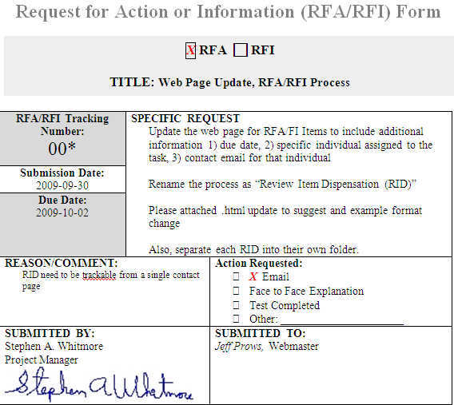
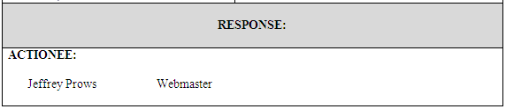
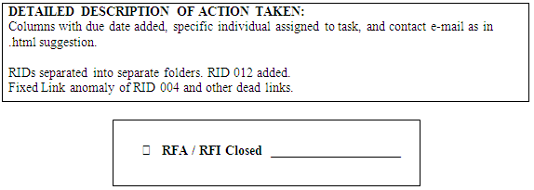
Completed RFA/RFI Form
http://www.neng.usu.edu/classes/mae/5900/USLI_2010/ReviewItemDisposition_Tracking_files/RequestforActionForm_USLI.doc
Each RID will require a two-slide! response to class on assigned due date
First slide is the complete form showing actions taken
gmail account: ChimaeraUSLI2010@gmail.com
password: usurocket

Slide 28
Issues, request for extension
Second slide … addresses issues, and requests an extension to complete rid
… be brief .. This is not a treatise
1) Work completed to date
2) Individuals involved with RID solution
3) Issues? (if none .. state so)
4) Required Information, actions
5) Requested extension date …..
… if an “in-class” informational briefing is requested …. In-class briefing is IN ADDITION to these two slides .. Start the briefing off with these two slides ... then get to the informational pitch

Slide 29
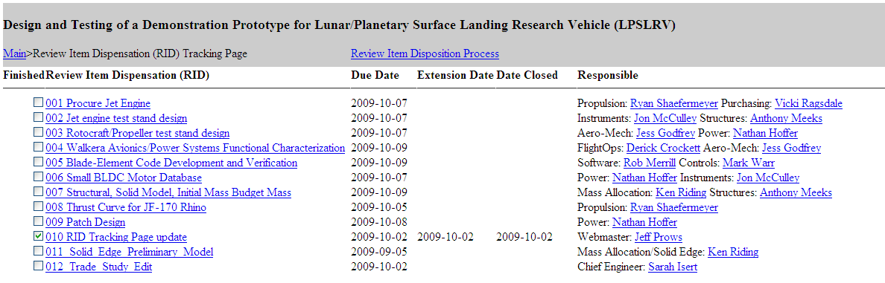
RID Process Tracking via Web page
AY 2009-2010 tracking web page
http://www.engr.usu.edu/classes/mae/5900/Lunar/Templates/RIDs.html
If RID is not closed here .. “It ain’t closed”

Slide 30
RID Process Tracking via Web page (2)
A whole lot of past-due RIDS assigned to your name will adversely effect your
grade in this class .. and make your classmates very unhappy with you

Slide 31
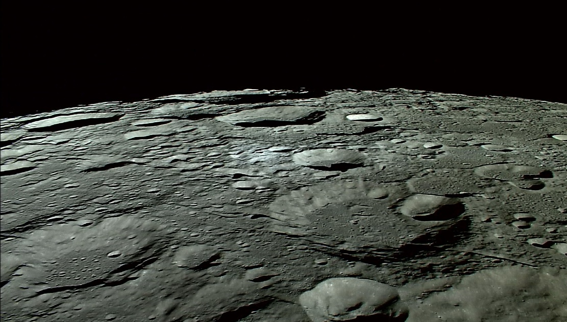
Questions??

