Slide 1
ESMD Senior Design Project
National Aeronautics and
Space Administration
Systems Engineering II: Design Tools
Sellers: Chapters 11, 15 + Material
From Auburn University Lunar Excavator
Design Course, Courtesy of David Beale
This section provides examples of systems engineering tools which may be needed during the design process.

Slide 2
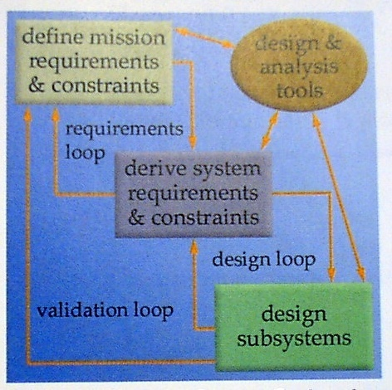
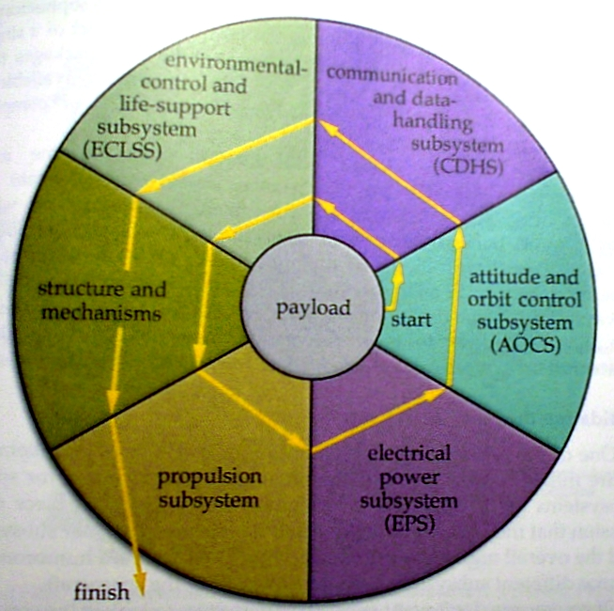
Systems Engineering Applied to Sub-System Design Process (1)
Subsystems Design
• Subsystem Design Process follows
a distinct order and development
hierarchy
• Hmmmm .. Why is the propulsion
System last on this chart?

Slide 3
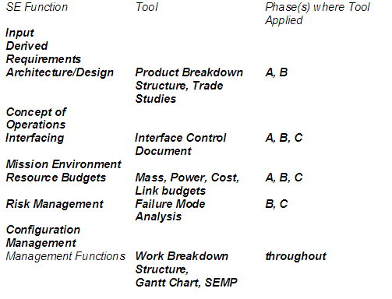
Systems Engineering Tools
Modeling and Simulation

Slide 4
Product Breakdown Structure
Allows the systems engineer to systematically divide an entire project into a set of major production areas including, sub-areas, and sub-sub areas.

Slide 5
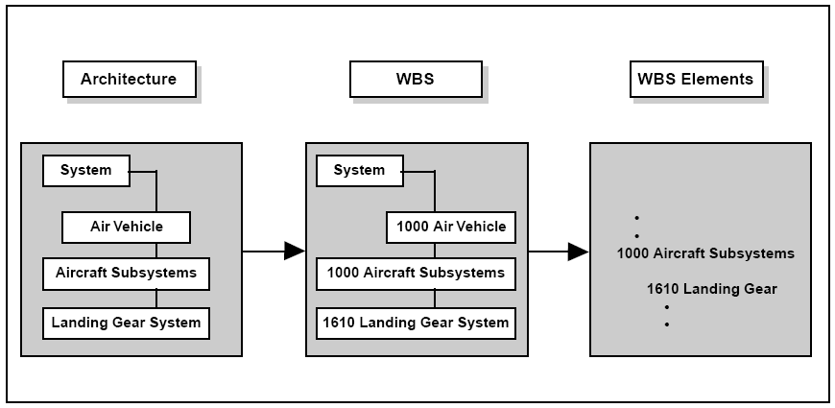
Work Breakdown Structure (2)
-- An Alternative Viewpoint
The first three WBS Levels are organized as:
Level 1 – Overall System
Level 2 – Major Element (Segment)
Level 3 – Subordinate Components (Prime Items)

Slide 6
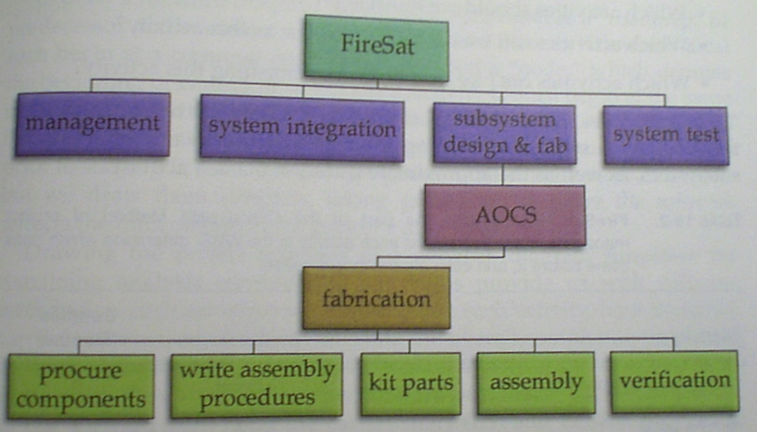
Work Breakdown Structure (WBS)
-- WBS allows the systems engineer to systematically divide an entire project into a set of major tasks, sub-tasks, and sub-sub tasks.
-- In this example, the tasks for fabrication of the attitude and orbit control system (AOCS) are broken into 5 sub-tasks. (Level 1 WBS)
-- Each sub-tasks can be further sub-divided (Level 2 WBS)
Program
Fundamental Management Tool

Slide 7
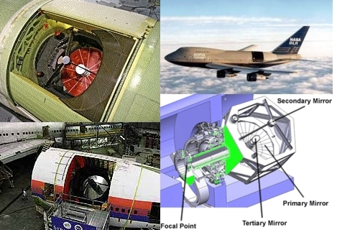
Product Breakdown Structure (2)
PBS for the SOFIA infrared telescope

Slide 8
Work Breakdown Structure (3)
WBS for
SOFIA Project

Slide 9
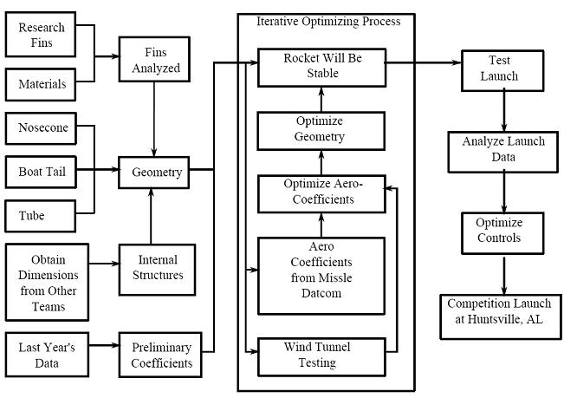
USU Chimaera WBS, 2008-2009

Slide 10
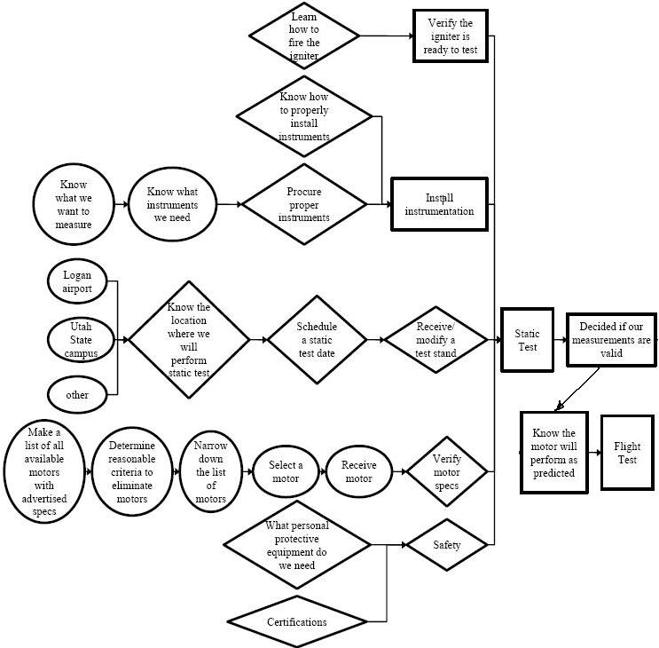
USU Chimaera WBS, 2008-2009 (2)

Slide 11
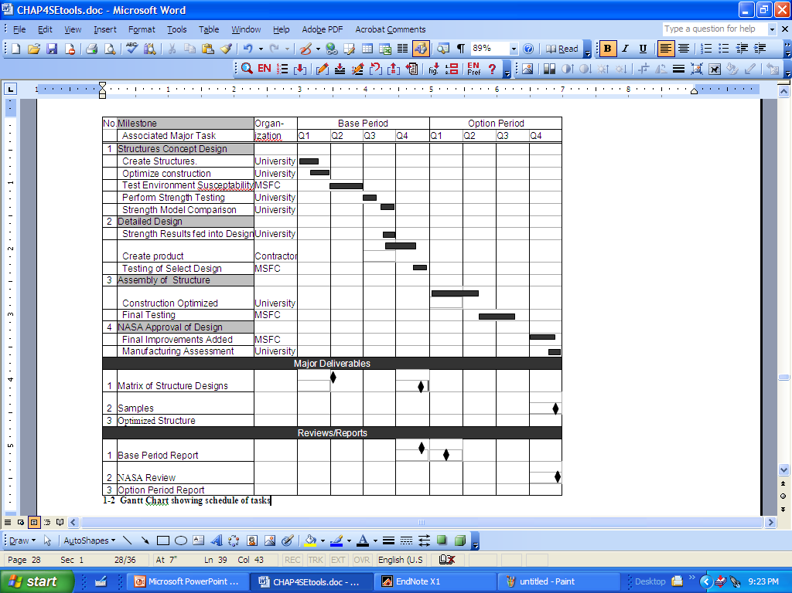
Gantt Chart
Bar chart that can be used to allot time to tasks, schedule reviews, and date milestones .. Complements WBS
Microsoft Project
Chart

Slide 12
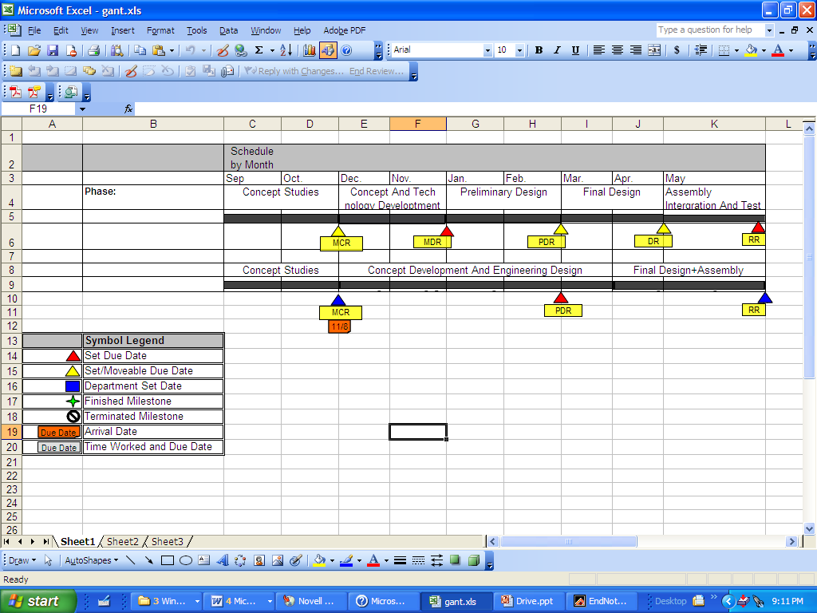
Gantt Chart (2)
Microsoft EXCEL Gantt Chart

Slide 13
Design Reference Mission (DRM)
One of the key enemies of a successful program is “mission creep”
- That is a mission that continually adds requirements or changes direction
- Mission creep more of ten not leads to a program “stalling” or collapsing altogether
A tried and true way to keep a program on track is to design to a well defined mission: A “Design Reference Mission” (DRM)
- DRM accomplishes top-level program requirements, but limits scope of design, and restricts unnecessary requirement growth
USLI Sets a lot of the design reference for us .. But not entirely .. We define our
Science mission…

Slide 14
Design Reference Mission (DRM) (2)
Step1: Define 2 (primary and secondary) Key mission objectives
Step 2: Develop a mission strategy
Step 3: Define phased operations and tasks
Step 4: Bound the mission operating environment.
Step 5: Identify desired outcomes
Step 6: Identify available resources and Sustainability
Step 7: Assess and develop plan for mitigating mission risk
Step 8: Create a Mission Timeline Event and Concept of Operations

Slide 15
Design Reference Mission (DRM) (3)
A DRM begins with a point of origination and terminates with a point of destination.
With the end to end boundaries specified, the DRM defines how the project gets from the point of origination to the point of destination.
The DRM strategy develops a mission profile that charts the progress through one or more staging or control points, called waypoints.
A waypoint represents a geographical location, a point in time, or objective to be accomplished as an interim step towards the final destination.
Each phase of operation is decomposed into one or more objectives focused on the roadmap to successfully reaching the final destination.

Slide 16
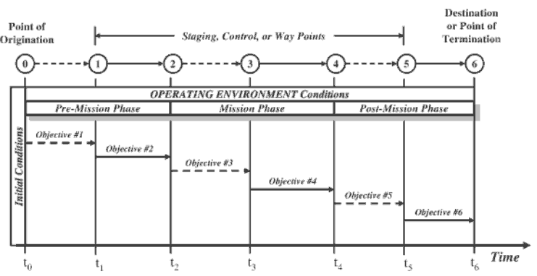
Design Reference Mission (DRM) (4)
Developing a DRM Timeline or Roadmap

Slide 17
Example DRM, Apollo Lunar Landing
The Apollo LM powered descent trajectory design was established… as a 4 phase maneuver…
First phase was a short-burn Hohmann transfer from the parking orbit to the powered descent altitude
Next phase was constant, continuous thrust braking maneuver, designed primarily for the efficient propellant usage while reducing velocity from orbital speeds to speeds compatible for landing …. This phase used the most “gas”
The braking phase terminated at the “high gate” condition, and initiated the third landing phase, called the approach phase. The term “high gate” is derived from pilot terminology for beginning the approach to an airport. Approach phase is designed for pilot visual (out the window) monitoring of the approach to the lunar surface.
The final “landing” phase, begins at “low gate” conditions (again from pilot terminology) , and was designed to provide continual visual assessment of the landing site and to provide compatibility for the pilot takeover from automatic control for the final touchdown on the surface.
“Apollo Lunar Descent and Ascent Trajectories”, NASA technical memorandum, NASA TM X-58040, March 1970, presented to the AIAA 8th Aerospace Sciences Meeting, NY, NY, 19-21 January, 1970

Slide 18
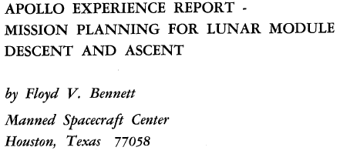

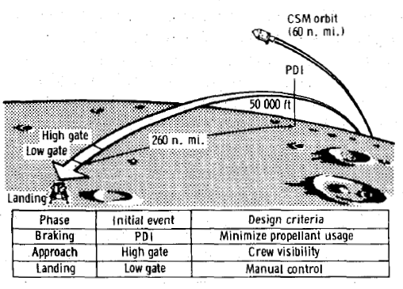
Example DRM, Apollo Lunar Landing (5)

Slide 19
Example DRM, Apollo Lunar Landing (4)
Identifiable Waypoints .. Where do we use
most of the propellant? How about energy management?
Apollo DRM
Waypoint | Predominant Physics | Altitude | Velocity
Lunar Orbit Insertion | Keplerian | 60 nm (1848.79 km radius) | 1.629 km/sec (5343 ft/sec)
Transfer Orbit Burn | Hohmann Transfer | 60 nm-50,000 ft (1752.84 km radius) | 1.607 km/sec- 1.695 km/sec (5273 ft/sec-5563 ft/sec)
Braking Maneuver | Constant Thrust, Oblate surface | 50,000 ft – 7000 ft | 1.695 km/sec-0.164 km/sec (5273 ft/sec-525 ft/sec)
High Gate | Constant thrust, flat surface | 7000 ft-500 ft | 500 fps horizontal -200 fps vertical to -3 fps vertical
Low Gate | Variable thrust, rough surface moon | 500 ft-0ft | -3 fps vertical, variable, small horizontal velocity
Landing | On the surface | 0 ft | 0!

Slide 20
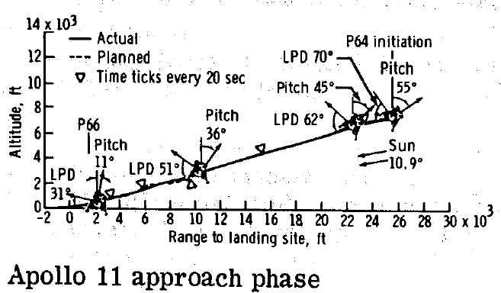
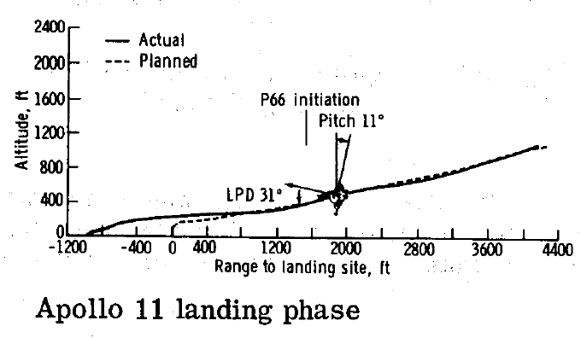
Example DRM, Apollo Lunar Landing (6)
… Houston, Tranquility Base here. The Eagle has landed!
Roger, Tranquility. We copy you on the ground. You've got a bunch of guys about to turn blue. We're breathing again. Thanks a lot.
The greater the uncertainty,
then the more general your
DRM must be

Slide 21
Concept of Operations (CONOPS)
Short Verbal or graphic statement, in broad outline, of a commander's assumptions or intent in regard to an operation or series of operations.
The concept of operations frequently is embodied in campaign plans and operation plans; in the latter case, particularly when the plans cover a series of connected operations to be carried out simultaneously or in succession.
The concept is designed to give an overall picture of the operation. It is included primarily for additional clarity of purpose. Also called commander's concept or CONOPS.

Slide 22
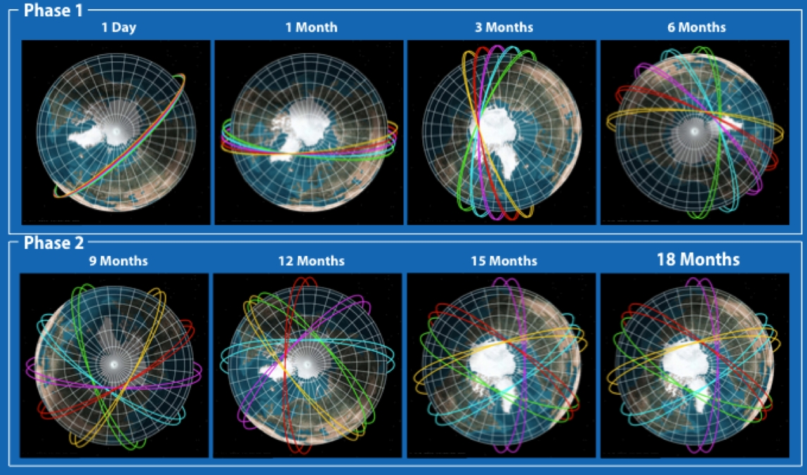
CONOPS Example
• As magnetosphere processes evolve during a geomagnetic disturbance,
HiDEF E-field observations provide a detailed map
• Constellation will utilize natural RAAN precession to transform cluster from
initially densely packed “sting of pearls” to a globally distributed sensor cluster
• HiDEF mission proposed for in-situ simultaneous E-field measurements
using constellation of pico-satellites

Slide 23






CONOPS Example2
Dispersion Envelope 1
Projected Altitude 1
Dispersion Envelope 2
Altitude Correction 1
Target Altitude 1
Projected Altitude 2
Target Altitude 2
Altitude Correction 2
Projected Altitude 3
Final Target Altitude
Altitude Correction 3
Waypoint
Dispersion Envelope 3
Waypoint
Final Dispersion Envelope
Waypoint
Airbrake Deployments At Predetermined Altitudes
Launch Site
Launch “high” and then control maximum altitude through successive application of airbrakes until desired energy state is reached
Inertial navigation used during powered ascent and a Kalman filter used for navigation during coasting stage-both navigation algorithms were student designed and implemented

Slide 24
Trade Studies
Trade study is a tool used to help choose the best solution among alternatives.
Numerical values are given based on weight factors and a normalization scale for the evaluation criteria.
Evaluation criteria are important factors that are included intrade study.
Weight factors are used to dictate how important the evaluation criteria are relative to each other.
The choice of weight factors and normalization scale are extremely important to this process.
Normalization scale creates a constant interval scale that allows us to set a numerical for each of the evaluation criteria (e.g. cost, mass, volume, power consumption legacy, ease of use).

Slide 25
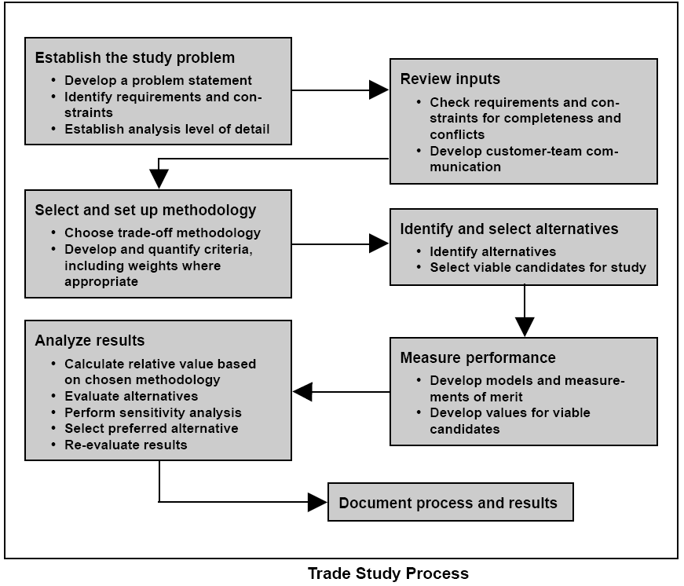
Trade Studies (2)
Steps to a trade study
1. Define the problem.
2. Define constraints on
the on the solutions.
3. Find 3-5 solutions
4. Define evaluation
criteria.
5. Define weight factors
6. Define normalization
scale
7. Populate trade matrix
8. Rank the solutions

Slide 26
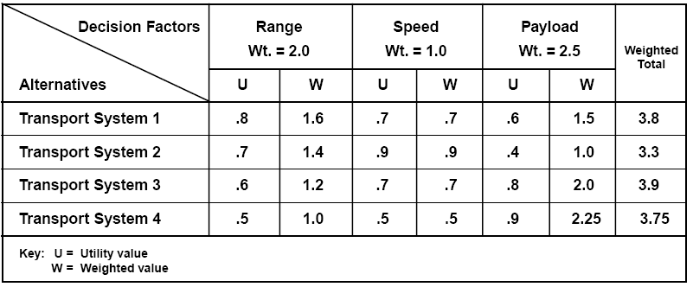
Trade Studies (3)
Sample Pugh Decision Trade matrix
Decision matrix: a decision-support tool allowing decision makers to solve their problem by evaluating, rating, and comparing different alternatives on multiple criteria ... Finding a “best” design
Prevents a team from “falling in love” with a flawed design or one not
meeting all design constraints or objectives
Communication tool; builds consensus

Slide 27
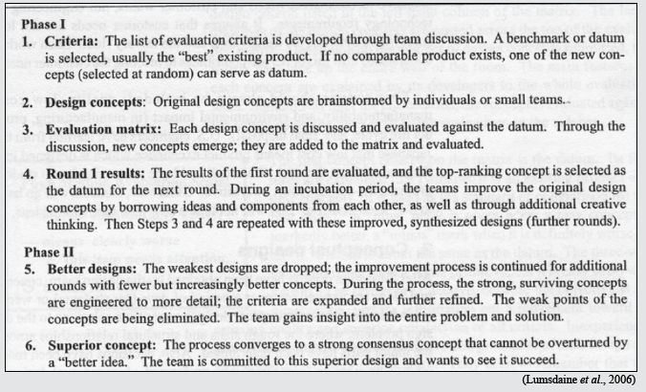
Trade Studies (4)
The Pugh Evaluation Process

Slide 28
Trade Studies (4)
3)Study Example – Comparison of Controllers for CubeSat

Slide 29
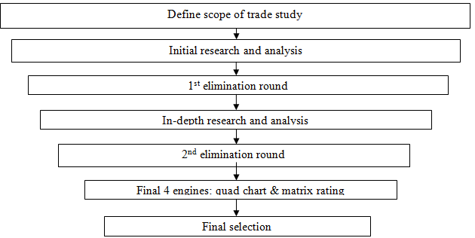
Engine Selection Trade Study

Slide 30
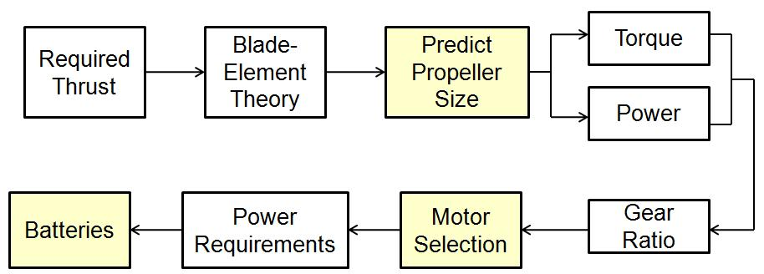
Maneuvering System – Initial Trades (2)
Rotor, Drive Mechanisms, and Power Component Selection Process
Brushless DC-motors, direct propeller drive
Matched Electronic Speed Controllers
Batteries Selected to Meet Brake Power Requirements

Slide 31
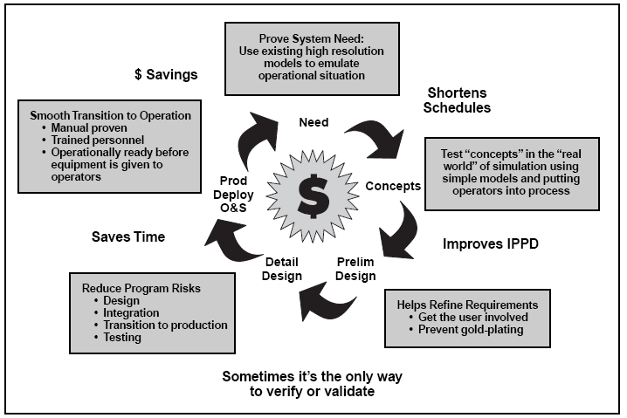
Modeling and Simulation
Allows complex
interactions to be
Discovered prior
to hardware
commitments

Slide 32
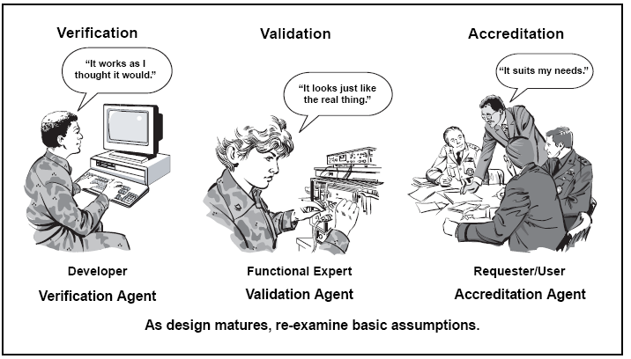
Modeling and Simulation (2)
Verification, Validation, and
Accreditation are integral part of simulation and modeling process

Slide 33
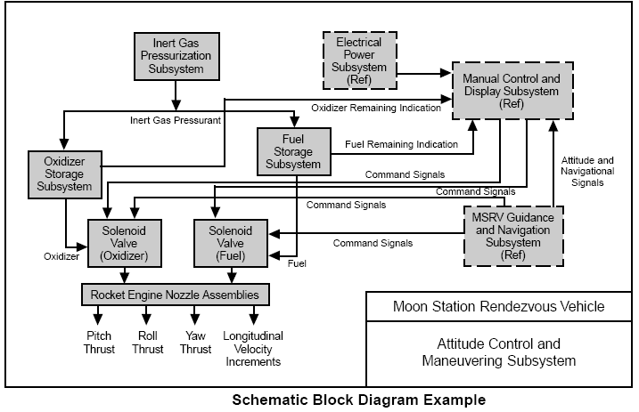
Functional Block Diagrams
Schematic Block Diagram (SBD) depicts hardware and software components and their interrelationships.
Developed at successively lower levels as analysis proceeds to define lower-level functions within higher-level requirements.
Useful for developing Interface Control Documents (ICD’s)

Slide 34
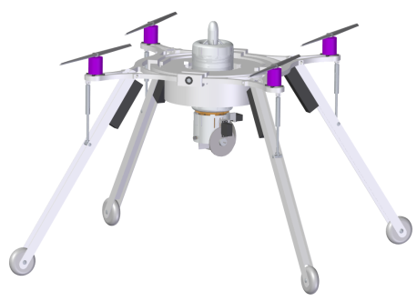
LPSLRV
Functional Elements
Vehicle
Jet Engine
Propellers
Structure
Thrust Vectoring
Power
Controls
Avionics

Slide 35
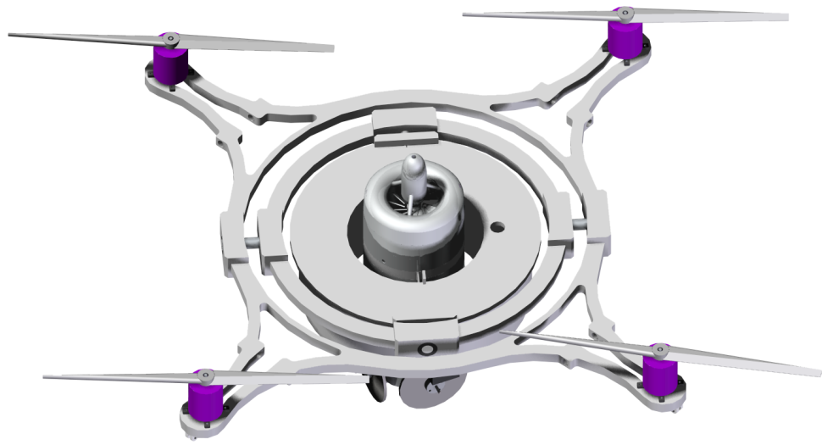
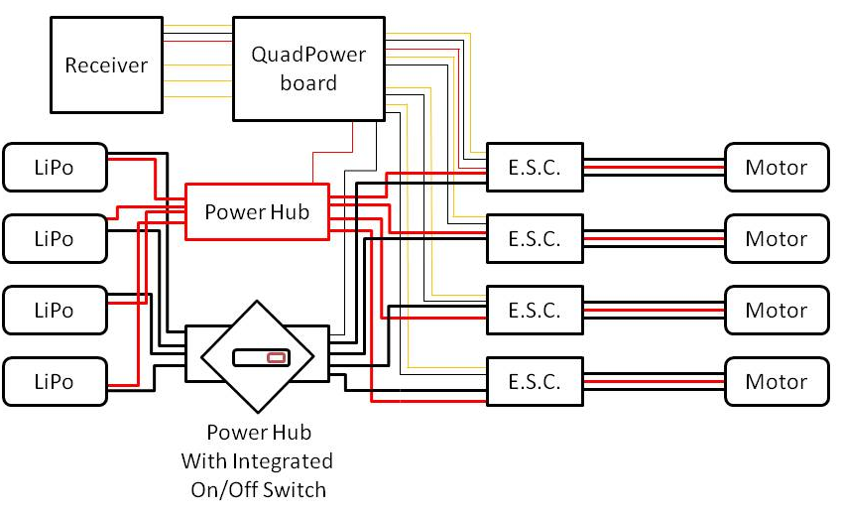
Power Distribution System
Outer Platform
Power System Distribution Diagram

Slide 36
Interface Control Document (ICD)
-- ICD’s define how the block within the SBD schematic are actually “connected”
--Interface control documents are a key element of systems engineering as they define and control interface(s) of a system, and bound its requirements.
-- The purpose of the ICD is to communicate all possible inputs to and all potential outputs from a system for some potential or actual user of the system.
-- An ICD should only describe the interface itself, and not the characteristics of the systems which use it to connect -- The function and logic of those systems should be described in their own design documents.

Slide 37
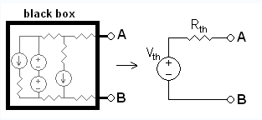
Interface Control Document (2)
-- Allows Disparate groups to work integrate sub-systems without complete working knowledge of what is inside of the “black box
-- In this way, independent teams can develop the connecting systems which use the interface specified, without regard to how other systems will react to data and signals which are sent over the interface.
-- An adequately defined ICD will allow one team to test its implementation of the interface by simulating the opposing side with a simple communications simulator.

Slide 38
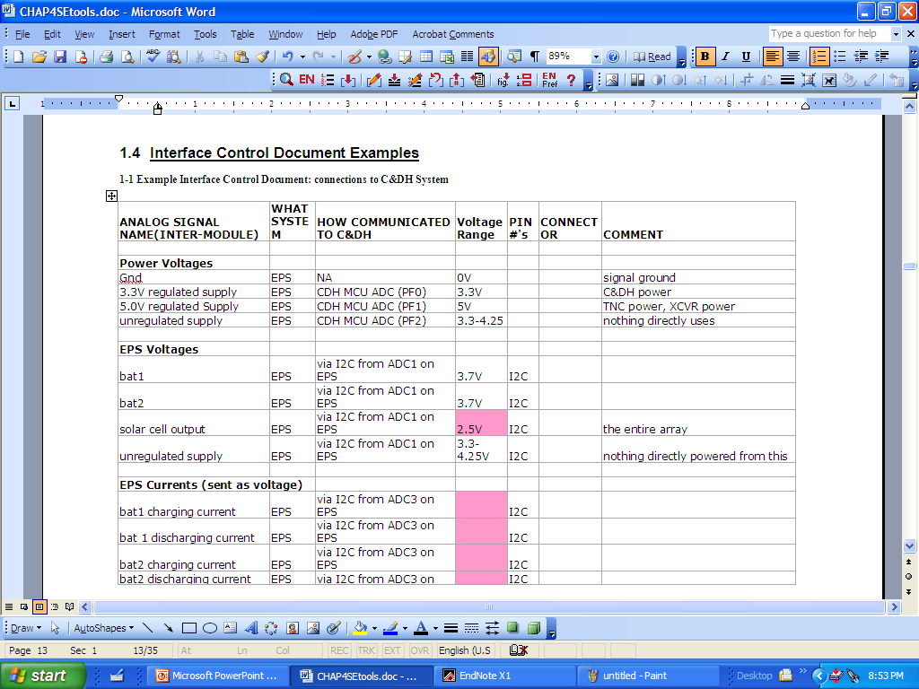
Interface Control Document (3)
Example ICD

Slide 39
Interface Control Document (4)
Example ICD

Slide 40
Power and Mass Budget Analysis
Weight and Power growth are major enemies of any spacecraft
Power and Mass Budget Analyses Insure spacecraft growth is bounded and eventually mandates comes in “under weight” and “overpowered”
Example

Slide 41
Power and Mass Budget Analysis (2)
Example

Slide 42
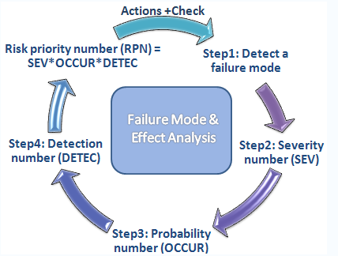
Failure Modes and Effects Analysis (FMEA)
-- A failure modes and effects analysis (FMEA) is a procedure for analysis of potential failure modes within a system for classification by severity or
determination of the effect of failures on the system.
--FMEA provides an analytical approach, when dealing with potential failure modes and their associated causes.
Failure mode: The manner by which a failure is observed; it generally describes the way the failure occurs.“
Failure effect: Immediate consequences of a failure on operation, function or functionality, or status of some item

Slide 43
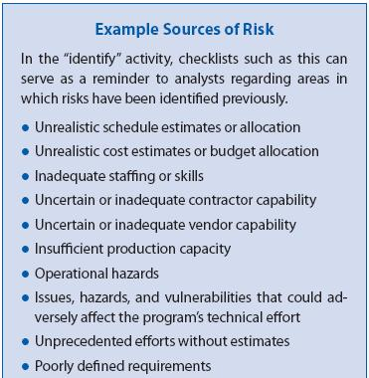
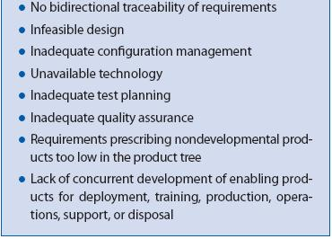
“Failure Mode
Criticality Analysis (FMCA) (1)
Notes:
Flip directions, Failure Model Criticality Analysis

Slide 44
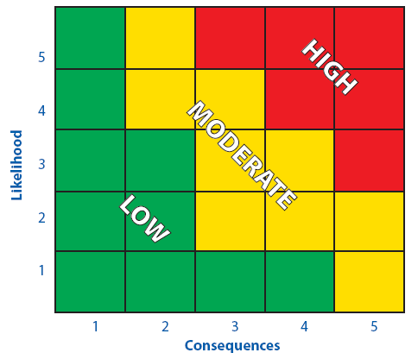
“Failure Mode
Criticality Analysis (FMCA) (2)
Hazard Assessment Matrix
Risk matrices provide assistance in managing and communicating risk.
Qualitative and semi-quantitative measures of likelihood with similar measures of
consequences.
Track the status and effects of risk- handling efforts,
And precisely Communicate risk status information.
Notes:
Flip directions, Failure Model Criticality Analysis

Slide 45
“Failure Mode
Criticality Analysis (FMCA) (2)
Hazard Assessment Matrix
Low (Green) Risk: Low potential for cost increase, schedule disruption, or performance degradation. .. acceptable risk.
Moderate (Yellow) Risk: May cause some cost increase, schedule disruption, or performance degradation. Special action and management attention may be required to handle risk.
High (Red) Risk: Likely to cause significant cost increase, schedule disruption, or performance degradation Significant additional action and high-priority management attention will be required to handle risk.
Notes:
Flip directions, Failure Model Criticality Analysis

Slide 46
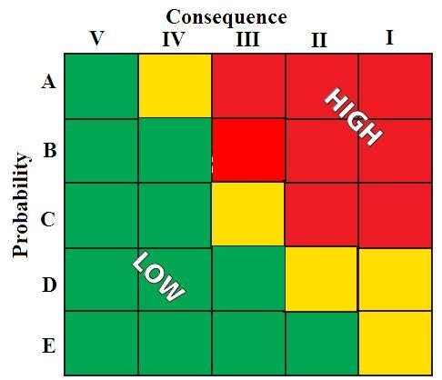
Flight Safety Hazard Assessment Matrix
Risk Consequence:
I - Catastrophic, Loss of Vehicle, Death of Crew
II - Severe, Significant Damage to Vehicle, Injury to Crew
III - Minor Damage to Vehicle, Potential for Minor Crew Injury
Loss of Mission Objectives
IV - Nuisance, Most Missions Objectives Accomplished
V - No Mission Impact
Failure Probability:
A - Likely (1 -- 1/10 )
B - Probable (1/10 -- 10⁻²)
C - Unlikely (10⁻² ⁻⁻ 10⁻³)
D - Very Unlikely (10⁻³ ⁻⁻10⁻⁵)
E - Remote < 10⁻⁵
Items in Yellow require NASA management
Waiver, Shuttle flies with III,C & management waiver

Slide 47
Risk Assessment
Example Hazard Tracking List
Hazard Level | Hazard | Causes | Preventative Measures
16 | Engine Failure, causing an inability to keep vehicle in air | Debris Weather Temperature | Screen on jet intake, Check flying conditions, Pre-flight checklist Pre-flight and in-flight systems check
9 | Human Injury | Burns from Jet Engine Exhaust Blowing debris Low-Voltage Electrical shock | Wear protective equipment, Designate “Keep out” zones, No power during maintenance, Follow manufacturer’s recommendations, Follow checklists
8 | Electronics Failure, causing a loss of power to rotors | Communication loss Communication interference Electrical shorting | Pre-flight and in-flight systems check
8 | Vibration Effects, causing the vehicle to become unstable or components to become loose | Rotors rotating near Resonance | Pre/Post assembly testing
4 | Fuel Leakage, forcing the time of the mission to be reduced | Bad seal on Fuel Tank, Improper filling of Fuel Tank | Quality check, Pre-flight checklist

Slide 48
Test Checklist
DAY OF TEST (typical)
0400 Mx Prep
0600 Crew Brief
07:30 Aircraft “Crew Ready”
07:45 Aircrew Step to Aircraft
08:15 Engine Start
08:45 Taxi
09:00 Takeoff

Slide 49
Test Checklist (2)
THINGS TO THINK ABOUT
GO-NO-GO ITEMS
WEATHER
Equipment STATUS
Contingency Options
LIMFACS (bandwidth, test site availability, range availability)
CONTROL ROOM POSITIONS
COMM SETUP

Slide 50
Rapid Prototyping
Rapid prototyping (RP) can be defined as a group of techniques used to quickly fabricate a scale model of a part or assembly using three-dimensional computer aided design (CAD) data.
RP has obvious use as a vehicle for visualization. In addition, RP models can be used for testing, such as when an airfoil shape is put into a wind tunnel. RP models can be used to create male models for tooling, such as silicone rubber molds and investment casts. In some cases, the RP part can be the final part, but typically the RP material is not strong or accurate enough.
Notes:
BY permission from NI.com

Slide 51
Rapid Prototyping (2)
The reasons of Rapid Prototyping are
To increase effective communication.
To decrease development time.
To decrease costly mistakes.
To minimize sustaining engineering changes.
To extend product lifetime by adding necessary features and eliminating redundant features early in the design.
Rapid Prototyping decreases development time by allowing corrections to a product to be made early in the process. By giving engineering, manufacturing, marketing, and purchasing a look at the product early in the design process, mistakes can be corrected and changes can be made while they are still inexpensive.
Notes:
BY permission from NI.com

Slide 52
Eight Rules for Prototyping
1 Recognize That Ideas Are Cheap – Given the connected, Internet-savvy world in
which we live, ideas have become cheap and they will probably become cheaper
with time. The expense lies in testing and verifying what has economic value.
A great prototype is often the best way to start a dialogue with potential customers
and test your idea’s value.
2 Start with a Paper Design – You may be eager to start coding or designing the
electronics too quickly. Fight the urge. Writing code without real consideration for
several design factors leads to heartache and a lot of rework. Start with a simple paper
design. For a user interface or Web software prototype, a paper design is
efficient and effective for quickly working through the functionality.
You can get peers and, hopefully, customers to give feedback on where images,
text, buttons, graphs, menus, or pull-down selections are located. Paper designs
are inexpensive and more valuable than words.
Notes:
BY permission from NI.com

Slide 53
Eight Rules for Prototyping (2)
3 Put in Just Enough Work – Know your objectives and stick to them. There are two good reasons to prototype: the first is to test the feasibility of a hardware or software architecture, and the second is to create a demonstration and gain customer feedback so you can price and put a value on your innovation. Keep these objectives in mind and be careful not to fall in love with the process. Prototyping is fun and innovators love to tinker, but you want to invest just enough time and work to meet the objectives.
4 Anticipate for Multiple Options – Design your prototype with modularity in mind. Great prototypes are often modular, which means you can quickly adapt them to meet customers’ unforeseen needs. Customers ultimately decide how to use your product, not you. Design in options for expansion, performance, packaging, and lower cost.

Slide 54
Eight Rules for Prototyping (3)
5 Design for Reuse in the Final Product – The ideal situation is to design a prototype you can produce and distribute in high volume. Not many prototyping tools can deliver on this promise. Typically you give up performance for design flexibility. Look for prototyping tools that make it possible for you to scale your prototype from lab to market.
6 Avoid Focusing on Cost Too Early – For hardware designs, a potential time sink and pitfall is getting caught up in endless cost optimization analysis during the early stages of your prototype design. Cost is always important, but your goal with a prototype is to be within striking distance of a profitable design. Initially, focus on proving the value of your innovation, and design with modularity in mind. While frustrating, your design may follow many paths that do not ultimately lead to value. Focus on securing your first set of customers and then work on cost optimization.

Slide 55
Eight Rules for Prototyping (4)
7 Fight “Reversion to the Mean” – When prototyping, the tendency is to develop something easy rather than develop something that has a “wow” factor. Stay true to your vision and make sure your prototype captures the original thought of your innovation.
8 Ensure You Can Demonstrate Your Prototype – Your prototype should be easy to demonstrate. With customers, venture capitalists (VCs), and potential employees, you want to start strong and show the most amazing capabilities first. Do not build up to a crescendo. Most people’s attention spans are limited to less than 60 seconds. In presentations, whether they are for a new employee or a VC, get to the demonstration as fast as possible. If the demonstration is amazing, all else falls into place.
http://zone.ni.com/devzone/cda/pub/p/id/579?metc=mtnxdy

Slide 56
Keys to Holding a Successful Meeting
• Meetings are essential to any team effort, be it designing a rocket System, or launching a new cosmetic product
• Done properly, meetings can quickly disseminate information, solve problems, create consensus, and get everyone “on the same page”
• Done improperly, meetings can bog down, cause dissention, delay, and sometimes cripple a project.
• Every meeting must a specific purpose – before arranging a meeting one need to think precisely about what it is that needs to be accomplished.

Slide 57
Keys to Holding a Successful Meeting (2)
• Typical Meeting Purposes”
Brainstorming new ideas
Developing an idea or plan
Having a progress update
Technical interchange
Considering options and making a collective decision
Selling something to a potential buyer
Building a relationship with somebody
There may be a mixture of objectives and desired outcomes for a particular meeting, however, primary objectives should kept clearly in mind and those should prioritized above others.

Slide 58
Keys to Holding a Successful Meeting (3)
Invite the right people. Make sure these people attend.
Start with a clear objective for the meeting. Particularly with routine meetings, it's tempting to hold the meeting because it's “checking a box”, but what are you really trying to accomplish? People don't actually bond very much in unproductive meetings that lack clear objectives.
Set up a written agenda in advance. As you build the agenda, get real about how long it will take to address each topic. As a guideline, assume that if the goal is to make a decision, it will take four times longer than if the goal is to simply provide a status report.

Slide 59
Keys to Holding a Successful Meeting (4)
Formally track problem-solving and decision-making discussions. If everyone is in same room, use a flipchart or whiteboard, otherwise use electronic recording media. Appoint someone to take notes at the beginning of the meeting. Formally archive meeting notes in a data base with access to participating team members.
Formal Tracking Tools:
  a. Action Items – Requests for Action (RFA)
  Who is assigned action?
  When is action due?
  Who are action’s “customers”
  b. Information Items – Requests for Information (RFI)
  Who provided the information and verification?
  When is action due?
  Who needs the information

Slide 60
Keys to Holding a Successful Meeting (5)
Log and Track RFA,’s RFI’s .. Don’t let people “off the hook” require that action forms be formally CLOSED.
End each meeting with a “consensus” check. Is everyone clear on assigned actions, and due dates. FORMALLY set a tentative time and date for a follow-up meeting, and who needs to be in attendance at this meeting. Log that follow up meeting time.

Slide 61
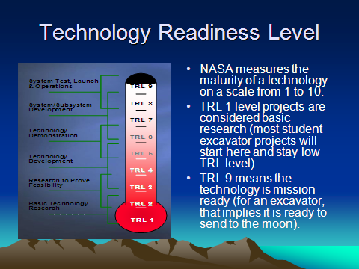
Technology Readiness Levels (TRL)
• Designing sub-systems using high TRL components is a good way to reduce or mitigate programmatic risk.
• High TRL systems have “heritage” and offer increased reliability and (hopefully) enhanced ease of integration.

Slide 62
Technology Readiness Levels (2)
• Cardinal Sub-system Design Rules:
Integrate when can (high TRL)
Design and fabricate when you must
Low TRL sub-systems require significant testing and evaluation before integration
Low TRL’s can “fight” each other and have potential to seriously impact overall design budget and schedule!
• High TRL systems have “heritage” and offer increased reliability and (hopefully) enhanced ease of integration.

Slide 63
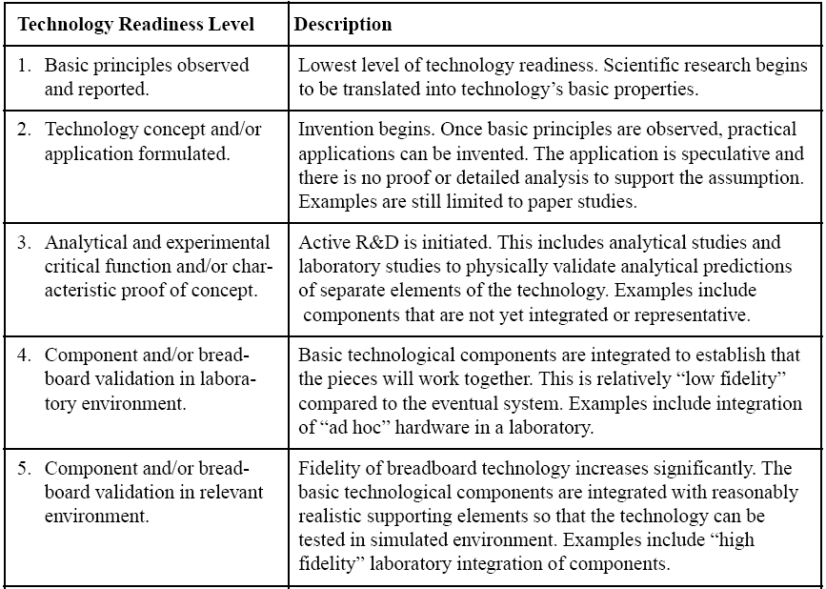
Conceptual Technology
Readiness Levels, 1-5

Slide 64
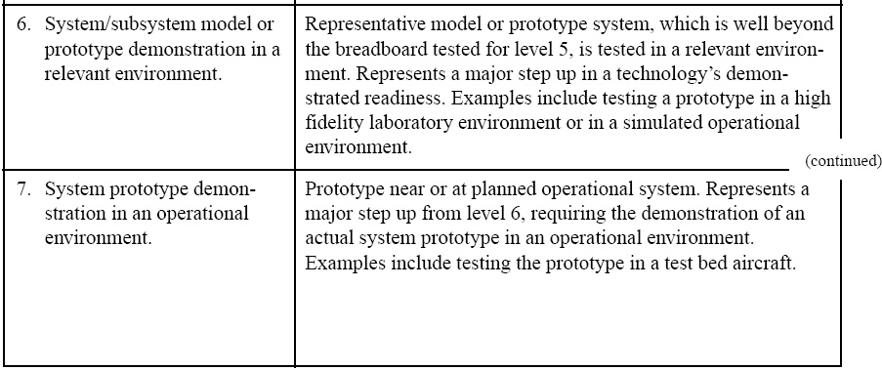
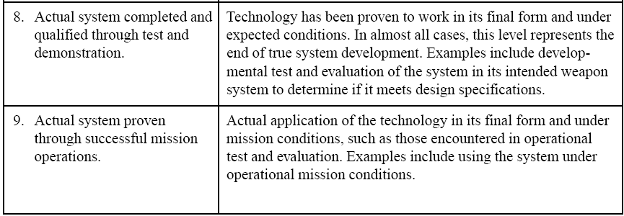
Prototype and Deployment Technology Readiness Levels, 6-9

Slide 65
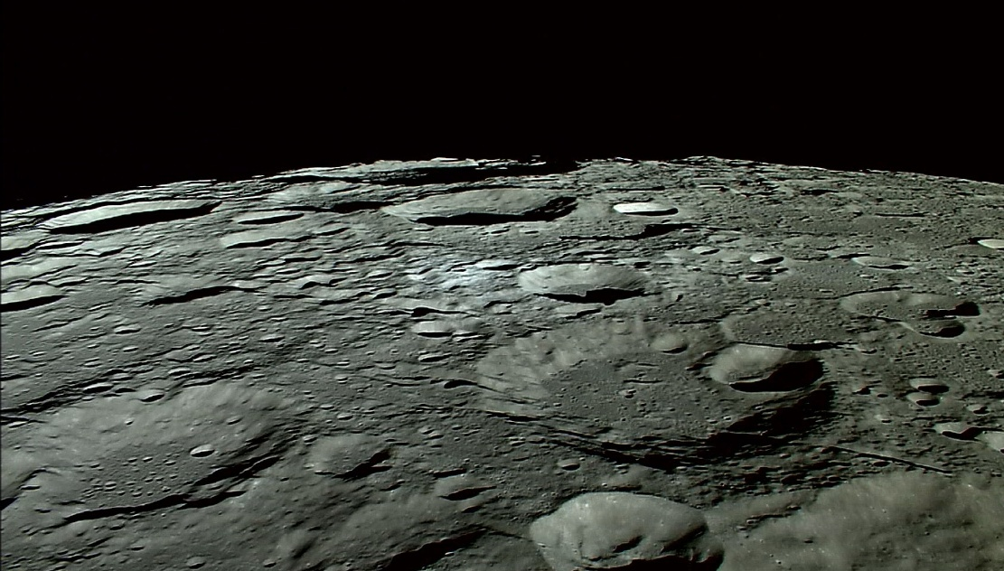
Questions??

