Slide 1
ESMD Senior Design Project
National Aeronautics and
Space Administration
Scientific and Technical Writing, 101
What is the Point of Technical Writing?
What makes for effective technical writing?
Some of the fundamental differences between technical writing and other forms of expository writing.
www.nasa.gov

Slide 2

ESMD Senior Design Project
National Aeronautics and
Space Administration
The Craft of Scientific Writing
www.nasa.gov

Slide 3
Figures of merit for technical writing…
Good technical writing can be judged based on how efficiently,
effortlessly, and correctly it transfers ideas, concepts and/or
information to the reader.
Maximize clarity
Minimize effort.
Completely cover relevant topics
Ensure that all information is correct
Allow zero ambiguity
Be concise
Use consistent and visually pleasing style
Write to the technical level of your audience
Organize in a way that makes sense
Use the most appropriate means to convey information
Use appropriate language and grammar

Slide 4
ESMD Senior Design Project
National Aeronautics and
Space Administration
Scientific and Technical Writing, 101
Technical writing differs significantly from other types of prose
Appropriate Content and Structure can “Make or Break” an Argument
  Content -- Message
  Style -- Way Message is Presented and Organized
  Form -- Appearance of Message (Syntax, Grammar)
Precision of Language is of Overarching Importance
  Target Audience
  Level of Complexity
www.nasa.gov

Slide 5
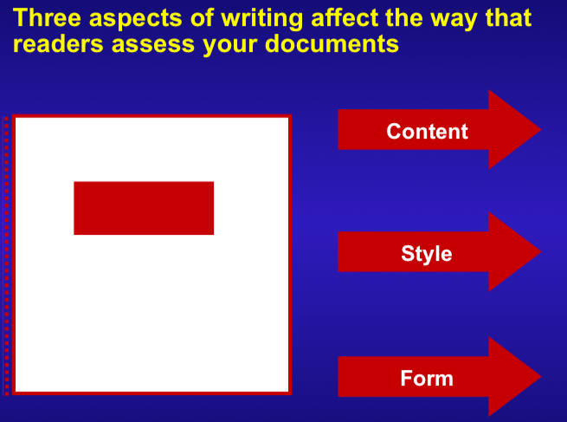

Hierarchy of Importance

Slide 6

Content
Your message …
What do you want to say!
Define the ‘Scope” of Your message
what to leave in
what to leave out
Identify your target audience
Do Not! Write a mystery story … get directly to the point

Slide 7
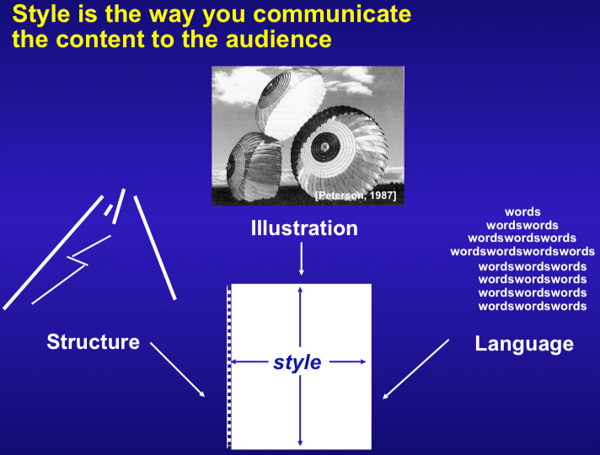
Style
Picture is sometimes worth
1000 words!

Slide 8
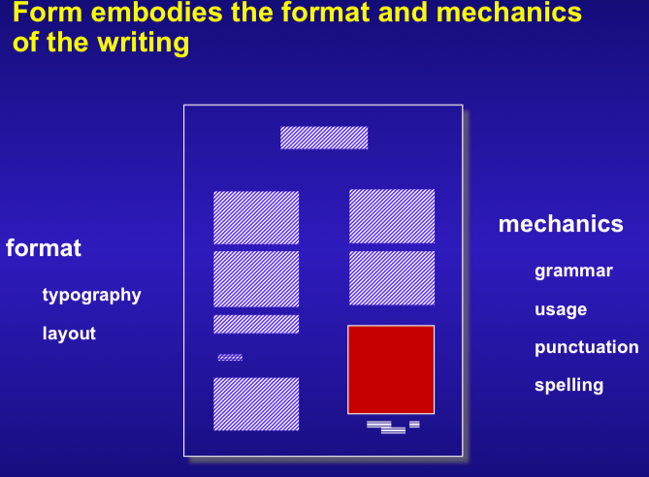
Form

Slide 9
Formatting
What’s the point?
Formatting makes things easier to read (serif vs sans)
Formatting give the report a coherent look
Formatting is often designed to save space
Consistent formatting helps the reader find and identify components in writing
Bad formatting kills people…

Slide 10
Morton-Thiokol’s CHALLENGER O-RING presentation to NASA suffered because of all capital letters on the slides
PRIMARY CONCERNS -
FIELD JOINT - HIGHEST CONCERN
• EROSION PENETRATION OF PRIMARY SEAL REQUIRES RELIABLE SECONDARY SEAL FOR PRESSURE INTEGRITY
• IGNITION TRANSIENT - (0-600 MS)
• (0-170 MS) HIGH PROBABILITY OF RELIABLE SECONDARY SEAL
• (170-330 MS) REDUCED PROBABILITY OF RELIABLE SECONDARY SEAL
• (330-600 MS) HIGH PROBABILITY OF NO SECONDARY SEAL CAPABILITY
• STEADY STATE - (600 MS - 2 MINUTES)
• IF EROSION PENETRATES PRIMARY O-RING SEAL - HIGH PROBABILITY OF NO SECONDARY SEAL CAPABILITY
• BENCH TESTING SHOWED O-RING NOT CAPABLE OF MAINTAINING CONTACT
WITH METAL PARTS GAP OPERATING TO MEOP
• BENCH TESTING SHOWED CAPABILITY TO MAINTAIN O-RING CONTACT DURING
INITIAL PHASE (0 - 170 MS) OF TRANSIENT
Notes:
Given on this slide is a poor example of typography from Morton-Thiokol’s presentation to NASA to try to delay the launch of the Space Shuttle Challenger. Because the Morton-Thiokol slide used all capital letters, the slide was difficult to read. Unfortunately, the presentation was critical. (Pages 225-226)
Citation for slide: Report to the President on the Space Shuttle Challenger Accident, vol. 4 (Washington, D.C.: Presidential Commission, 6 June 1986), p. 646.

Slide 11
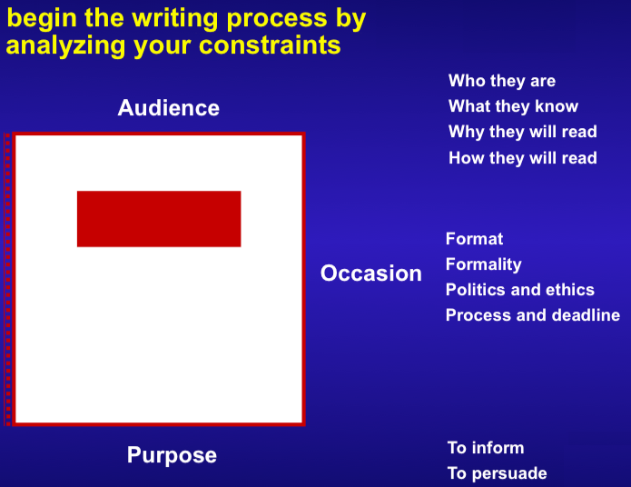
Target Audience

Slide 12
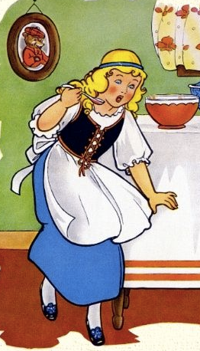
Target Audience (2)
Know what experience your audience has with your topic
Know the length of report (or presentation) required by your topic
Know the style required by your audience or publication
“JUST RIGHT”
Too Technical
Too Simplistic
Reader cannot understand
report without the use of a technical dictionary and a scratch pad and decides to punch kittens
Reader is insulted that you needed to explain what velocity was and decides to punch kittens.

Slide 13
Staying on Message .. Prepare an outline …
Team summary
Introduction
  Project Overview
  Top Level Requirements
  Previous Work
Vehicle Information
  Concept of Operations
  Design reference Mission
  Vehicle Configuration
Subsystem Overview
  Subsystem Under Consideration- Gravity offset
  Mass Budget
  Analysis of Alternatives
  Risk Analysis
Trade Analysis
  Summary of Analysis
  Required Trade Data
  Numeric Calculations
  Engine Comparison
    Initial Research and Analysis
    In-depth Research and Analysis
    The Final four
  Final Recommendation
    Impact of Decision on Design
    Availability
    Thrust Curve
Summary and Concluding Remarks
Cover the subject
  Make a list of everything that needs to be covered
Use clear and informative headings
Group your clear and informative headings together, create hierarchies and an overall organizational structure

Slide 14
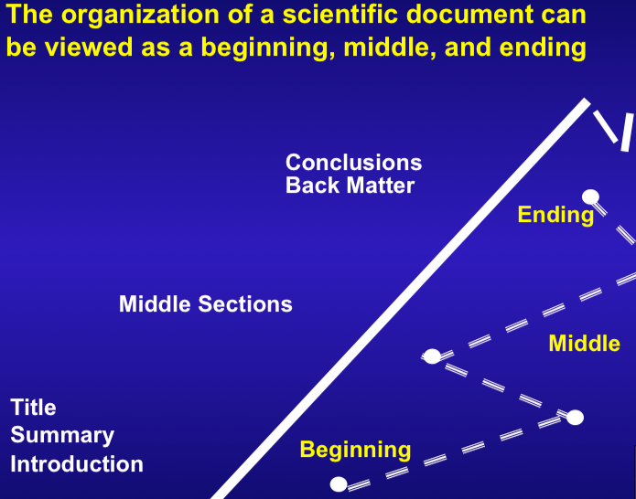
Organization

Slide 15
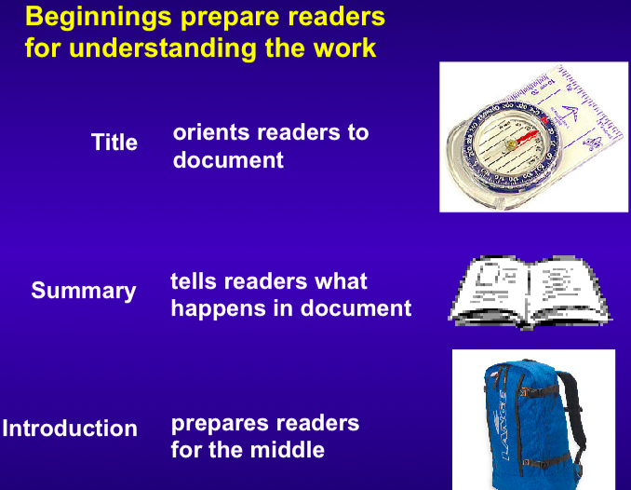
Organization (2)

Slide 16
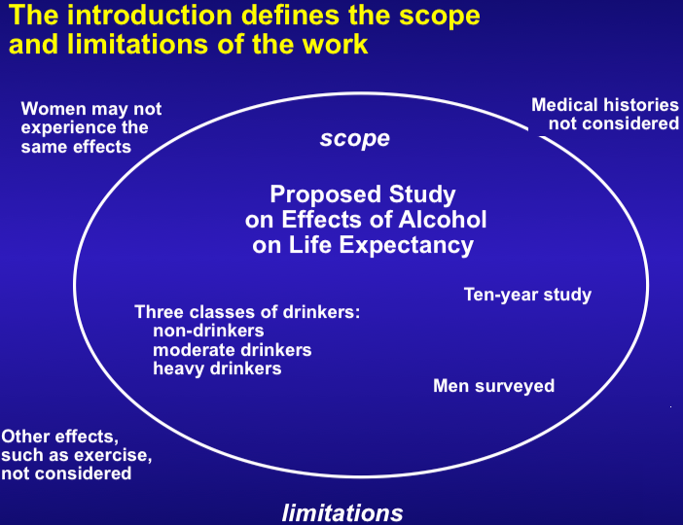
Organization (3)

Slide 17
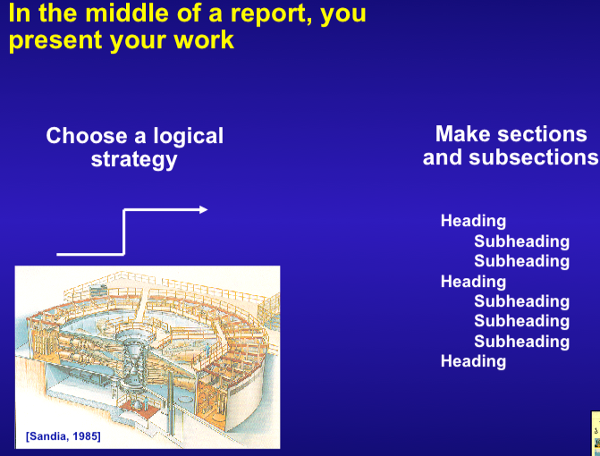
Organization (4)

Slide 18
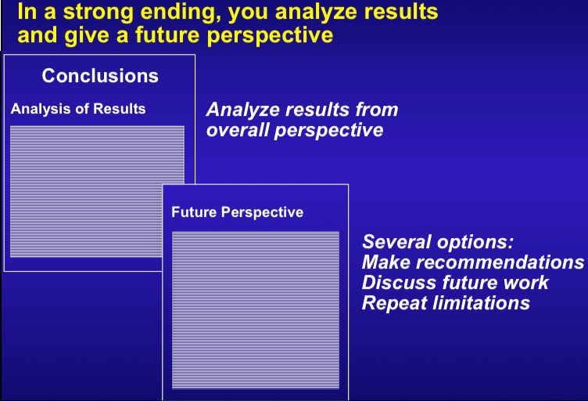
Organization (5)

Slide 19
Common language mistakes…
Writing sentences that are too convoluted.
Using pompous words when others will do
  saying “utilize” when “use” will work for example, overuse of buzzwords
Use of first person
Incorrect tense, tense, passive voice.
Wordiness, do not use 10 words, when 5 will do!

Slide 20
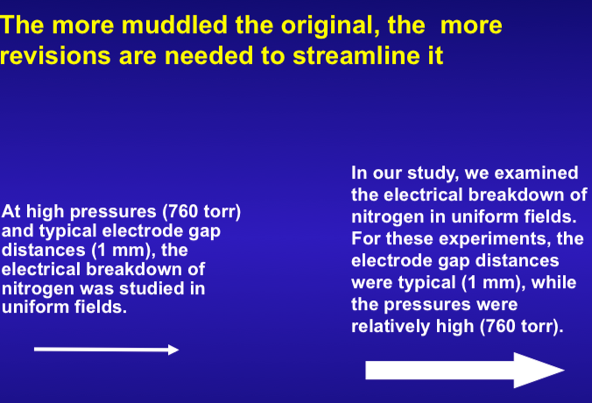
Common language mistakes…

Slide 21
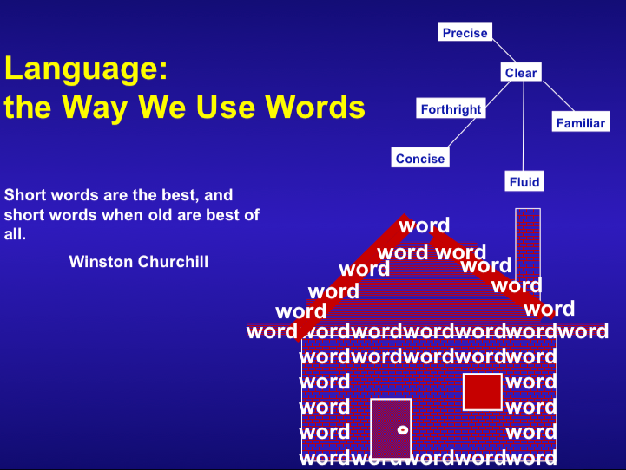

Slide 22
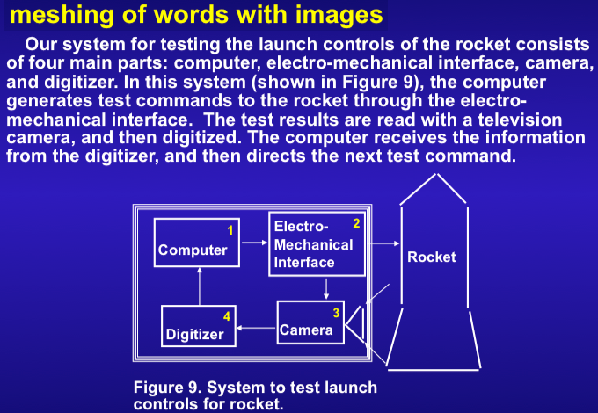
The Art of Figures…
Which tells a more complete story?

Slide 23
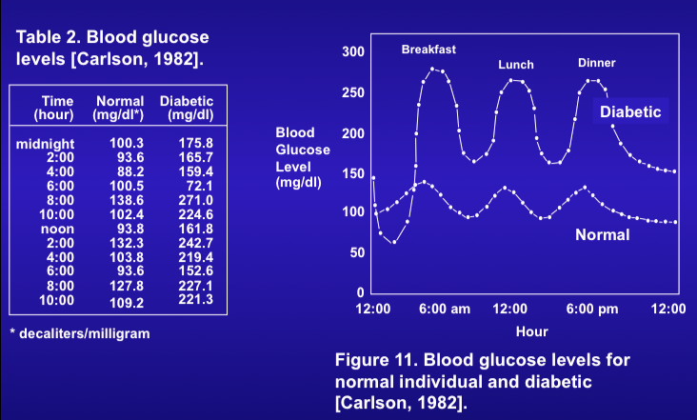
The Art of Figures…(2)
Which tells a more complete story?

Slide 24
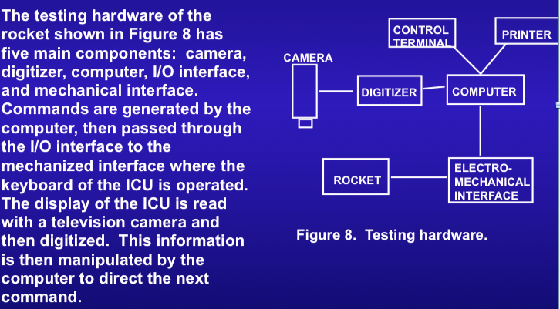
The Art of Figures…(3)
Beware of inconsistencies between text and figures
Which tells a more complete story?

Slide 25
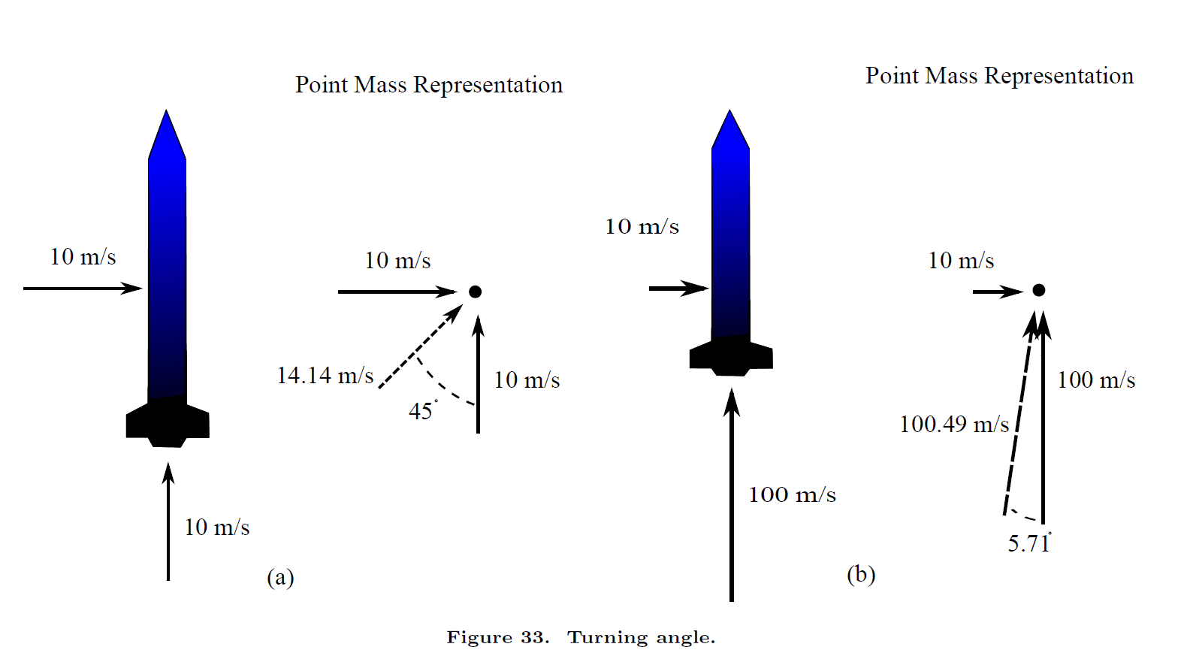
The Art of Figures… (4)
Any idea what this figure is trying to say?

Slide 26
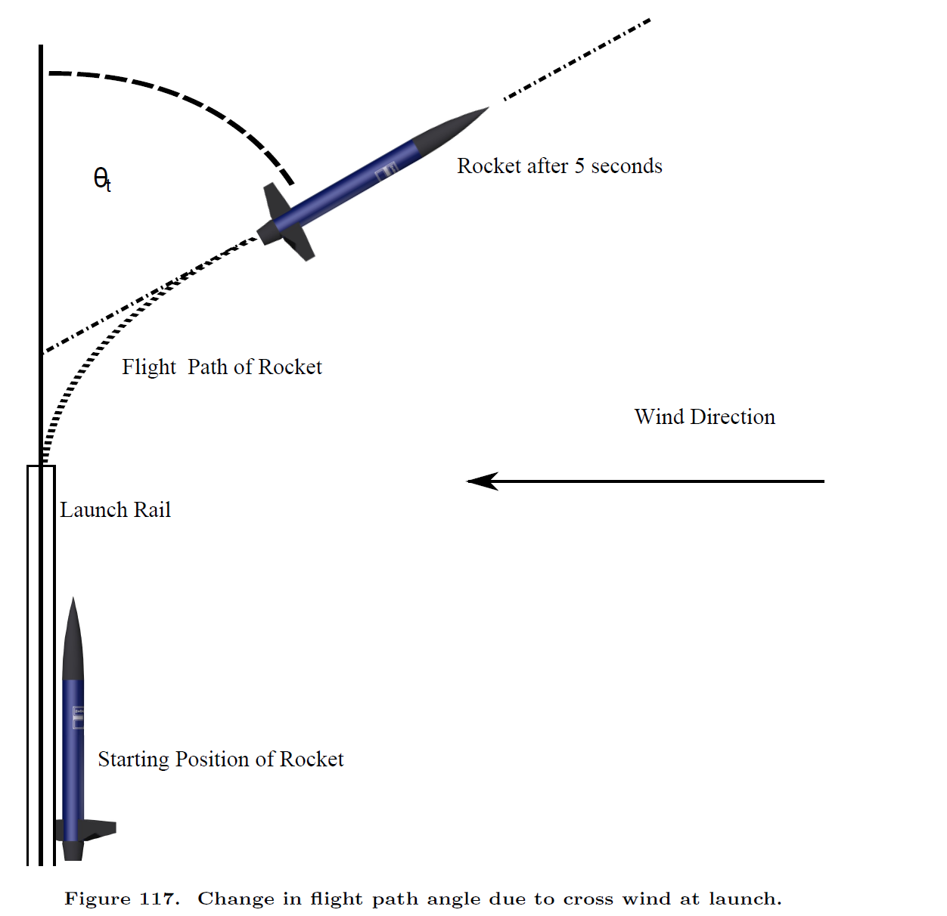
The Art of Figures… (5)
Version 2…
Same information, better presentation.

Slide 27
More Figures…
Don’t’ be afraid to label stuff
Add objects that help the reader interpret the figure
Don’t plot constants, that’s what tables are for
Use descriptive captions. Captions are sentence fragments
Do not say “plot of” or “figure of” in the label … reader knows that it is a plot, or a figure.
ALL axes must be labeled with units!

Slide 28
More Figures…
A good figure
Uses space well
Is informative
Is easy to read
Is pleasing to the eyes
Use a consistent font through the ENTIRE report

Slide 29
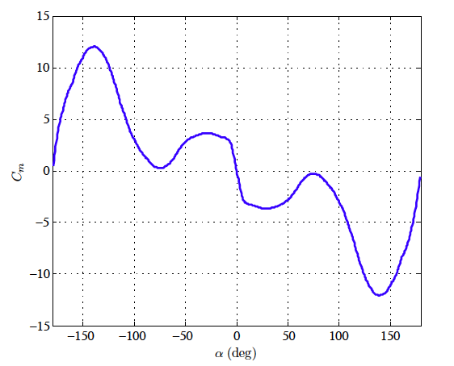
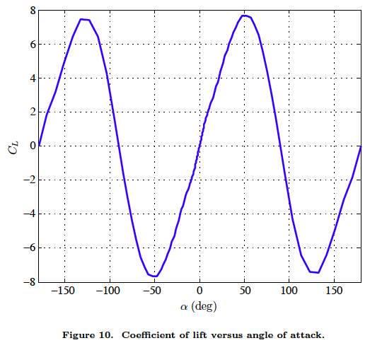
More Figures…
• A good figure presents data with the appropriate scale to feature
only the salient data
OK … we lose out vehicle beyond +50 alpha … so who cares about +180 deg.?

Slide 30
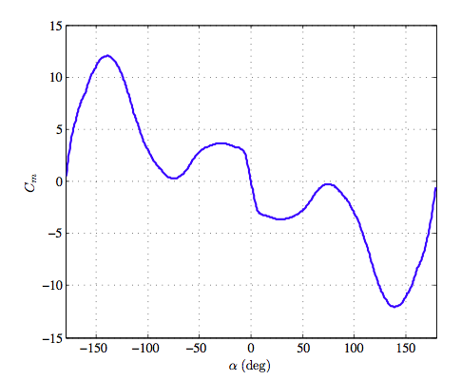
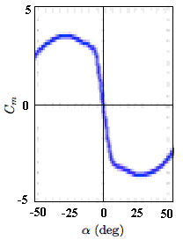
More Figures…
• Better
• Even Better ….
stable
unstable
unstable
stable

Slide 31
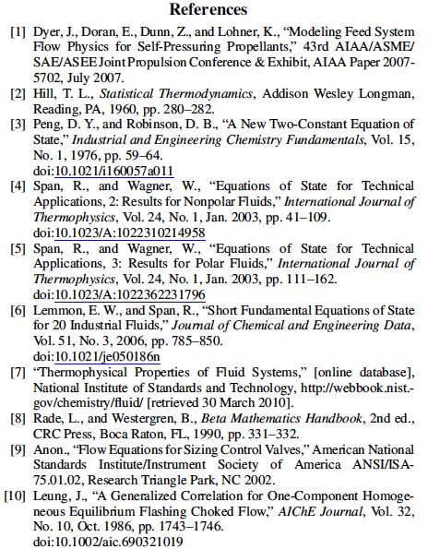
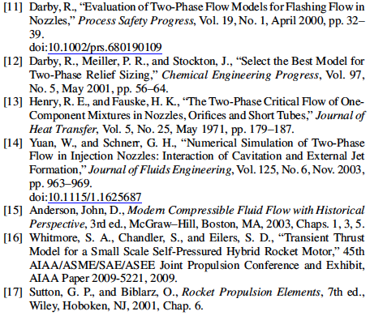
Citations and Bibliography
Citations give, breadth, depth, and credibility to a scientific paper.
Typical Journal
Paper Bibliography

Slide 32
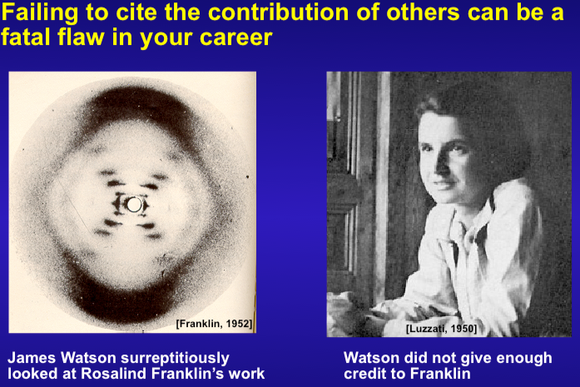
Citations and Bibliography₍ ₂₎

Slide 33
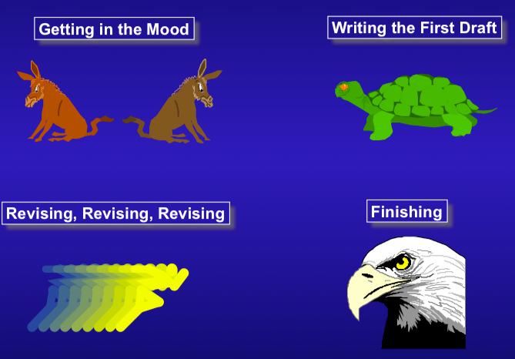
The Writing Process …..

Slide 34
The Editing Process
Step 1: Fix the vile aberration of language that you just defiled a perfectly good page with.
Step 2: Have others fix the vile aberration of language that you just defiled a perfectly good page with.
Step 3: Fix the vile aberration of language that others just defiled a perfectly good page with.
There is no such thing as good writing. There is only good editing and re-writing.

Slide 35
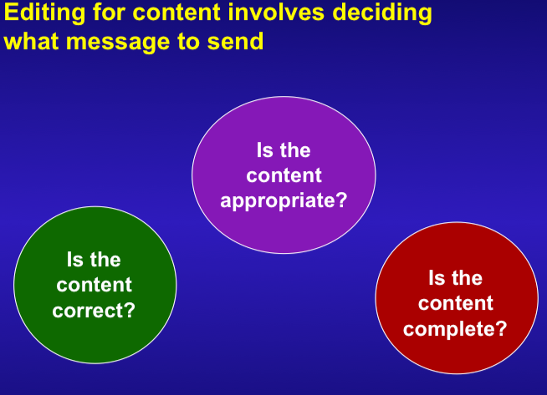
The Editing Process (2)

Slide 36
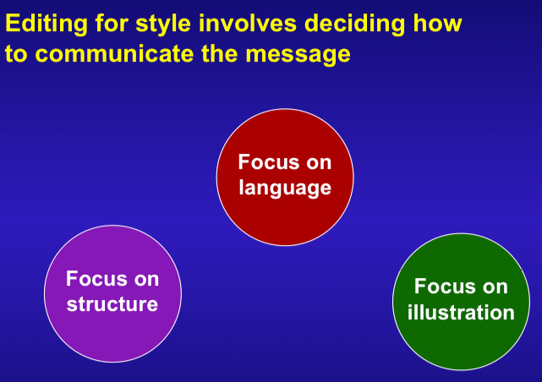
The Editing Process (3)

Slide 37
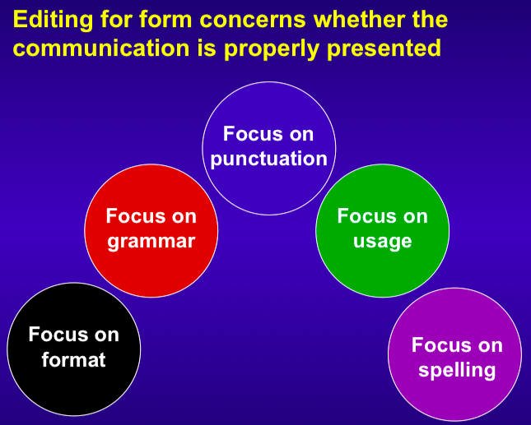
The Editing Process (4)

Slide 38
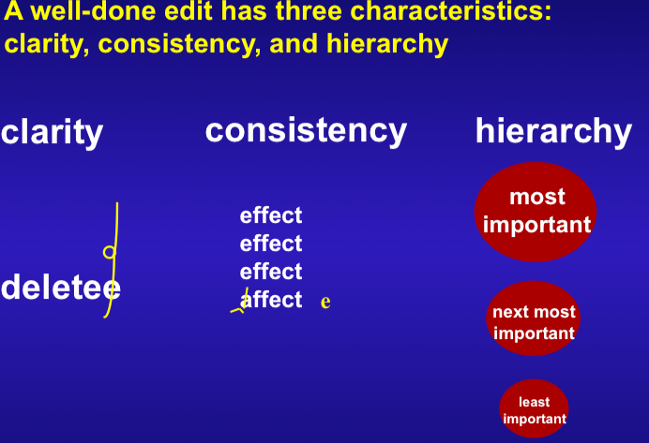
The Editing Process (5)

Slide 39
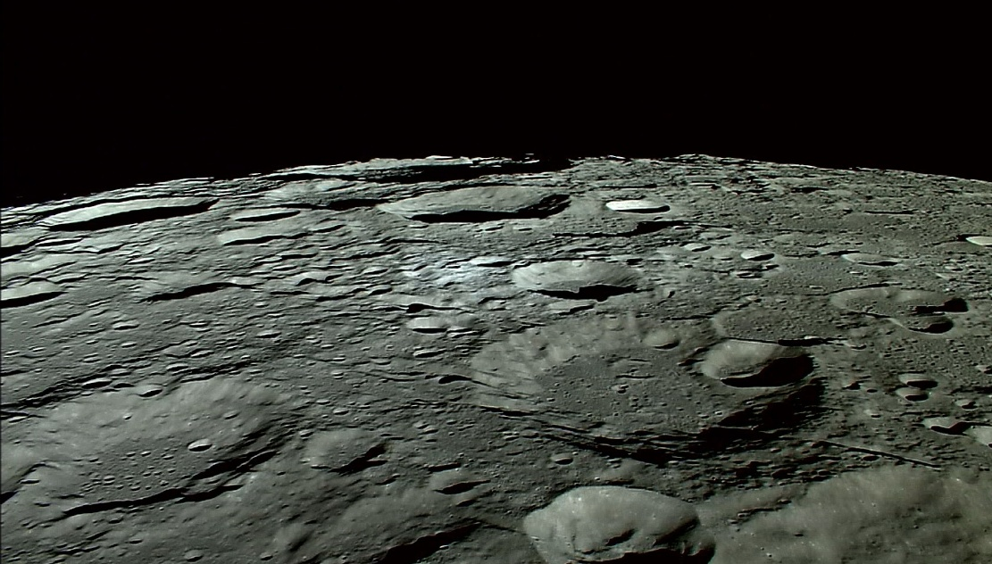
Questions??

